Slide 1
Title
How to characterize the audiovisual consumption of children in early childhood?
Autores: PhD Annia Cano Pérez, Full Professor and Assistant Researcher, University of Havana
PhD Isabel Ríos Leonard, Full Professor and Assistant Researcher, ICCP
M. Sc. Idania de la Vega Hernández, Assistant Professor, UCPEJV
Cuba, 2022
Notes:
Good morning, the paper that is presented is entitled How to characterize the audiovisual consumption of children in early childhood?. Its Cuban authors, teachers and researchers, who feel great love and commitment to early childhood. It is valid to clarify that although today the result is presented by us, there is a group of researchers who contributed to it.

Slide 2
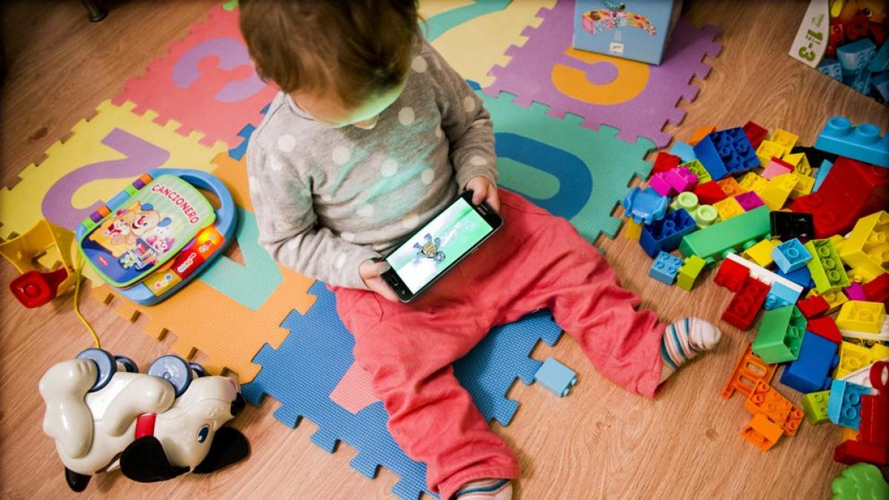
Notes:
The accelerated scientific-technical development that characterizes the times in which we live impacts all areas of human activity, being among the most visible, the sphere of information and communication technologies, due to the influence they exert on the daily life of all people, in their relationships of family and social coexistence, in addition to the possibilities of access to local, national and global cultural assets.

Slide 3
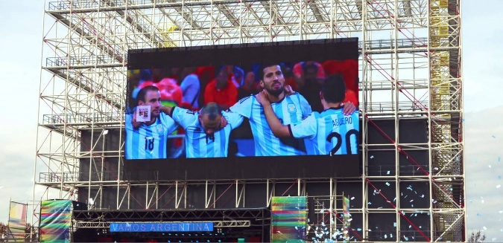
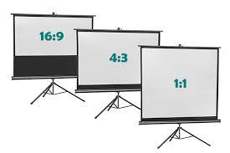
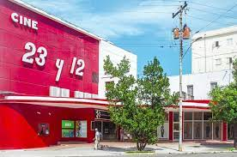
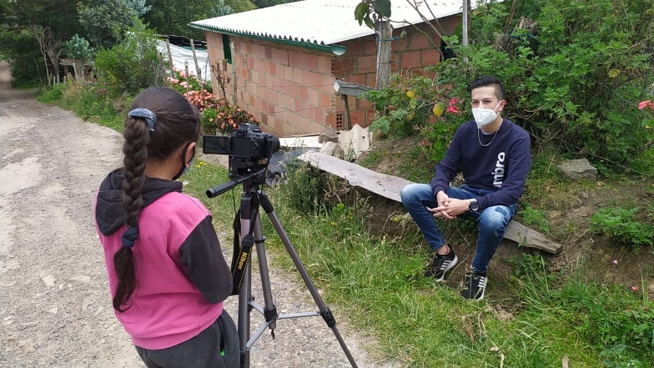
diversification
Notes:
The specific impact of the research is manifested by the vertiginous enrichment and diversification of screens, which include those originally assigned to project and transmit content and incorporate possibilities ranging from distance interpersonal communication, recording, multiplication and exchange of content, videogames, the use adapted to the users' demand for time and place, to the domestic production of audiovisual materials and the corresponding generation of new content.
So that the data obtained through studies carried out in different countries, show the increase in consumption habits, now with the presence of a digital scenario with multi-screen access; of an increasingly early start in consumption and also of a greater presence in the general educational and specific school environments.

Slide 4
Great challenges to pedagogical research
identifies
formative
methodological
largest amount of research in this sphere is associated with the areas of communication and culture
didactic
cultural consumption
Notes:
This situation poses great challenges to pedagogical research, due to its formative, didactic and methodological implications, especially when it is identified that the largest amount of research in this sphere is associated with the areas of communication and culture, for which the main sources of knowledge, are located in studies of cultural consumption.

Slide 5
Many of the investigations
Restricted to quantitative explorations
Skew the look at the role of consumption in society
Ignoring that a profound vision of it means analyzing it from its essential function, which is to give meaning
Notes:
It was found that many of the investigations are restricted to quantitative explorations that account for the possession of goods, on the one hand, and consumption habits, on the other. These considerations skew the look at the role of consumption in society, ignoring that a profound vision of it means analyzing it from its essential function, which is to give meaning.
In my opinion, the appropriation does not end with the acquisition or contact with the cultural product, but the use continues in the interaction that the subjects strengthen with them in their enjoyment.

Slide 6
Objective
Socialize the methodological package proposal prepared for the characterization of the audiovisual consumption of Cuban children in early childhood, as the first result of the research project
Notes:
The main objective of this paper is to socialize the methodological package proposal prepared for the characterization of the audiovisual consumption of Cuban children in early childhood, as the first result of the research project.

Slide 7
Some of the countries of Iberian-America
the annual realization of national surveys of consumption of audiovisual content
Instruments which are applied in many cases, generally respond to ages greater than 8 years
Audiovisual consumption and early childhood
Notes:
Some of the countries of Iberian-America have established since the last century and others in more recent years, the annual realization of national surveys of consumption of audiovisual content, as is the case of Mexico, Argentina, Chile, Colombia and Uruguay. It was possible to corroborate that the instruments, which are applied in many cases, generally respond to ages greater than 8 years.

Slide 8
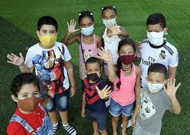
Research on cultural consumption is scarce
Within the specific field of media studies
Notes:
In the case of childhood, research on cultural consumption in Cuba is scarce.
Within the specific field of the media, the studies carried out by the Social Research Center of the Cuban Institute of Radio and Television and the Research Department of the Cuban Institute of Cinematographic Art and Industry, and other institutions such as the Faculties of Psychology and Communication of the University of Havana and the Juan Marinello Cuban Institute for Cultural Research, which do not consider early childhood in their larger-scale studies.
In general, the exclusion of early childhood is not surprising, since this behavior is similar in other fields of action or areas of study, in which the first years of life of girls and boys are subsumed or made invisible. Added to this is that audiovisual consumption studies in early childhood require higher costs and more complicated logistics.

Slide 9
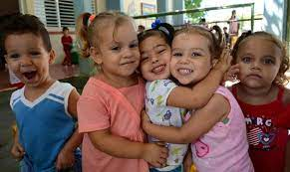
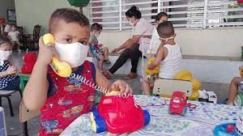
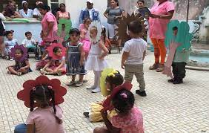
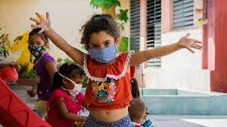
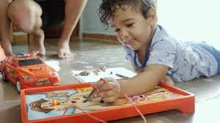
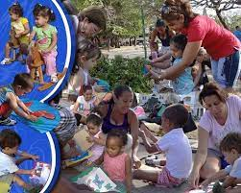
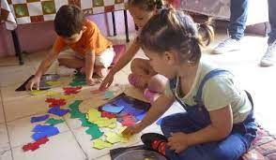
Key stage in the assimilation of values and behavior patterns that make up identity
The products that are made available to children and their protection with respect to content considered harmful are essential to complete the training process
Certain media content can be harmful to their moral and emotional development, as well as to the assimilation of roles, values and behavior patterns
The activities carried out by the child through the exploration of the senses and the active use of his body, allow him to use it as a vital communication resource
“Every moment of a child's life should be educational”
López J. (2001)
Notes:
Early childhood is a key stage in the assimilation of values ​​and behavior patterns that make up identity, and the audiovisual media are increasingly present among the socializing agents that influence this complex process. For this reason, the products that are made available to children and their protection from content considered harmful are essential to complete the training process in such a sensitive period of development.
The activities carried out by the child through the exploration of the senses and the active use of his body, allow him to use it as a vital resource of communication and justify the affirmation of López J. (2001), that each moment of the life of a child should be educational.

Slide 10
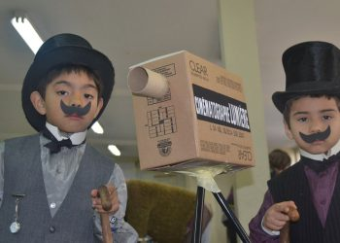
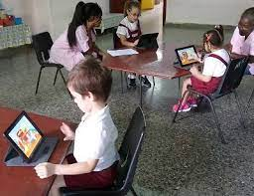
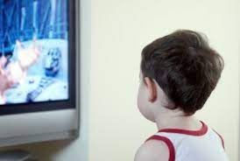
The audiovisual media become means of the educational process of girls and boys
ability to capture the attention and motivate children
A beneficial audiovisual consumption for early childhood will be, above all, a mediation activity
Notes:
From this position, the audiovisual media become means of the educational process of girls and boys, both within the framework of educational modalities, and in the conditions of the home. Audiovisual media in general have the ability to capture the attention and motivate children, but for it to be beneficial it must not occur spontaneously. A beneficial audiovisual consumption for early childhood will be, above all, a mediation activity.

Slide 11
Mediation of audiovisual consumption
The interaction between the production space and the reception space, as the starting point for an investigation of the significance and meaning that children attribute to their practices and objects. Of consumption, so that it is an important attempt to recover the perspective of it as an active subject
Notes:
So mediation of audiovisual consumption is understood, as the interaction between the production space and the reception space, as the starting point for an investigation of the significance and meaning that children attribute to their practices and objects. of consumption, so that it is an important attempt to recover the perspective of it as an active subject.

Slide 12
Scientific research
confirms
majority of children in Cuba do not have mediation in one of its primary manifestations
Notes:
Scientific research carried out at the Faculty of Psychology of the University of Havana, in conjunction with the ICAIC Animation Studies, confirms that the majority of children in Cuba do not have mediation in one of its primary manifestations, which is supervision. necessary by parents, in relation to the use of video games or audiovisuals and digital technologies in general.

Slide 13
Aspects that has certainly gained more awareness
regulation of consumption time
generate
Such as states of over-anxiety
Deterioration or insufficient development of social skills and competencies
Addictions
Serious impairment of psychological development
Notes:
The regulation of consumption time is one of the aspects that has certainly gained more awareness, given its direct impact on children's mental health. It is no less true that they generate multiple consequences, such as states of over-anxiety, deterioration or insufficient development of social skills and competencies, addictions, and serious impairment of psychological development, when children overuse before the age of three. lifetime.

Slide 14
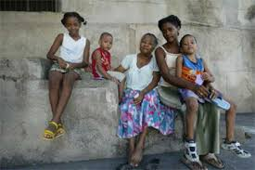
“Parents, even feeling concerned about this problem, distance themselves from what their children do when they are in front of a screen“
Castellanos (2020)
Notes:
Castellanos (2020) states that "parents, even feeling concerned about this problem, distance themselves from what their children do when they are in front of a screen".

Slide 15
Mediation of audiovisual consumption
meet
encourage
the needs that arise in children to understand what is observed
delve
verbal expression
The mediating subjects cannot be only the members of the respective families and the educators
satisfy
into certain issues
verify
the interests of children
rectify
understanding
stimulate
errors
the creation of new audiovisual or other products
Notes:
Mediation must meet the needs that arise in children to understand what is observed, it must encourage verbal expression, delve into certain issues, satisfy the interests of children, verify understanding, rectify errors and stimulate the creation of new audiovisual or other products.
The mediating subjects cannot be only the members of the respective families and the educators. It will be necessary to consider other subjects, whose social function in this specific context generates that responsibility.

Slide 16
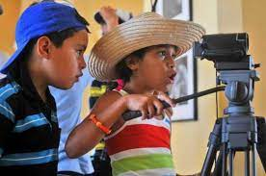
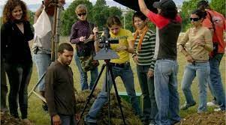
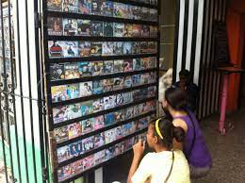
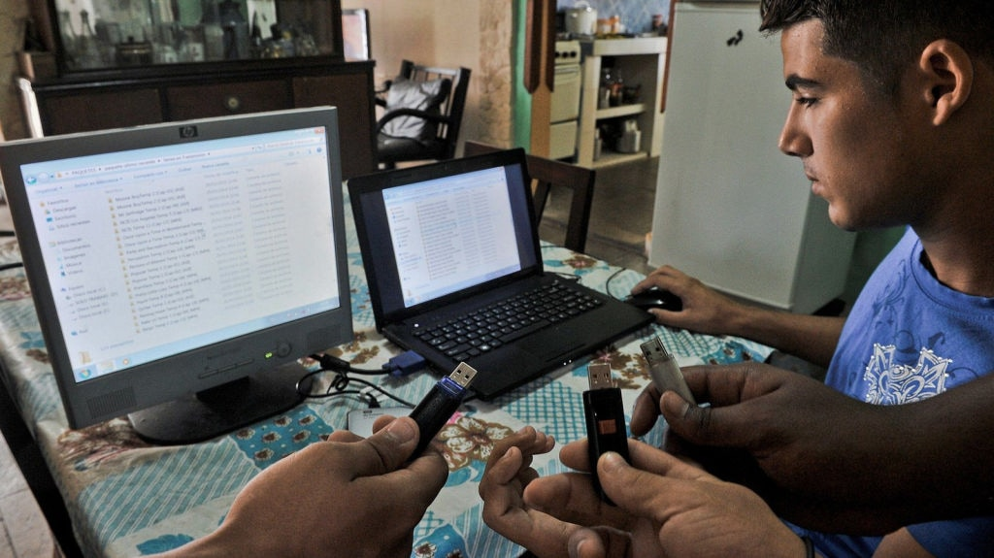
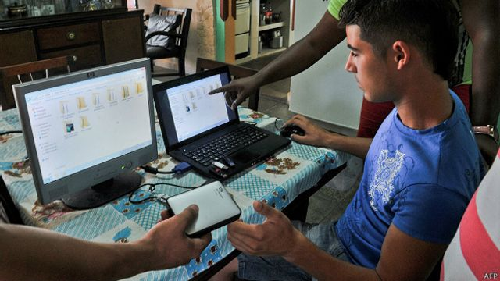
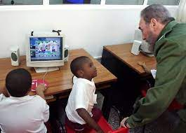
Other mediators
other children who may or may not be family
Subjects that produce and market audiovisuals
The decisive act of providing and accessing the diversity of audiovisual materials
Notes:
In this sense, other mediators are recognized as other children who may or may not be family members and those subjects who produce and market audiovisuals, whose performance and place in the consumption of the latter is generally assigned to the product of their work, that is, to the audiovisual content itself. It is the directors and producers, those who generate these contents, those who decide the approach with which they will be treated and those who introduce the artistic and aesthetic resources for their expression; so that they exert an apparently indirect mediation, but without which the act of consumption would be impossible.
The decisive act of providing and accessing the diversity of audiovisual materials ceased to be an institutional responsibility, to become an increasingly shared function, with people who facilitate this enjoyment in the private space of homes, based on private efforts or of groups with different levels of specific preparation. That is why all subjects are also recognized as mediators, who are not part of the family, but who provide audiovisual materials and therefore influence the consumption of early childhood children.

Slide 17
Audiovisual consumption for early childhood development
Particular type of activity, which fosters interaction and appropriation by children of audiovisual content, through essential management of their carrier devices and from the mediation of "others" who produce, provide, guide and/or accompany, in a context specific socio-cultural
Notes:
As a construct derived from the studies carried out, audiovisual consumption for early childhood development is defined as; a particular type of activity, which fosters interaction and appropriation by children of audiovisual content, through essential management of their carrier devices and from the mediation of "others" who produce, provide, guide and/or accompany, in a context specific socio-cultural.

Slide 18
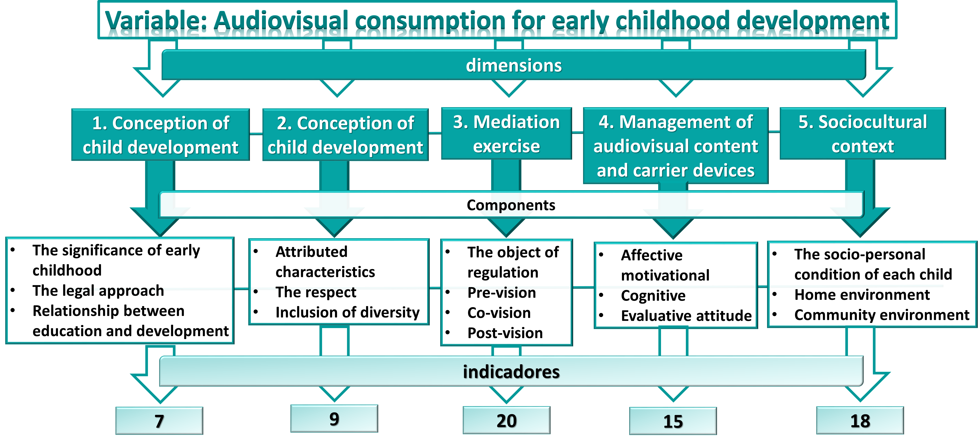
Notes:
Once the theoretical construction process was carried out, based on the analysis of the conceptual definition of audiovisual consumption for early childhood development, the designated work team carried out the process of operationalizing the variable, determining dimensions, components and indicators.
The result was evaluated and approved, through the criteria of 10 specialists after two rounds of pertinent adjustments.

Slide 19
13 instruments were developed, which were applied to the units of analysis
Instruments | Analysis units
 | Kids | Families | Educators | Providers | Filmmakers
Observation | x
Poll |  | x (2) | x (2) | x | x
Interview | x | x | x | x | x
Anecdote |  | x
Instruments for characterizing the audiovisual consumption of early childhood children
Notes:
The previous operationalization was applied to the subjects involved in audiovisual consumption that acquire the status of study units and are composed of: boys and girls from early childhood; their parents or guardians as the most responsible for the education and care of the children; their educators, promoters and caregivers; the providers of its radius of action and responsible institutions, in addition to state and private filmmakers and producers.
13 instruments were developed, which were applied to the units of analysis
The age range recommended by the international literature for the approach of early childhood to audiovisuals is from 3 years old, so that this criterion is respected and the stage of preschool childhood was determined as the age of the study.

Slide 20
Conclusions
The application of the systemic approach in the study carried out, conditioned a greater amplitude in the definition of the audiovisual consumption variable for the development of early childhood
2. The results presented were subjected to a rational validation process, in correspondence with the current conditions
3. The characterization of audiovisual consumption in early childhood is not the ultimate goal of this research project; although its importance lies in the fact that its results are decisive as a means to obtain essential information
Notes:
In this way we arrive at the following conclusions
The application of the systemic approach in the study carried out, conditioned a greater amplitude in the definition of the audiovisual consumption variable for the development of early childhood, specifically in the consideration of both direct and indirect mediators, which had repercussions on the increase in indicators and instruments necessary for its characterization.
The results presented were subjected to a rational validation process, in correspondence with the current conditions, and its complement with the characterization in a selected sample in the Revolution Square municipality, through a doctoral thesis.
The characterization of audiovisual consumption in early childhood is not the ultimate goal of this research project; although its importance lies in the fact that its results are decisive as a means to obtain essential information and thus move accurately, to carry out actions for the promotion of an audiovisual culture.

Slide 21
Thank you

