Slide 1
The relation between Executive functions and Activity regulation functions of children with different language status at the beginning of school education
The research was conducted with the financial support from Russian National Fund, No. 23-28-10202.
Yulia O. Novgorodova
Postgraduate student at Udmurt State University
Vera Yu. Khotinets
PhD, Professor at Udmurt State University
Daria S. Medvedeva
PhD, Docent at Udmurt State University

Slide 2

Research problem
The study raises the problem of benefits and difficulties of younger monolingual and bilingual schoolchildren at the beginning of school education by identifying the relation between activity regulation functions and executive functions.
Photo from the author's archive of the study. The children's parents agreed to its use.

Slide 3

Basic definitions
Activity regulation functions ensure the maintenance of general and selective activity associated with indicators of pace, fatigue, impulsivity, hyperactivity and inertia. Executive functions provide planning and programming of activities, retention of the plan during execution, control over the processing and the achieved result.

Slide 4

Sample
The study involved 150 primary school children in age from 7 to 8.4 (M = 7.7, SD = 0.39). Among them: 75 primary school children (33 boys and 42 girls) with balanced bilingualism (Udmurt and Russian languages) from the national Udmurt gymnasium named after Kuzebay Gerd, Izhevsk city. The comparison group consisted of 75 Russian native speakers monolinguals (38 boys and 37 girls) from a general-education school located in Izhevsk, Udmurt Republic.

Slide 5

Мethods
The following methods of neuropsychological executive functions research were used: Go-No-Go Task, Verbal Fluency Test, Counting, Problem Solving, Verbal Memory Test, Visual-Spatial Memory; computerized tests of the psychologists toolkit software «Moscow State University Practice»: Stroop Test, Shulte Tables, Dots. Activity regulation functions were observed during all the trials.
The mathematical and statistical analysis of the data included statistical method for analyzing empirical research data called SEM (Structural Equation Modeling). It was implemented with IBM SPSS Statistics V22.0 for Windows with built-in IBM SPSS AMOS V22.0 module. The leading functions of activity regulation were identified as predictors of executive functions productivity in monolingual and bilingual primary school students.

Slide 6
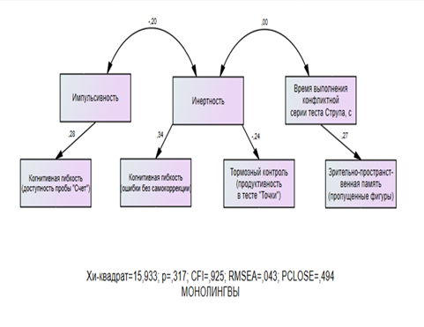
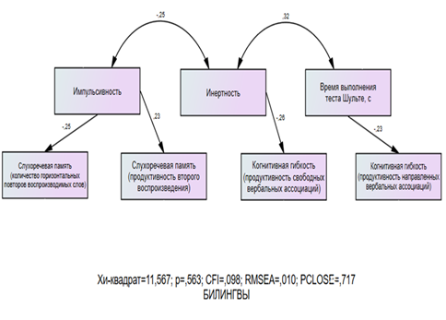



Slide 7

Results
Different development trajectories of executive functions individual components of children with different language status were identified: if an increase of reactivity of monolinguals reduced the productivity of their cognitive flexibility in nonverbal activity, then among bilinguals it ensured the productivity of auditory-speech memory; if activity of monolinguals led to an increase of cognitive flexibility and inhibitory control in solving non–verbal tasks, bilinguals tended to increase cognitive flexibility in speech activity.

