Slide 1
The skills of primary school students to exercise self-regulation: an interview of classroom teachers
Olga А. Stankevich
Researcher in the field of Educational psychology,
Master of Psychology,
Teacher of the Department of Psychological Support of Professional Activities
of the Institute of Psychology
of the Belarusian State Pedagogical University named after Maxim Tank
Minsk, Republic of Belarus
1-2 June 2024

Slide 2
Requirements faced by primary school students in school and in educational activities:
1. it is necessary to attend classes;
2. it is necessary to do homework;
3. it is necessary to follow the rules of conduct at school (raise your hand if you want to answer, do not shout from your seat, follow the instructions of the teacher, etc.).
Changes in interaction with the outside world in primary school students:
1. the child's circle of contacts is significantly expanding;
2. the child acquires a new social role - the student;
3. a new significant figure of the teacher appears in the life of a schoolchild.

Slide 3
Educational activity is the leading activity in primary school age
(D.B. Elkonin, V.V. Davydov, etc.).
Mastering learning activities at primary school age largely depends on the child's ability to accept and understand the goals of their activities, to understand and implement actions to achieve their goals, to control and evaluate the results.
Thus, the mastery of educational activities largely depends on the self-regulation of the child.

Slide 4
The purpose of the research:
to identify the skills of younger schoolchildren to self-regulate activities, including educational activities, by interviewing classroom teachers.
Research methodos:
Questionnaire BRIEF (Behavior Rating Inventory of Executive Function) by Gerad A. Gioia, Peter K. Isquith, Steven C. Guy, and Lauren Kenworthy (adaptation by Ekaterina Y. Gorina, Tatyana V. Akhutina, 2019).
Research participants: 31 class teachers of grades 1-4.

Slide 5
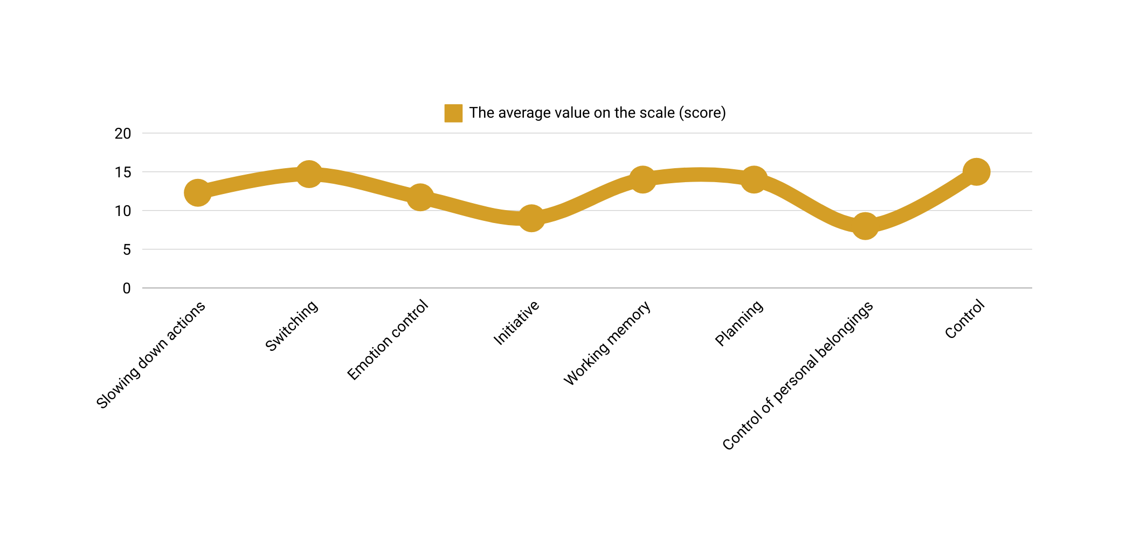
The results obtained in the survey results:

Slide 6
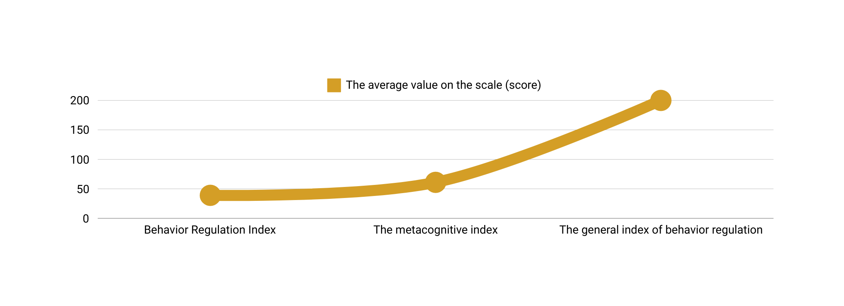
The results obtained in the survey results:

Slide 7
The main conclusions of the research:
Modern primary school students, according to classroom teachers, do not have sufficient skills to carry out self-regulation, which can lead to difficulties in mastering educational activities.
The development of self-regulation skills in younger students is an important task. The ability of students to independently accept and put forward goals of activity, build a program of actions to achieve it, monitor and correct it will not only effectively carry out educational activities, but will also contribute to personal development. In the future, the ability to exercise self-regulation will be important in mastering the profession and forming a high-level specialist.

Slide 8
Thank you for you attention!
Olga А. Stankevich
сontacts:
E-mail: shavluykevich@mail.ru
Google Scholar ORCID eLibrary
We are glad to cooperate!

