Slide 1

Project Escaramujo
University of Havana.
Adolescer 2022: Reflections and good practices of digital socialization of Cuban children and adolescents.
Authors : Lic. Gisela Lianet Carrete Betancourt
MSc. Isys Pelier Alvarez
Mabel González Fuentes

Slide 2

Escaramujo: The history of an university Project.
Cuban educommunicative project, created in 2010.
General objective:
To contribute to the psychosocial development of children and adolescents in Cuba.
A project conceived from the conceptions and methodologies of Popular Education.

Slide 3
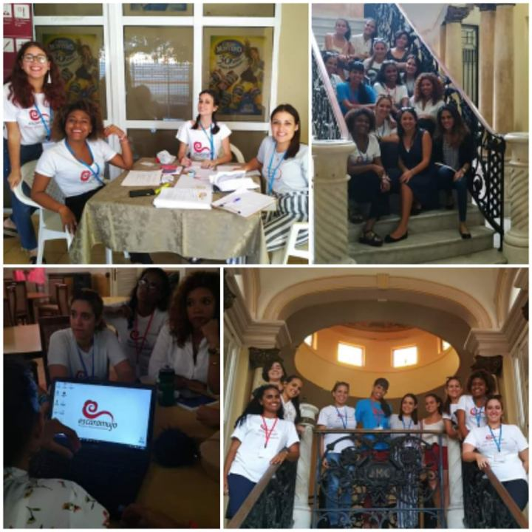
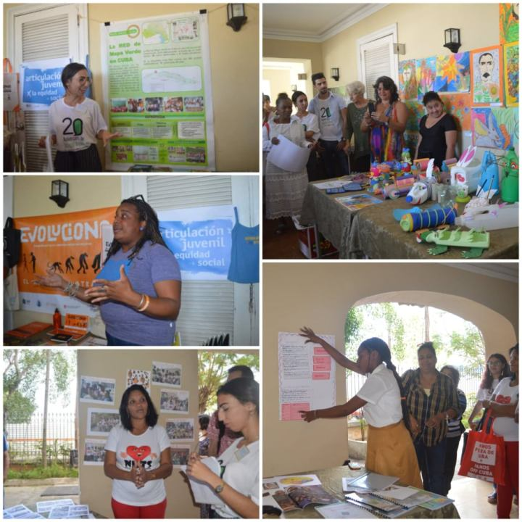
“Adolescer”
In 2015, the project concieves the event as an annual space.
Academic socialization about/for the Cubans children and adolescences.
Panels, thematic forums or work tables, sessions with the adolescents and a experience fair.

Slide 4


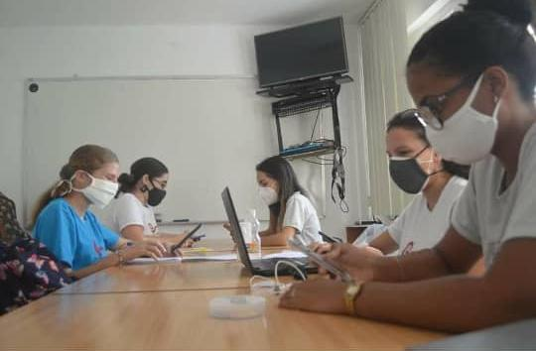
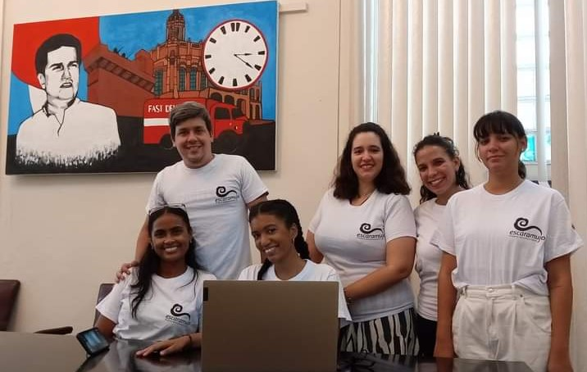

Slide 5
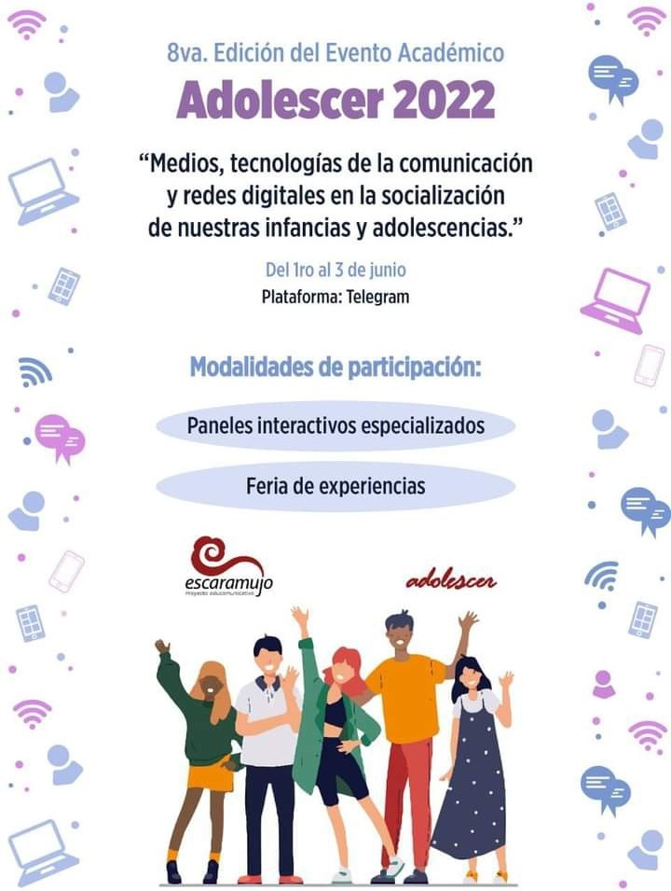

VIII“Adolescer”
Theme: “Medias, communication´s technologies and socials networks in the socialization of ours childhoods and adolescences”
Results related to the socialization of these groups in virtual environment.
Materialization of the memories in a book with the whole details of the academic infromation and experiences.

Slide 6
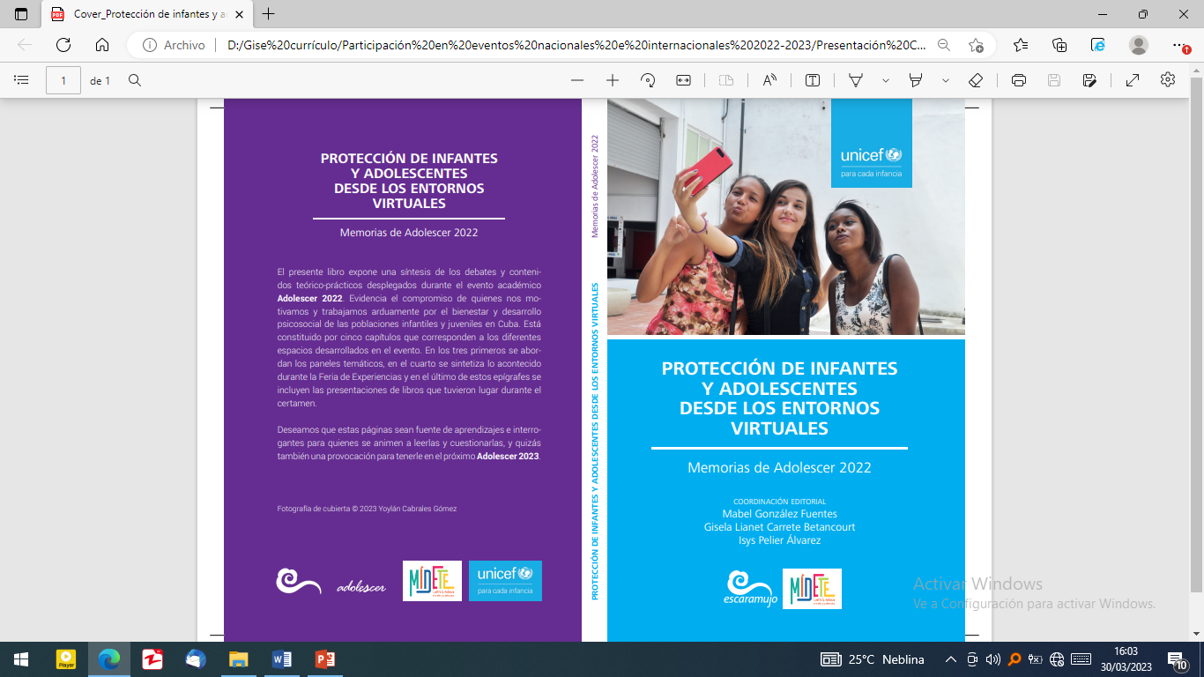
Summarizes the debates, reflections y results of the experts in five chapters, which correspond to the different spaces of the event.
Chapters I,II, III: Thematic panels.
Chapter IV: Experiences fair.
Chapter V: Book presentation.
Need to accompany and educate the children and adolescents to accomplish a digital socialization more effective y save for them.

