Slide 1
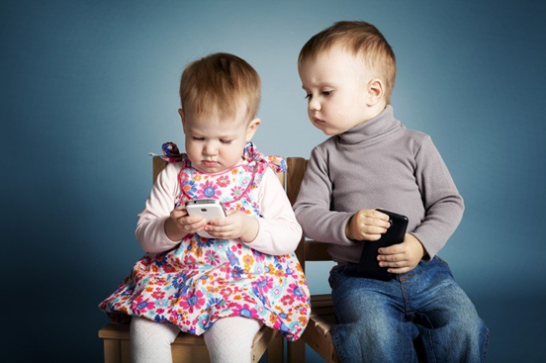
[{{{
The impact of early childhood digital addiction on cognitive and emotional development.
Child Psychology

Slide 2
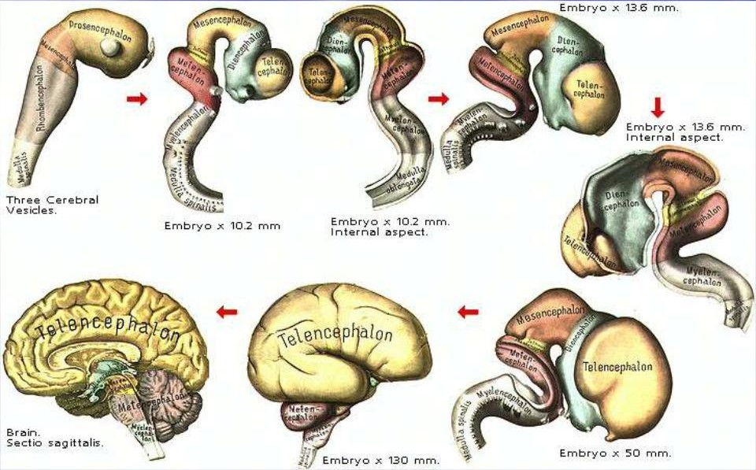
Brain shaping
The introduction of information technology at an early age into a child's life has a detrimental effect on the yet unformed neural networks of the brain, which adversely affects cognitive and emotional development.
In order to better understand what kind of harm we are talking about, we need to understand how the children's brain and psyche are formed.
The development of the child's brain can be decomposed into several periods, which affect the brain stem at the initial stage, and the cerebral cortex at the final stage.
The first period begins in the womb, in which the most critical is considered to be 20-27 days, when the children's brain begins to form from the front of the neural tube. Around this time, the frontal, parietal and occipital lobes of the brain are formed, and the neuroectoderm arises from the neuron disk.
The second period can be attributed to infancy, passing into early childhood, in which the most critical is considered to be 1-8 weeks due to the formation of visual functions and 6-24 months, the so-called sensitive period, when a certain set of psychological properties and behaviors are formed.
And so on, up to 20-23 years, when the final maturation of the prefrontal cortex of the brain occurs.

Slide 3
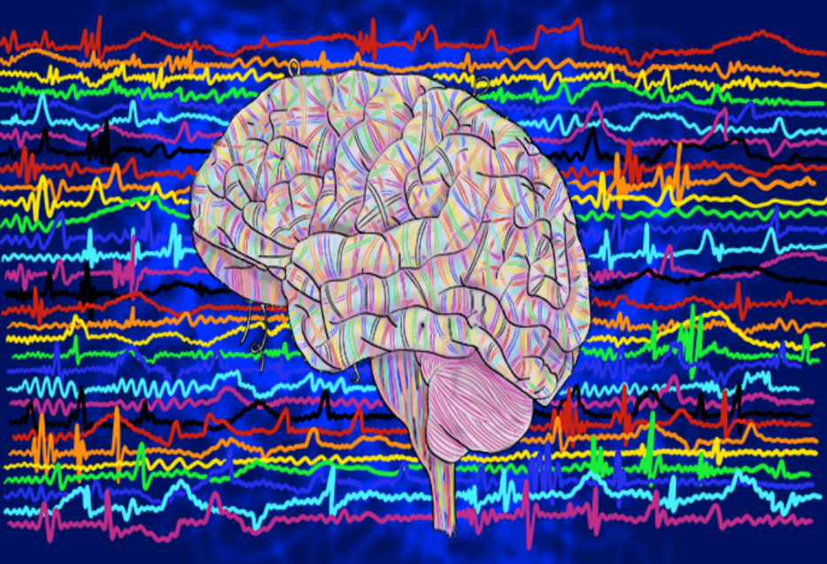
The development of the brain has a wave diagram, but the most significant burst of activity in my opinion is the period of the first three years due to the intensity of the formation of the foundations of conditioned reflex connections, which are distinguished by their strength and can last until the end of life. The first three-year interval is very significant. I think that it is during this period that you should not immerse the child in the digital world at all. Interactive gadgets are of particular danger, as there is very fast communication and, as a result, more intense addiction. During this period of the formation of the child's psyche, replacing the real world with a virtual one, we replace the skills that have not yet been formed with third-party ones. In fact, slowing down the development of their own and grossly interfering in their formation, causing irreparable harm to the child's psyche for life.

Slide 4
Imagine for a moment what it will cost to break the established deep connection after the child has had a substitution of skills formed with the use and capabilities of artificial intelligence. When programs and various algorithms intuitively replace imaginative thinking, various feelings, including a sense of self-preservation, communicative qualities, etc. It's like taking a part of the child from him.
You should always remember that weaning a child from anything is always more difficult than teaching. And the solution for the sake of your laziness or simply short-sightedness with the help of a gadget of momentary difficulties associated, for example, with feeding, morning preparations for kindergarten or for a walk, is not correct and very harmful, with very far-reaching consequences. Absolutely do not make such mistakes.
From 3 to 10 years old are also undesirable, but contacts with gadgets are possible for no more than 15-30 minutes a day. The later this acquaintance takes place, the better for the child.
The problem of the modern world is global digitalization and our involvement in it. It is very difficult to protect a child from the influence of digital technologies, when even studies are moving to an interactive format, from e-books to a school board or remote platform.

Slide 5
And here it is necessary for everyone to independently and consciously make their choice and build their life in accordance with it and the available opportunities.
If we are talking about children who are already addictive, here, first of all, parents must decide what they want and what they are ready for for their child. It is very difficult to imagine the process of weaning a child from gadgets when his parents do not let them out of their hands all day and the children see it.
This is a very difficult and lengthy process, it is comparable to weaning from drugs. What is not figurative. Children may develop a fever, become depressed, lose their appetite, become aggressive, cheat to get what they want, etc.

Slide 6
In this connection, it is not recommended to act radically and prohibit everything at once. It is necessary to reduce the time that the child spends with electronics, gradually. The freed time must be immediately filled with anything that will force him to imagine, to read, to think, to create, to show feelings such as curiosity, interest, care, compassion, love. Be sure to try to involve the child in sports, take long walks in the fresh air.

Slide 7
There are a lot of examples and opportunities to fill the free time, from reading books, watching filmstrips, working with interesting designers, etc., ending with visiting an animal shelter or nursery to provide its inhabitants with all possible assistance in the form of care and care. For example, take one of the pets for walks, comb out the mane of a pony, or feed a rabbit with carrots. What is important is the process that will form positive emotions in the child and gradually replace gambling addiction.

Slide 8
The most important thing is that the child does not have free time. As soon as free time appears, problems will return with it. This is a titanic, everyday work.
And I wish everyone involved in the process of patience, endurance and wisdom.

Slide 9
This Presentation is Prepared by
ZAVGORODNII ALEKSEI
сity of Sevastopol
Tel: +7 (915) 085-65-69
E-mail: alexey.psychologist@gmail.com
Https://alexey-psychologist.ru
Https://алексей-психолог.рф
Zen.yandex.ru/idid/602586414dd9d44296f0d6fb/602586414dd9d44296f0d6fb

