Slide 1
The Role of the Family in the Digitalization of Childhood. Its Influence on Academic Performance
Lic. Sailí Cruz Cáceres
Juan Enrique Jimenez
Faculty of Foreign Languages. University of Havana

Slide 2





World dominated by new technologies

Slide 3
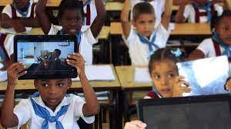
Objective
To explore these issues and how they manifest in Cuba. We intend to highlight the necessary parent-school relationship in the process of digitalizing childhood and its future impact on students' academic performance.

Slide 4
Many authors have defined new technologies ICT as devices or technical systems that are used to store and use information interactively, instantly, and innovatively. Users can not only create messages but also establish relationships between them to improve and modify information.

Slide 5
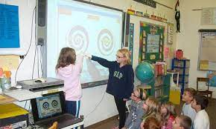

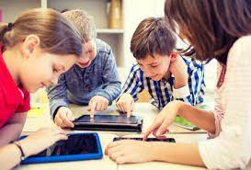
In order to automate habits and develop skills, teaching tools such as software, educational videos, or internet information search under the supervision of teachers facilitate the gradual, controlled, and rational acquisition of knowledge.

Slide 6
Factors that influence children´s development
Biological Factors
Enviromental Factors
Interpersonal Relationship
Early enviroment and expiriences

Slide 7
Integration into the technological world is essential for the new generations, not only because it aligns with the characteristics of their time but also because, according to pediatrician Gustavo Valderrama, it "facilitates the increase of symbolic and numerical intellectual development, written communicative expression, and the early acquisition of discriminative critical thinking."

Slide 8
The interplay between parents and the school is essential for the child's holistic development. Parents should not only transmit theoretical knowledge to their children but also work on the development of social and technological skills that are essential for their future careers.

Slide 9

In the current digital society, students constantly face increasingly challenging demands.

Slide 10

Academic performance is sometimes not determined solely by the role of the teacher in the classroom but also depends on the skills that the student possesses and has developed throughout their years of study.

Slide 12
Conclusion
The use of ICT from an early age can have a positive impact on students' academic performance. However, it depends on the amount of time and the type of material the child is exposed to.
In Cuba A student who starts their studies at the age of five and has had no contact with any computational technology will have the opportunity in school to gradually learn how to use them in their future areas of study.

Slide 13
Conclusion
These findings provide valuable information for teachers and educators seeking to incorporate new technologies into their pedagogical practices and promote the development of digital skills in their students.

Slide 14

Thank you for
the attention!
cruzsaili9@gmail.com
juanaenriquej15@gmail.com

