Slide 1
Student Well-being in the Digital Education Environment
Svetlana V. Persiyantseva
Phd, Associate Professor of the Department of General Psychology
Psychological Institute of the Russian Academy of Education
Russian State University for the Humanities

Slide 2
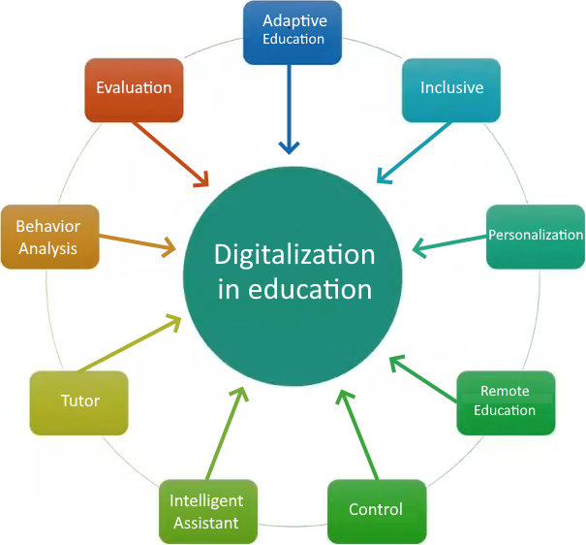
To form a digital space in the educational environment, it is necessary to use and develop educational technologies, including remote ones.

Slide 3
RELEVANCE
I. The need to improve the efficiency of higher education
II. Preserving the psychological well-being and development of self-regulation of future specialists in the digital educational space
III. Reducing the psychological stress associated with the educational process

Slide 4
The aim of this study
Participants
N = 106 students:
1st - 2nd year (n=50)
M = 19,44; SD = 1,43
range = 17–22 years
4th - 5th year students (n=56)
M = 22,02; SD = 2,33
range = 20–29 years
was to explore the activity of students in the digital space, their level of well-being and regulatory characteristics.

Slide 5
Methods
Self-regulation Profile Questionnaire
Scales:
Planning goals
Modeling significant conditions
Programming actions
Evaluating results
Flexibility
Reliability
Independence
Morosanova, et al., 1994
Ryff Scales of Psychological Well-Being
Scales:
Autonomy
Environmental Mastery
Personal Growth
Positive Relations with Others
Purpose in Life
Self-acceptance (I like most aspects of my personality)
Ryff, 1989. Russian adaptation by Shevelenkova, et al., 2005

Slide 6
Interview method
How many hours per week you spend online?
How many hours per week you spend online for study purposes?
How many hours a week do you spend online for entertainment purposes (games, videos, et al.)?
How many hours a week do you spend online on social networks (social communication)?

Slide 7
PRINCIPAL FINDINGS…
The age dynamics of the level of psychological well-being and regulatory characteristics of students has been established.
With age, there is a significant increase in indicators on the scales "Autonomy", "Environmental Mastery", "Positive Relationships with Others".
Significantly with age, indicators for regulatory characteristics such as "Independence", "Evaluation of results", "Reliability" increase (p<0.05).
The components of psychological well-being "Personal Growth", "Purpose in Life" significantly decrease with age (p<0.05; Mann–Whitney U test).
Digital activity is high in two groups. By the 4th year, the activity of using digital technologies in the field of education, aimed at self-education, increases.
The relationship between the level of psychological well-being and digital activity was revealed. The higher the overall level of psychological well-being, the more active the student in the digital environment, however, this pattern is observed only among students of the 1st and 2nd courses (ρ = 0.32; p<0.05; Spearman's rank correlation coefficient) .

Slide 8
THANK YOU

