Slide 1
Eye-tracking systems as a perspective tool for assessing state of higher mental functions
Panfilova Elizaveta Arkad’evna,
Polikanova I.S., Leonov S.V.
Federal Scientific Center for Psychological and Interdisciplinary Research
Moscow-2025

Slide 2
Physiological functions can indicate the development of certain higher mental functions
Visual perception
Eye movements as the reflection of the HMF development
Hand-eye coordination
Visuo-spatial memory
Visual attention
2

Slide 3
Eye-tracking in the diagnostics of visual working memory
Studying the mechanisms of visual-spatial memory states the ability to separate the causes of impairment, in particular low attention, from deeper mechanisms of memory impairment.
Van der Stigchel, Hollingworth, 2018
The relationship between attention shifts and the work of visual-spatial memory was assessed using the analysis of fixation parameters.
The success of a preschooler in completing a motor task significantly correlates with the solution of visual-spatial tasks.
Olsen et al., 2014
Falikman, 2009
The duration of the first fixation made it possible to study prospective memory in children aged 6-7 and 9-10 years and its relationship with regulatory functions, including working memory.
3
Hartwig et al., 2021

Slide 4
The aim of the study was to show, that visuo-spatial memory and visual attention can be reflected by oculomotor reactions.
4

Slide 5
Methods
47 healthy children from preschool classes: 23 females (6,76±0,32 years old) and 24 males (6,74±0,31 years old).
The visuo-spatial working memory and attention were assessed with Russian version of subtest Memory for designs (MfD) from NEPSY-II.
Eye movements were recorded with the infrared video-recorded eye-tracker Pupil Labs Invisible (Pupil Labs GmbH) with recording rate 200 Hz.
5

Slide 6
Methods
Eye-tracking
Data analysis
«Memory for Designs»
10-20 min
6

Slide 7
Results
 | Images
Quantile (n/3) | Lower (n=16) | Middle (n=15) | Upper (n=16)
Scores | 39 | 44 | 48
 | Location
Quantile (n/3) | Lower (n=16) | Middle (n=15) | Upper (n=16)
Scores | 20,3 | 23,6 | 24
 | Total score
Quantile (n/3) | Lower (n=16) | Middle (n=15) | Upper (n=16)
Scores | 73,6 | 97,6 | 120
Values of lower, middle and upper quantiles (n/3) of Memory for designs subtest’s scores for each scale: images, location and total score
7

Slide 8
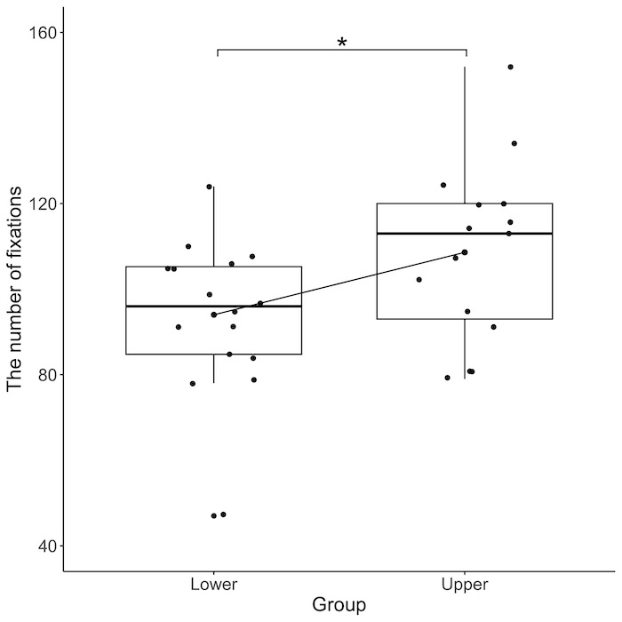
Results
Mean values of the total number of fixations for two quantile groups of the “Total” and “Location” scales
Index | Quantile (n/3) group |  | t | df | p
 | Lower (n=16) | Upper (n=15)
Total score | 90,1±15,5 | 100,13±17,0 | -1,71 | 28 | p <0,1
Location | 94,0±17,6 | 118,6±20,8 | -2,1 | 27 | p <0,05
The number of gaze fixations correlated with points of Spatial scale of MfD test (p <0.05, Rh = 0,32).
8

Slide 9
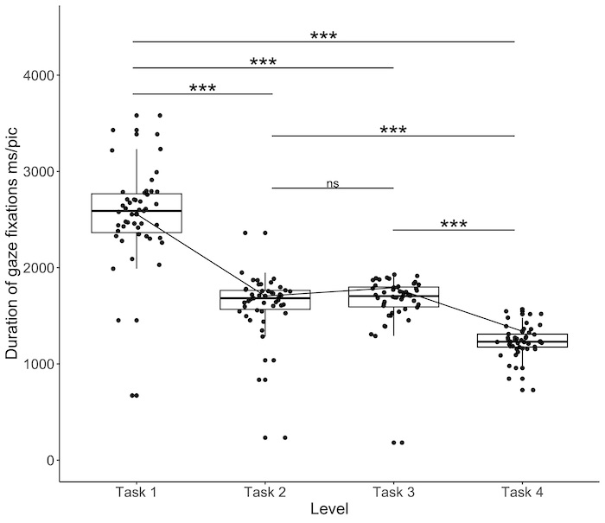
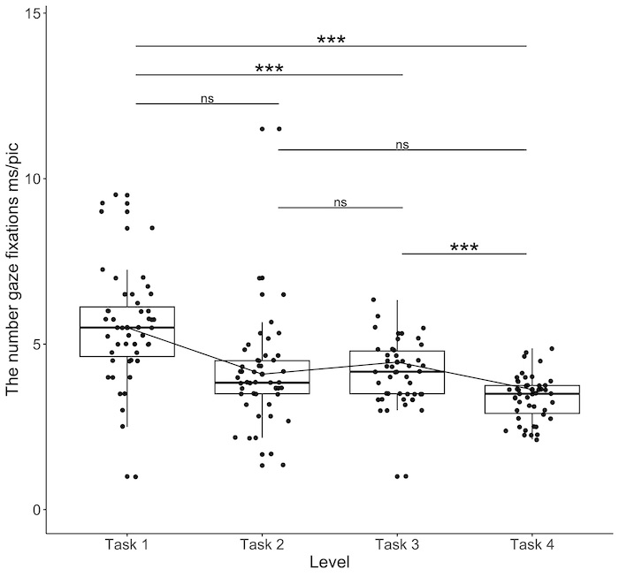
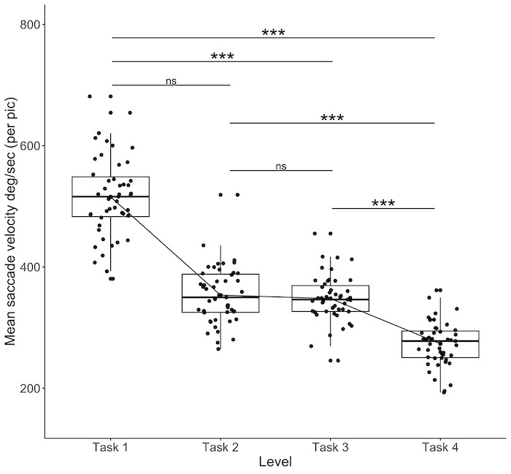
Results
Oculomotor reactions in relation to one stimulus gradually decreased from the first to the fourth task (0,001 <p <0,01).
9

Slide 10
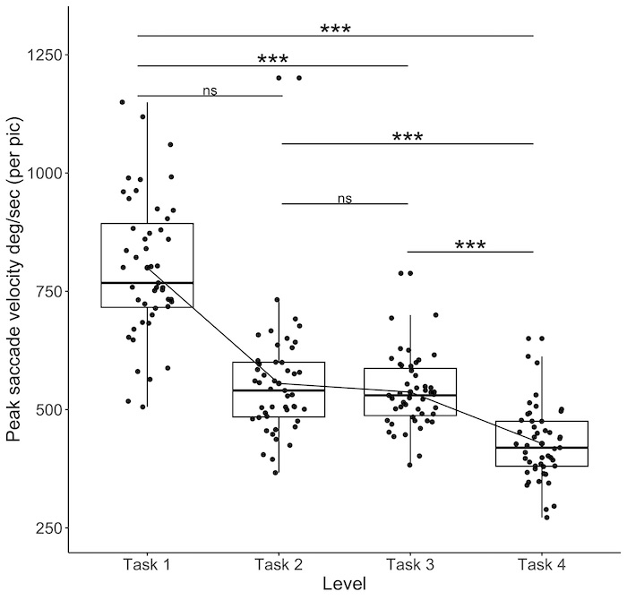
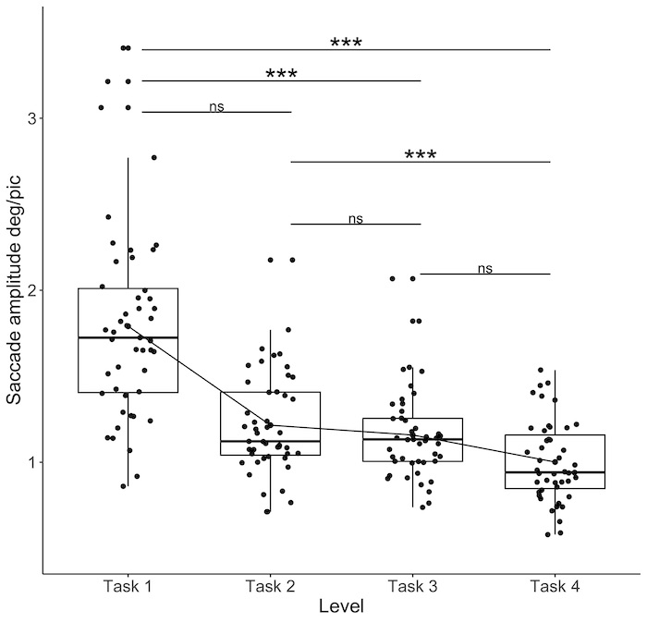
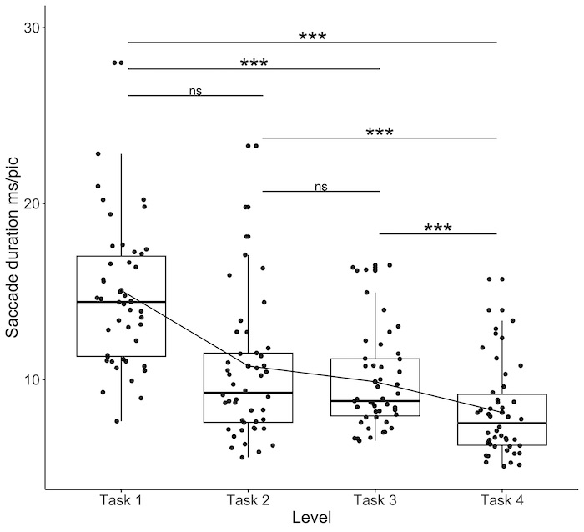
Results
Oculomotor reactions in relation to one stimulus gradually decreased from the first to the fourth task (0,001 <p <0,01).
10

Slide 11
Conclusion
There is a close connection between visuo-spatial working memory and oculomotor control in preschool children with different levels of spatial memory.
Our results highlight the spreading distribution of attention on the stimulus material in accordance with the increase in the number of stimuli from the first to the fourth task.
Visuo-spatial memory and visual attention are reflected by oculomotor reactions.
The application of eye-tracking systems is important in assessing the state of higher mental functions and the entire network.

Slide 12
THANK YOU !
lizaPanf11@yandex.ru

