Slide 1
The impact of teenagers internet involvement
on their emotional intelligence
The research described in this publication was made possible in part
by R&D Support Program for undergraduate and graduate students and
postdoctoral researcher of PetrSU, funded by the Government of the
Republic of Karelia.

Slide 2
Relevance
Modern teenagers are the first generation whose adolescence is directly linked to digital technology. The question of whether high internet activity has an impact on psychological and emotional development is actively discussed among doctors, psychologists, and educators. Emotional intelligence is linked to adolescent adaptation, psychological well-being, and academic achievement. It has been found that teenagers with high levels of emotional intelligence demonstrate more productive coping styles, and the ability to understand and manage their emotions is a basic soft skill.

Slide 3
01
The goal
identify the relationship between the level of emotional intelligence development and internet involvement among teenagers

Slide 4
Methods
01
02
The first subtest of Guilford's Test of Social Intelligence
The questionnaire of problematic Internet use
(Vadim N. Kolesnikov, Yuriy I. Melnik, Lidia I. Teplova)

Slide 5
The sample consisted of
400 teenagers from 6th to 9th grades from different regions of the Republic of Karelia

Slide 6
The results

Slide 7
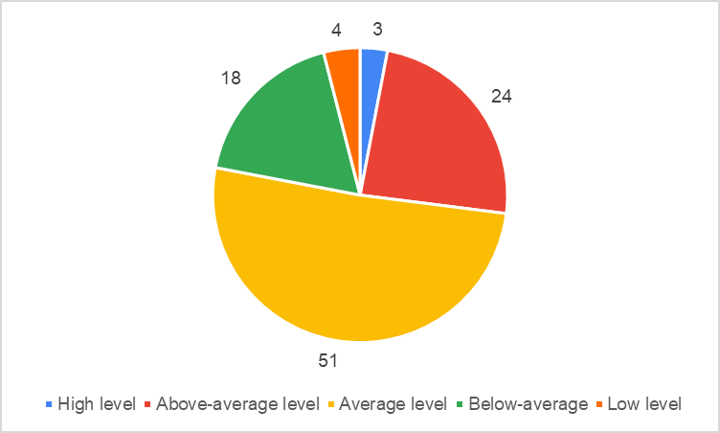
Тhe level of emotional intelligence in adolescents of the Republic of Karelia

Slide 8
The Internet Problem Use scale
The maximum score on the Internet Problem Use scale is 132. The average score among the students who participated in the study is 67. Thus, teenagers have an average level of problematic Internet use.

Slide 9
Mathematical statistics
When examining the relationship between the two indicators, the Pearson's correlation coefficient was used. The data indicates a very weak and practically non-existent correlation between Internet involvement and emotional intelligence. The Pearson correlation coefficient value is close to 0, indicating no linear relationship between these two parameters.

Slide 10
Conclusion
Thus, Internet involvement does not affect the level of emotional intelligence in teenagers. However, this is only a statistical conclusion, and final conclusions about the reasons why Internet involvement may not influence emotional intelligence should not be drawn. It is possible that the influence of other factors, such as family environment, education, upbringing, or personal qualities, may outweigh the influence of Internet involvement on emotional intelligence.

Slide 11
Plans
Onlain-trainer
With psychological tasks
Socio-psychological training

Slide 12
Contacts
Dudareva Alexandra
Email: alexandradudareva2001@gmail.com

