Slide 1
Board Games VS Digital Games:
What is More Beneficial for Preschoolers?
Olga V. Salomatova, Junior Research Fellow of the Centre for Interdisciplinary Research of Contemporary Childhood, Moscow State University of Psychology and Education, Moscow, Russia
Olga V. Rubtsova, PhD in Psychology, Associate Professor, Head of Center for Interdisciplinary Research on Contemporary Childhood, Moscow State University of Psychology & Education, Moscow, Russia
The reported study was funded by Russian Science Foundation, project number 23-28-01204

Slide 2
Empirical Research: Stage 2
Objectives of the Second Stage
2) To determine the relationship between intelligence indicators and regulatory function indicators
3) To identify gender differences in the development of cognitive functions and intelligence in preschoolers
1) To compare the impact of digital and board games on the development of regulatory functions and intelligence in preschool children

Slide 3
Methodology
"Dimensional Change Card Sort"
"Learning 10 Words" (A.R. Luria)
"Raven Progressive Matrices"
Assessment of auditory short-term and long-term memory parameters such as memorization, retention, and reproduction
Investigation of general (abstract) intelligence
Assessment of cognitive flexibility, i.e., the child's ability to switch between instructions

Slide 4
Design and sample - stage 2
Timing
Research Design
Group 1 (N=27) – Experimental – played "Tangram" and "Dobble!" in the traditional version
February – May 2024
88 children (49 boys and 39 girls)
Sample
Group 2 (N=25) – Experimental – played digital versions of board games "Tangram Puzzle: Poligram Game" and "Double Match: One Common Image"
Group 3 (N=36) – Control
Input testing
Conducting the experiment
Output testing

Slide 5
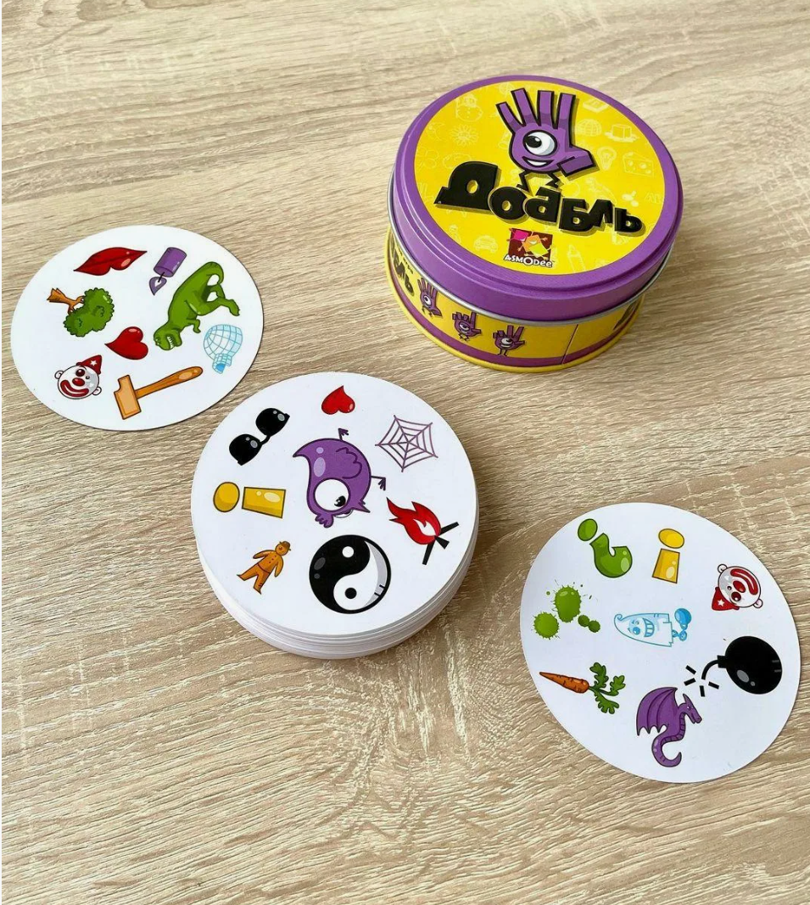
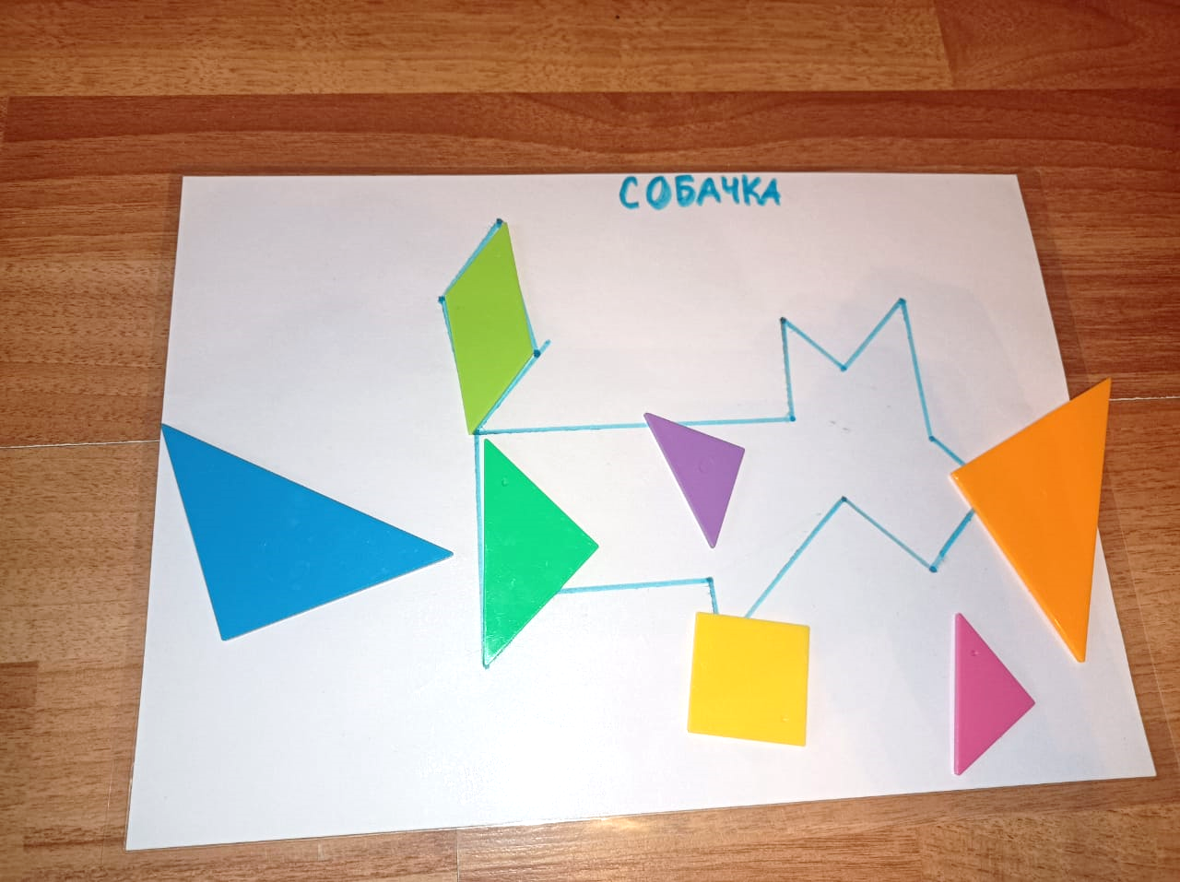
“Dobble” and “Tangram”

Slide 6
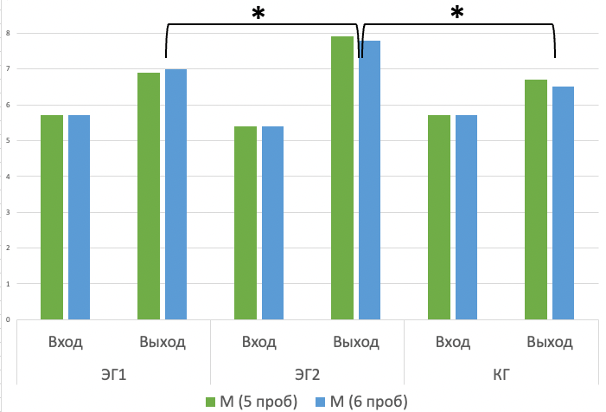
Research Results
"Learning 10 Words" (A.R. Luria)
Comparison of baseline and exit testing indicators across all groups.
The results of the comparative analysis show an effects on the development of short-term and long-term auditory memory in children who played the digital game.

Slide 7
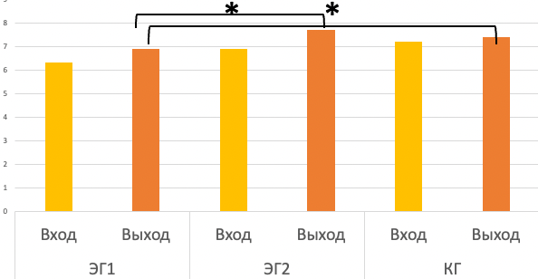
Research Results
"Dimensional Change Card Sort"
Comparison of baseline and exit testing indicators across all groups.
According to the obtained data, it is not possible to draw a conclusion about the influence of the game type on the development of cognitive flexibility.

Slide 8
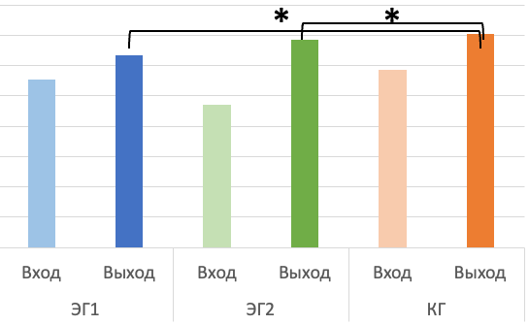
Research Results
"Raven Progressive Matrices"
Comparison of baseline and exit testing indicators across all groups.
The CG indicators at the exit testing stage are significantly higher than in EG1 and EG2. At the same time, no differences were found between EG1 and EG2.

Slide 9
Results of the Study
Relationship Between Intelligence Indicators and Regulatory Function Indicators
A significant medium direct correlation was found both at the entry and exit between the indicators of abstract intelligence (Raven Progressive Matrices) and cognitive flexibility indicators (Dimensional Change Card Sort) (α<0.001, Spearman's coefficient at entry r=0.4 and at exit r=0.5).

Slide 10
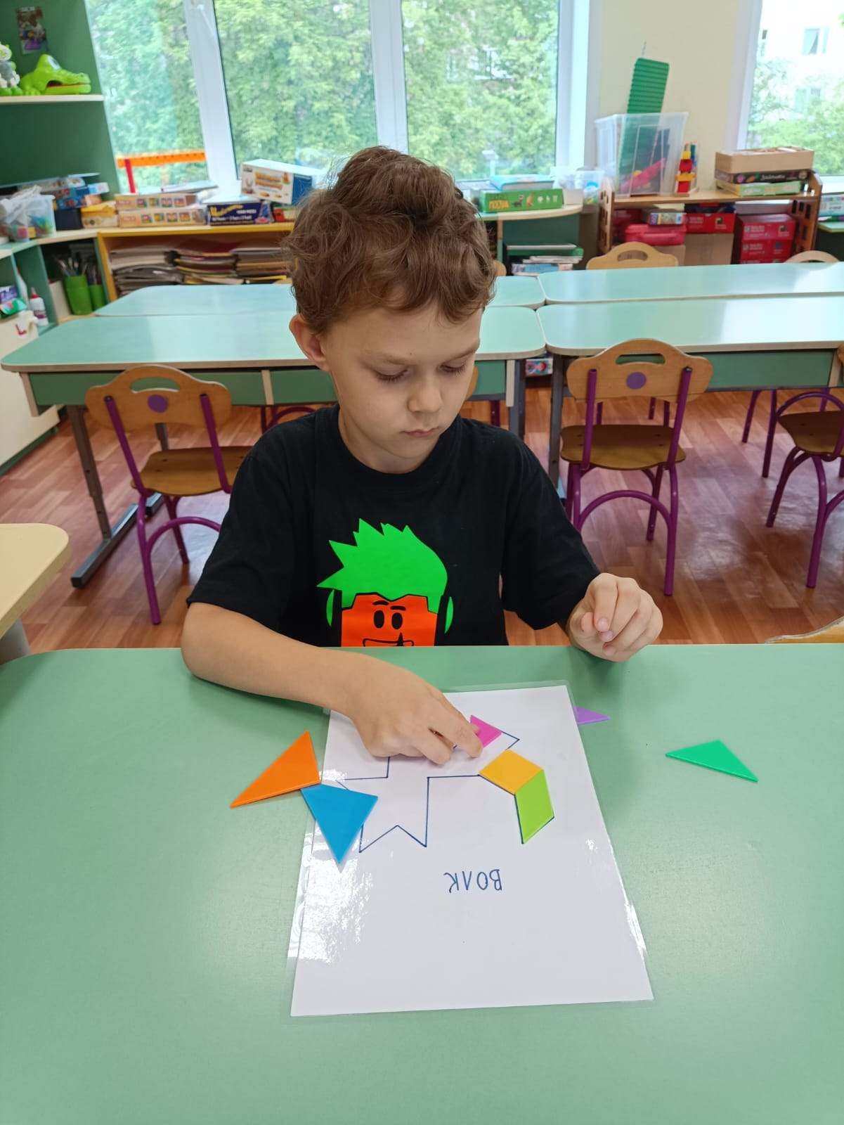
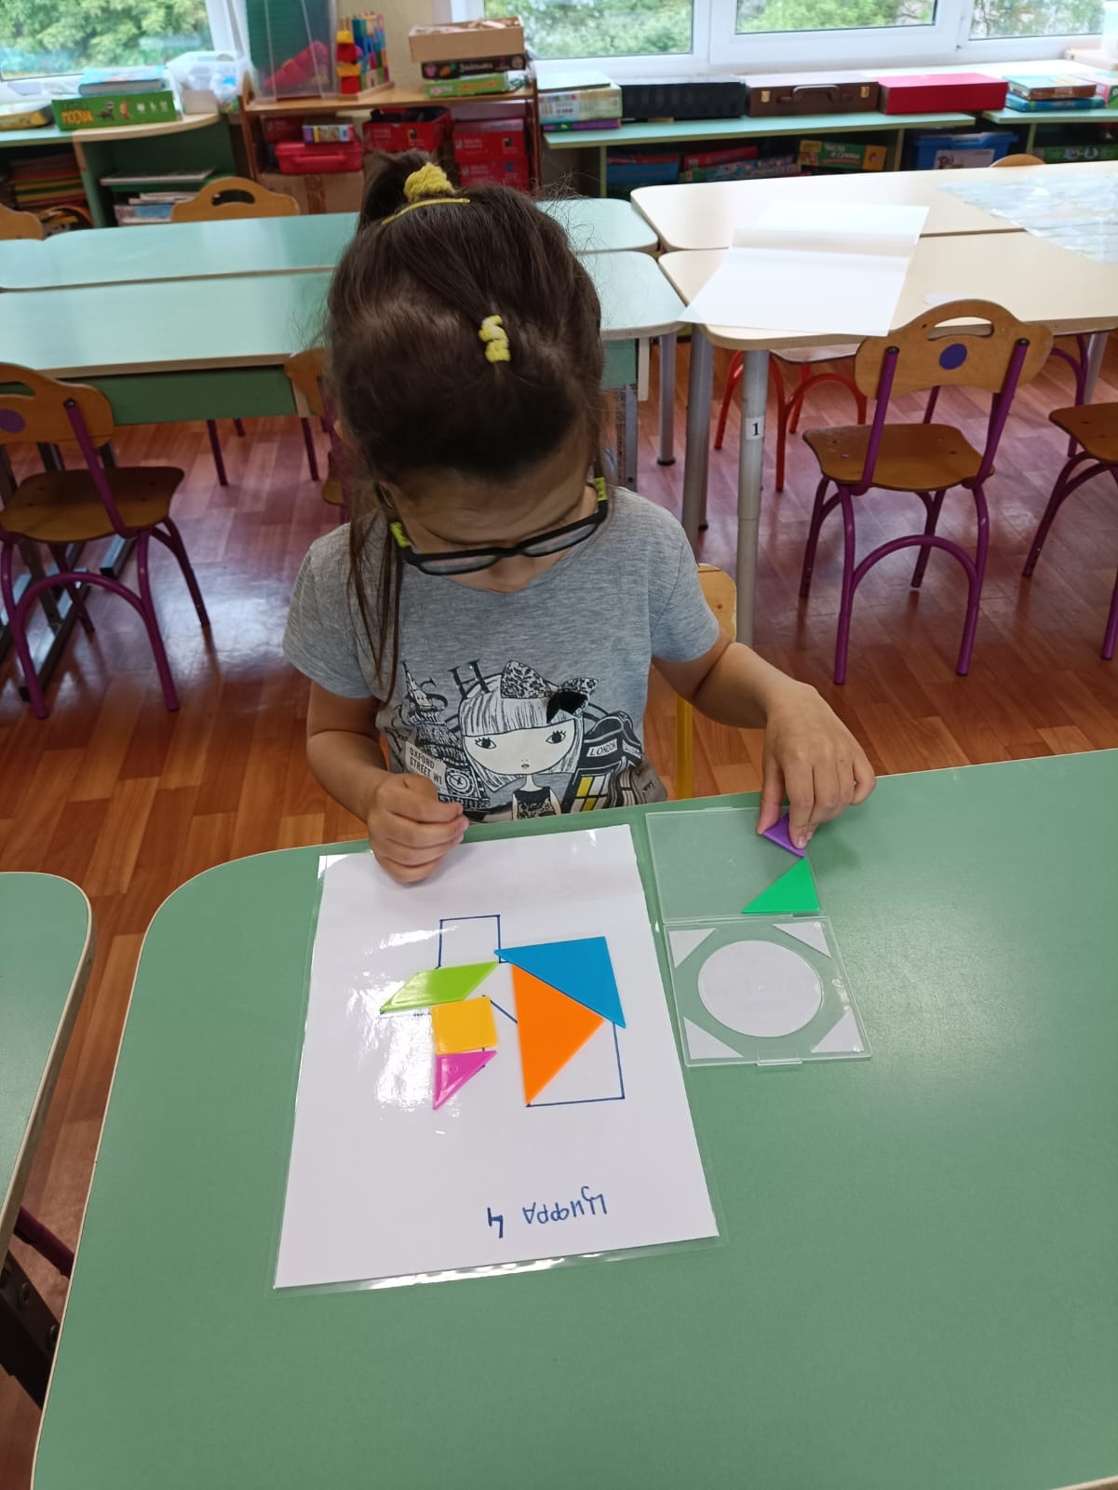
Results of the Study
Gender Differences
Gender differences were found only in the results of the "10 Words" methodology
When comparing data from entry and exit testing, both boys and girls significantly increased their results with α<0.001 each. However, the scores in the girls' group became significantly higher compared to the boys in two indicators: "average of 5 trials" (α=0.049<0.05) and "average of 5 trials plus delayed time" (α=0.047<0.05)

Slide 11
Conclusions
The results of the comparative analysis show significant effects in the experimental group children who played the digital version of the board game,
in the development of short-term and long-term auditory memory
as well as
high degree of stability of voluntary attention,
a high pace of activity,
and more effective memorization and reproduction of visual stimuli.
However, no connection was found
between the development of cognitive flexibility indicators and the type of game used;
between abstract intelligence and the type of game used.

Slide 12
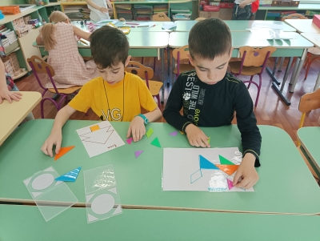
Conclusions
A direct relationship was identified between abstract intelligence and the level of cognitive flexibility development: the higher the intellectual abilities, the greater the attention-switching ability in children aged 6-7 years
Girls aged 6-7 demonstrated better reproduction scores on the auditory memory test compared to boys

Slide 13
Board Games VS Digital Games: What is More Beneficial for Preschoolers?
In the short term, digital analogs of board games have a more positive impact on the formation of various types of memory and attention than traditional printed versions

Slide 14
Brief recommendations on the use of digital and board games for the development of preschoolers.
During developmental activities in kindergarten and at home, it is recommended to use both traditional board games and their digital counterparts.
Digital versions of board games can be used for faster program acquisition, as in the short term, digital games have a greater impact on the development of cognitive processes in preschoolers.
It is not recommended to leave a child alone with a digital device. Digital games, like board games, can serve as a platform for supporting and strengthening parent-child interaction.
It is important to limit a preschooler's digital playtime to no more than 15 minutes per day.

Slide 15
Публикации
Tokarchuk Yu.A., Salomatova O.V., Gavrilova E.V. The Use of Board Games and Digital Games by Preschoolers: Results of a Survey of Russian Parents. Psikhologopedagogicheskie issledovaniya = Psychological-Educational Studies, 2024. Vol. 16, no. 1, pp. 76–95. DOI:10.17759/psyedu.2024160105 (In Russ.).
Rubtsova O.V., Tokarchuk Yu.A., Salomatova O.V., Gavrilova E.V. Association between Memory and Attention Performance among Preschoolers Playing Traditional and Digital Games (on the Example of “Dobble”). Psikhologicheskaya nauka i obrazovanie = Psychological Science and Education, 2024. Vol. 29, no. 3, pp. 5—19. DOI: https://doi.org/https://doi.org/10.17759/pse.2024290301 (In Russ.).
Salomatova O.V., Tokarchuk Yu.A., Rubtsova O.V., Khusnutdinova M.R. Application of Digital and Board Games for Cognitive Development of Preschoolers: Recommendations for Teachers and Parents. Konsul’tativnaya psikhologiya i psikhoterapiya = Counseling Psychology and Psychotherapy, 2024. Vol. 32, no. 4, pp. 53—72. DOI: https://doi.org/10.17759/cpp.2024320403 (In Russ.).

Slide 16
Thank you for your attention!

