Slide 1
Psychological well-being and mental health of adolescents
Svetlana V. Persiyantseva
Phd, Associate Professor of the Department of General Psychology
Psychological Institute of the Russian Academy of Education
Russian State University for the Humanities

Slide 2
Problem and purpose of the study
Demographic, socio-cultural, technological information and communication changes in the country affect the mental state of young people, their emotional and psychological state, as well as the degree of their social adaptation and self-realization. The study and understanding of the mechanisms that affect the psychological well-being and mental health of young people in a transitive society is a key and urgent task for modern psychology.
The purpose of the study is to study the factors affecting the psychological well-being, life satisfaction and mental health of young people.

Slide 3
Methods
Ryff Scales of Psychological Well-Being Scales;
Satisfaction with life scale (SWLS);
WHO5 (P. Beck);
Multiple stimulus types ambiguity tolerance scale-I (MSTAT);
Hardiness Survey (S. Maddi);
General self-efficacy scale (R. Schwarzer);
Self-control scale (Tangney, Baumeister, Boone);
Test of meaningful life orientations (D. A. Leontiev);
Educational Needs Questionnaire (N.V. Khodyakova).

Slide 4
Participants
II Stage
I Stage
N = 57 students:
1st - 2nd year
M = 17,79; SD = 0,41
range = 17–18 years
2018 | 2023
N = 29 students: 1st - 2nd year | N = 51 students: 1st - 2nd year
range = 17–18 years

Slide 5
Results
psychological well-being | resilience |  | meaningful life orientations |  | self-efficacy |  | self-control |  | tolerance
 | Mean | SD | Mean | SD | Mean | SD | Mean | SD | Mean | SD
Mean 61,13 SD=1,38 | 44,33↑ | 1,8 | 103,7↑ | 2,6 | 30,17↑ | 0,6 | 40,36↑ | 1,9 | 94,66↑ | 2,3
Mann–Whitney U test | p<0,001 |  | p<0,001 |  | p<0,01 |  | p<0,05 |  | p<0,05

Slide 6
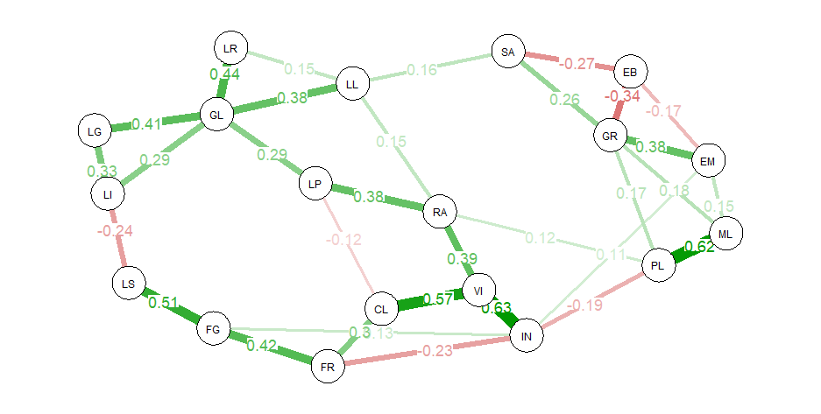
The method of constructing regularized networks of correlations glass

Slide 7
The purpose of training

Slide 8
Content and teaching methods

Slide 9
The type of teacher and the role of the learner

Slide 10
PRINCIPAL FINDINGS…
Adolescents with psychological well-being and mental health are self-confident. They are convinced that their activities can change the situation for the better. They adhere to the principle "There are no failures, there is only experience." They have life goals and meaning in life. They are able to control their lives, freely make decisions, set goals and implement them in life. They believe that their life is interesting and emotionally rich.
The educational needs of modern students are associated with educational and subject activities, with the need to implement their own projects. In 2018, students are more focused on traditional learning and constructive communication with the subjects of the educational process.

Slide 11
THANK YOU Svetlana V. Persiyantseva perssvetlana@yandex.ru

