Slide 1
Psychological features of risky Internet behavior of adolescents
Southern Federal University
Academy of Psychology and Pedagogy
Pankratova Irina Anatolyevna,
PhD in Psychology,
Associate Professor, Southern Federal University
Rostov-on-Don
2022

Slide 2
The purpose of our study was to study the psychological characteristics of the risky Internet behavior of adolescents. Our study involved 60 schoolchildren aged 10-14, who were subsequently divided into groups by gender.
Notes:
Термин «burnout»- «выгорание», предложил Г. Фрейденбергер (H. Freundenberger) в 1974 году для описания деморализации, разочарования и крайней усталости, наблюдаемых у специалистов, работающих в системе профессий «человек-человек».

Slide 3
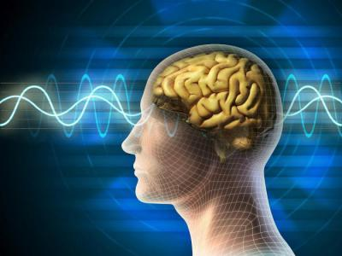
Research methods
questionnaire "Level of computer game addiction" O.M. Vidov;
methodology "Indicator of coping strategies";
Kimberly-Young test for internet addiction.

Slide 4
The results of the analysis of computer gaming addiction
 | low | medium | high
Escape from reality | 48% | 32% | 20%
Social maladaptation | 13% | 27% | 60%
Acting out emotions | 45% | 35% | 20%
The pursuit of learning in the game | 33% | 20% | 47%
Addiction to computer games | 20% | 37% | 43%
Total indicator | 23% | 33% | 43%
Notes:
Существует три вида лжи: ложь, наглая ложь и статистика… М. Твен

Slide 5
Internet Addiction Indicators

Slide 6
Results of analysis of coping strategies
 | very low | low | medium | high
Problem resolution | 31% | 8% | 61% | 0%
Seeking Social Support | 33% | 12% | 55% | 0%
Avoiding Problems | 29% | 29% | 31% | 10%

Slide 7
Correlations between the components of game computer addiction and coping strategies

Slide 8
Thank you for attention!

