Slide 1
The development of Adolescent's Subjectivity in a Digital Environment
Arseny Dzhanashia
Mogilev State A. Kuleshov University
2023

Slide 2
Development of digital technologies and AI
In addition to all the obvious advantages...
Minimize direct contact with the other person

Slide 3
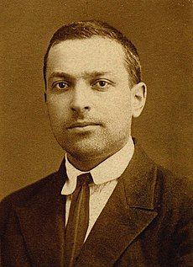
Human development during childhood
Speech is a tool for mastering one's own affects (feelings), behavior and activity (L.S. Vygotsky)

Slide 4
Comparative research
1 episode
2007, N=157, age 14.75±0.05
Methods: MMI, UVSV, USK, VSK
2 episode
2020, N=315, age 14.89±0.05 years
Methods: MMI, UVSV, USK, VSK

Slide 5
Observation
Difficulties in formulating intentions and goals
Difficulties in explaining the reasons for successes and failures
Difficulties in the perception and presentation of written text

Slide 6
Content Visualization Trends
Consequences:
- Minimal use of speech
- Decline in reading fluency and comprehension tongue-tied
Difficulties in reflecting one's own feelings, desires, intentions
Problems with volitional regulation

Slide 7
Adult and adolescent
Problem: How is knowledge and experience transferred?
Cooperation between an adult and a teenager in the implementation of their intention to engage in self-education is possible under the following conditions:
- independence of intentions and goals of a teenager
- understanding the specificity of self-education as an activity
- reliance on the features of age

Slide 8
Thank you!
dzhanashia@msu.by

