Slide 1
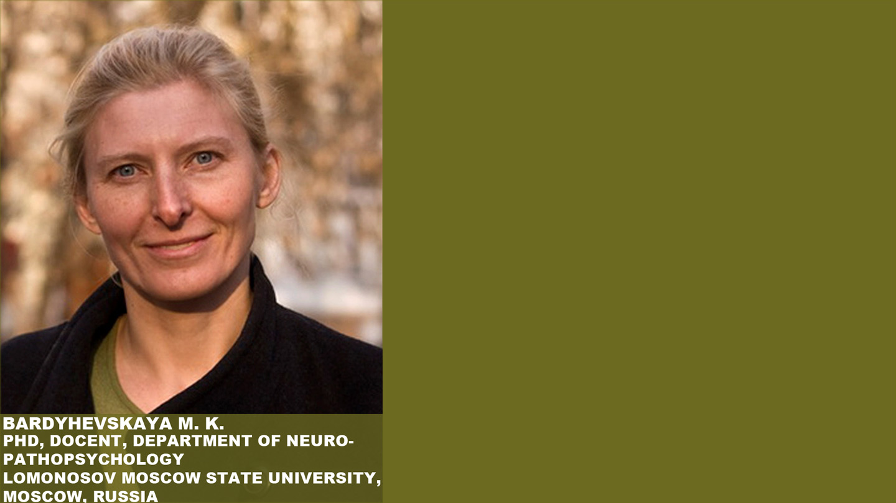
Work with video recordings
of psychic development
in professional training of clinical psychologists

Slide 2
The differences of professional video recording in child clinical psychology from family or amateur one
Professional video suitable for lectures
Amateur video
Focus on wide spectrum of changes and development
Different modes of contact with a child during the session
The material can be assessed quantitatively and qualitatively according to the model
Focus on the event
Accent on a child’s dominant state
A motive of recording – imprinting for the memory or for sharing an experience or to prove an idea
The video material is expected to be assessed by anyone using emoji (like/dislike)

Slide 4
Notes:
Почему начала изучать развитие? Чтобы доказать, что его можно запустить, показать это на видео и даже представить количественно.

Slide 5
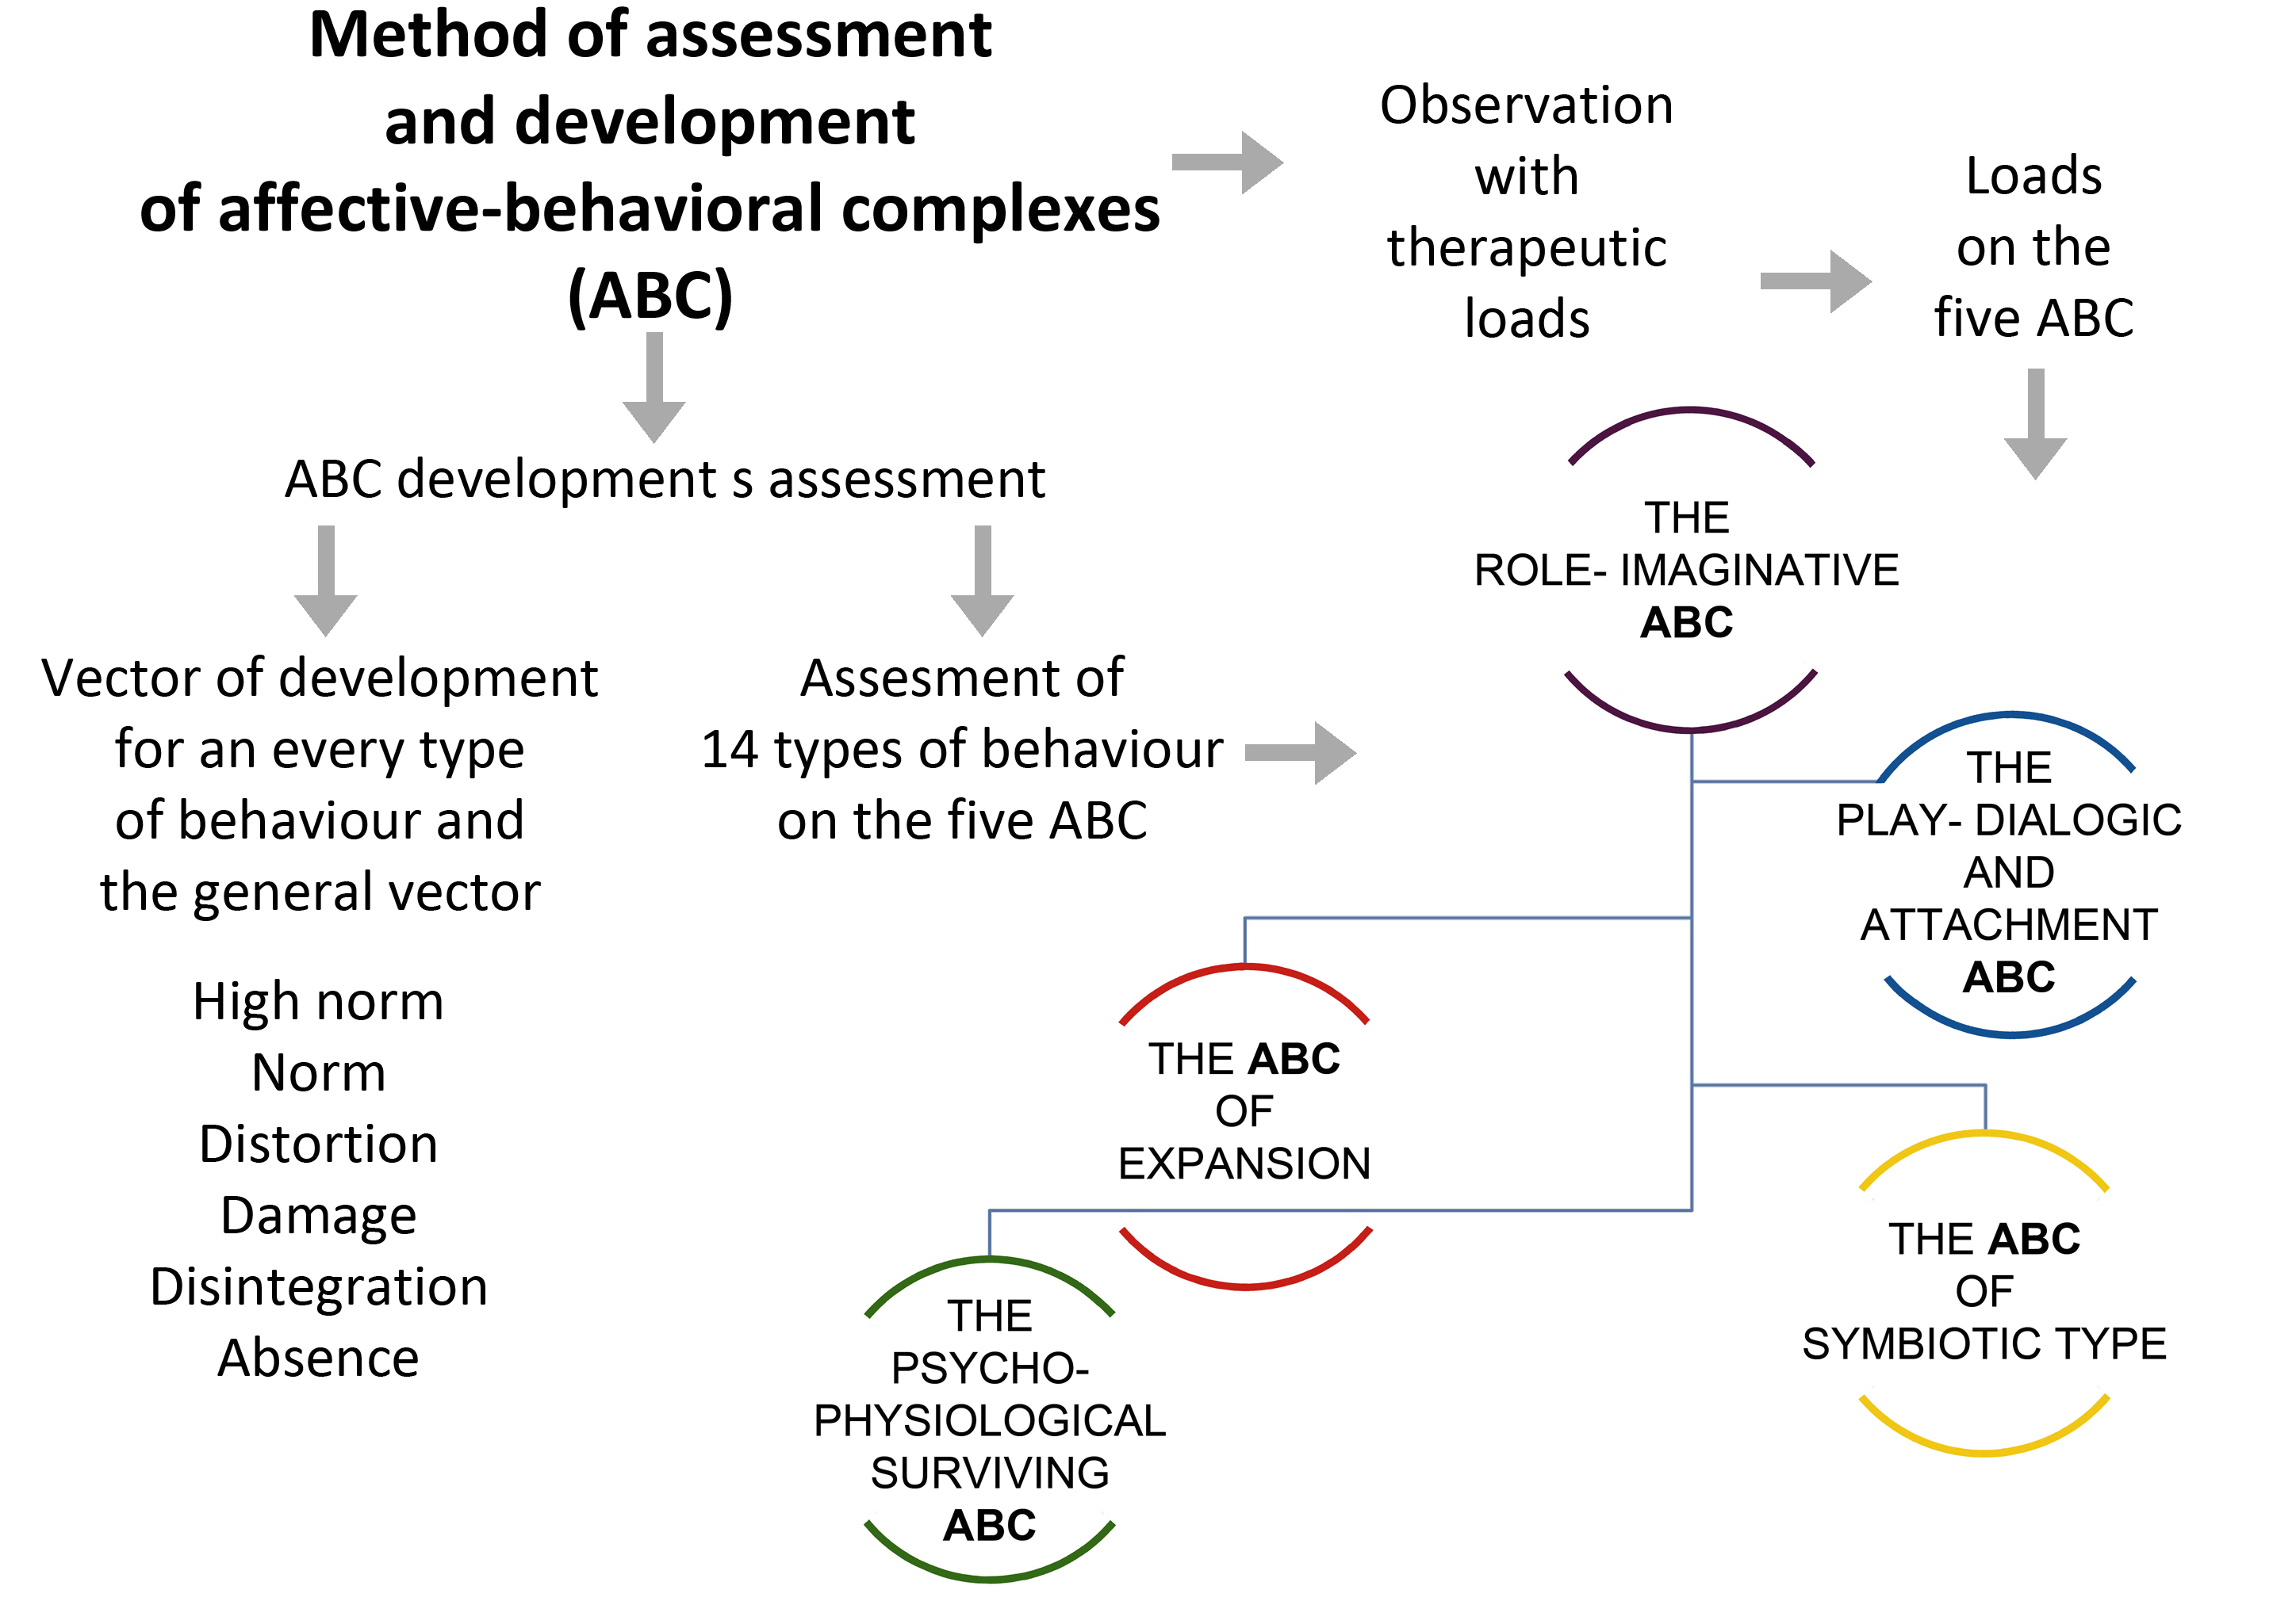

Slide 6
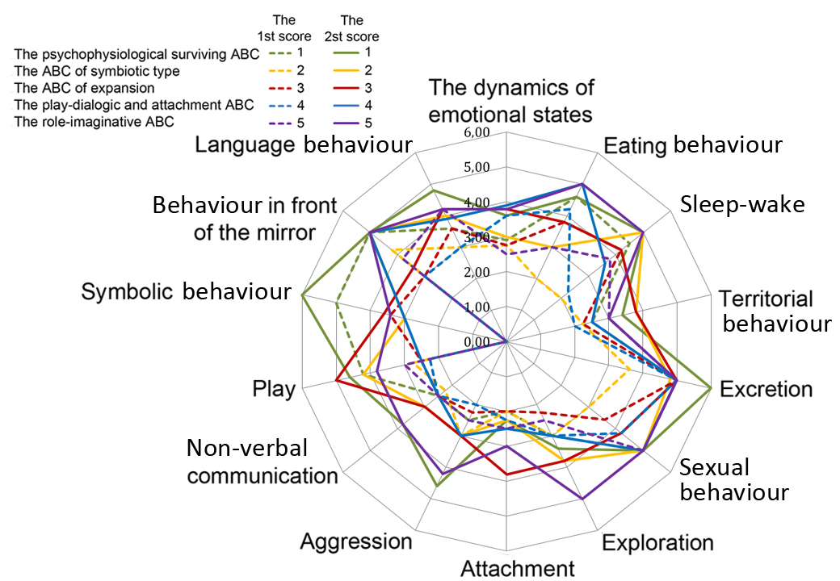

Slide 7
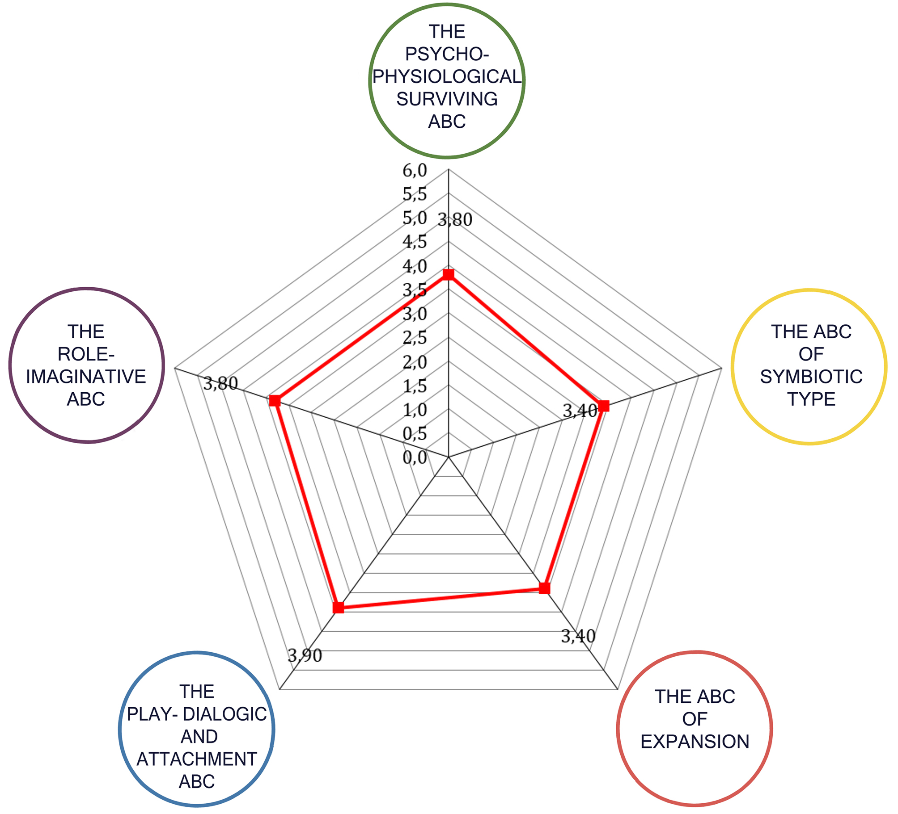
Profiles of psychic development (according to 5 affective-behavioural complexes) in children with autistic spectrum disorders
Notes:
Оценки по 5 АПК

Slide 8
Video recording of diagnostic sessions with therapeutic impacts
Tradition: hard structure
Therapeutic assessment: dynamics and flexible structure
The different child’s motives are revealed: from the basic to more cultural
The more open position of psychologist
The new forms of the child’s behaviour and emotional states are encouraged
Transitions between different vectors of development are shown
The causes of rejection of the development are clearly observed
The optimal therapeutic loads are chosen
The child’s motive is examination
A closed position of a psychologist
The structure of defect is in a focus
One main type of disonthogenesis is defined
The causes of developmental disorders remain in the shadows
The conclusion is made for the psychiatrist

Slide 9
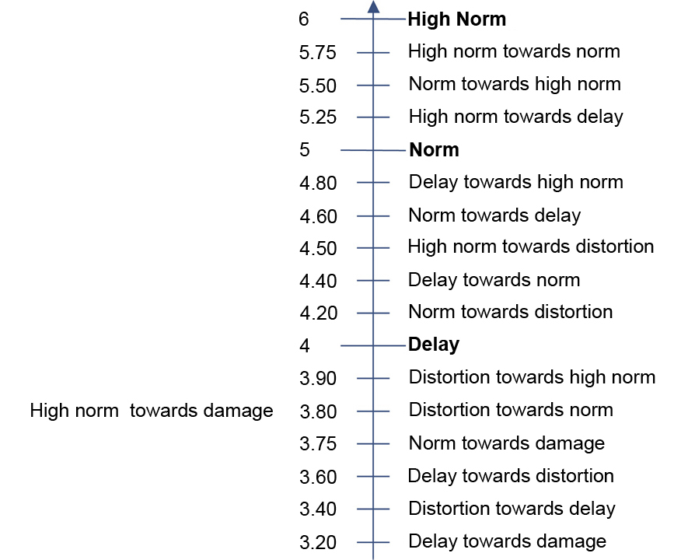
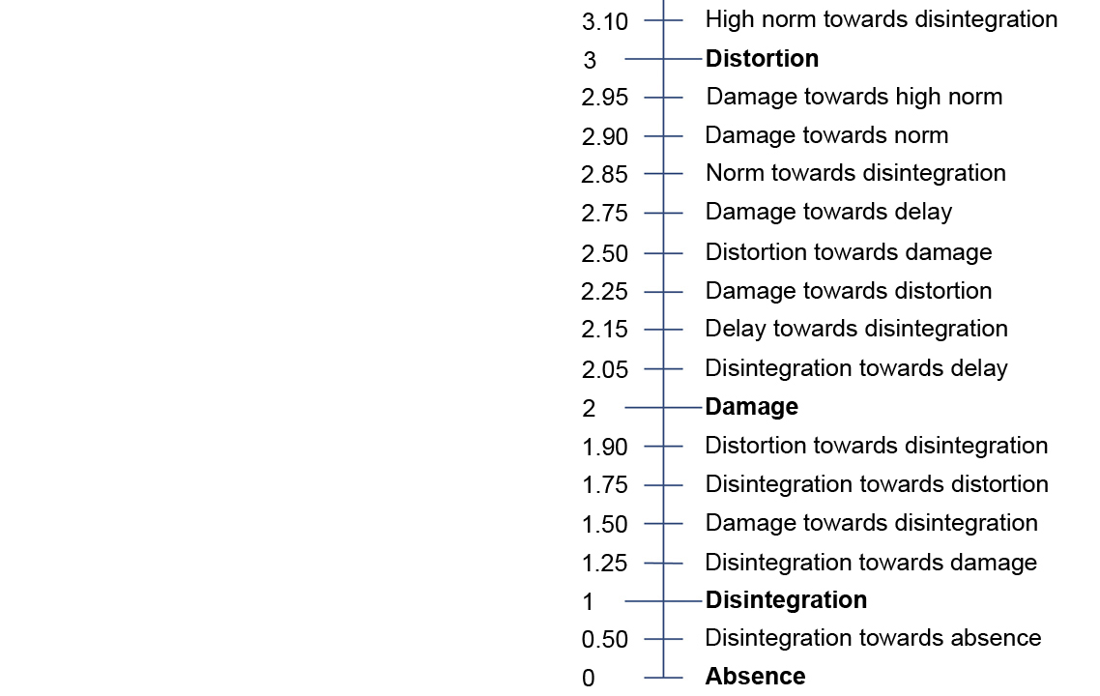

Slide 10
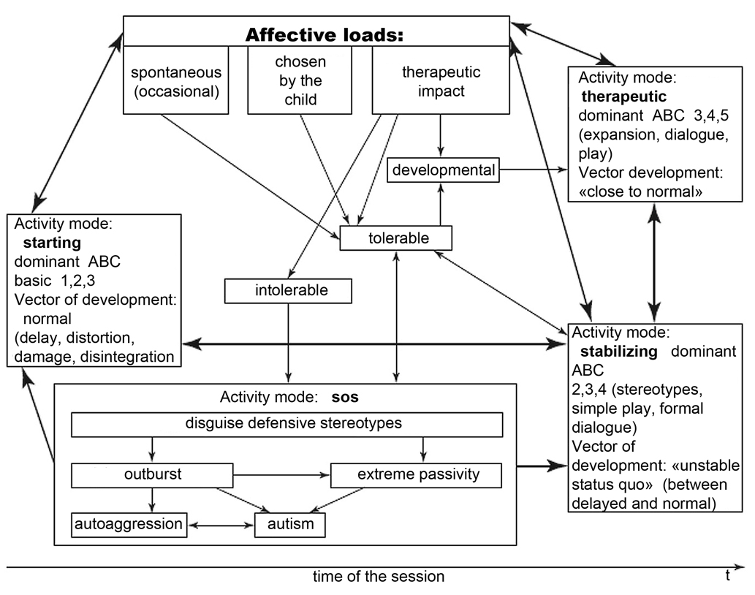

Slide 11
Express assessment of motives of development on dynamics of non-verbal communication with an operator: from rejection through expansion to open contact. The boy of 5 years old.
Notes:
От АПК психофизиологического выживания к АПК игровому-диалогическому и привязанности и АПК образно-ролевому.
От искажения к задержке.

Slide 12
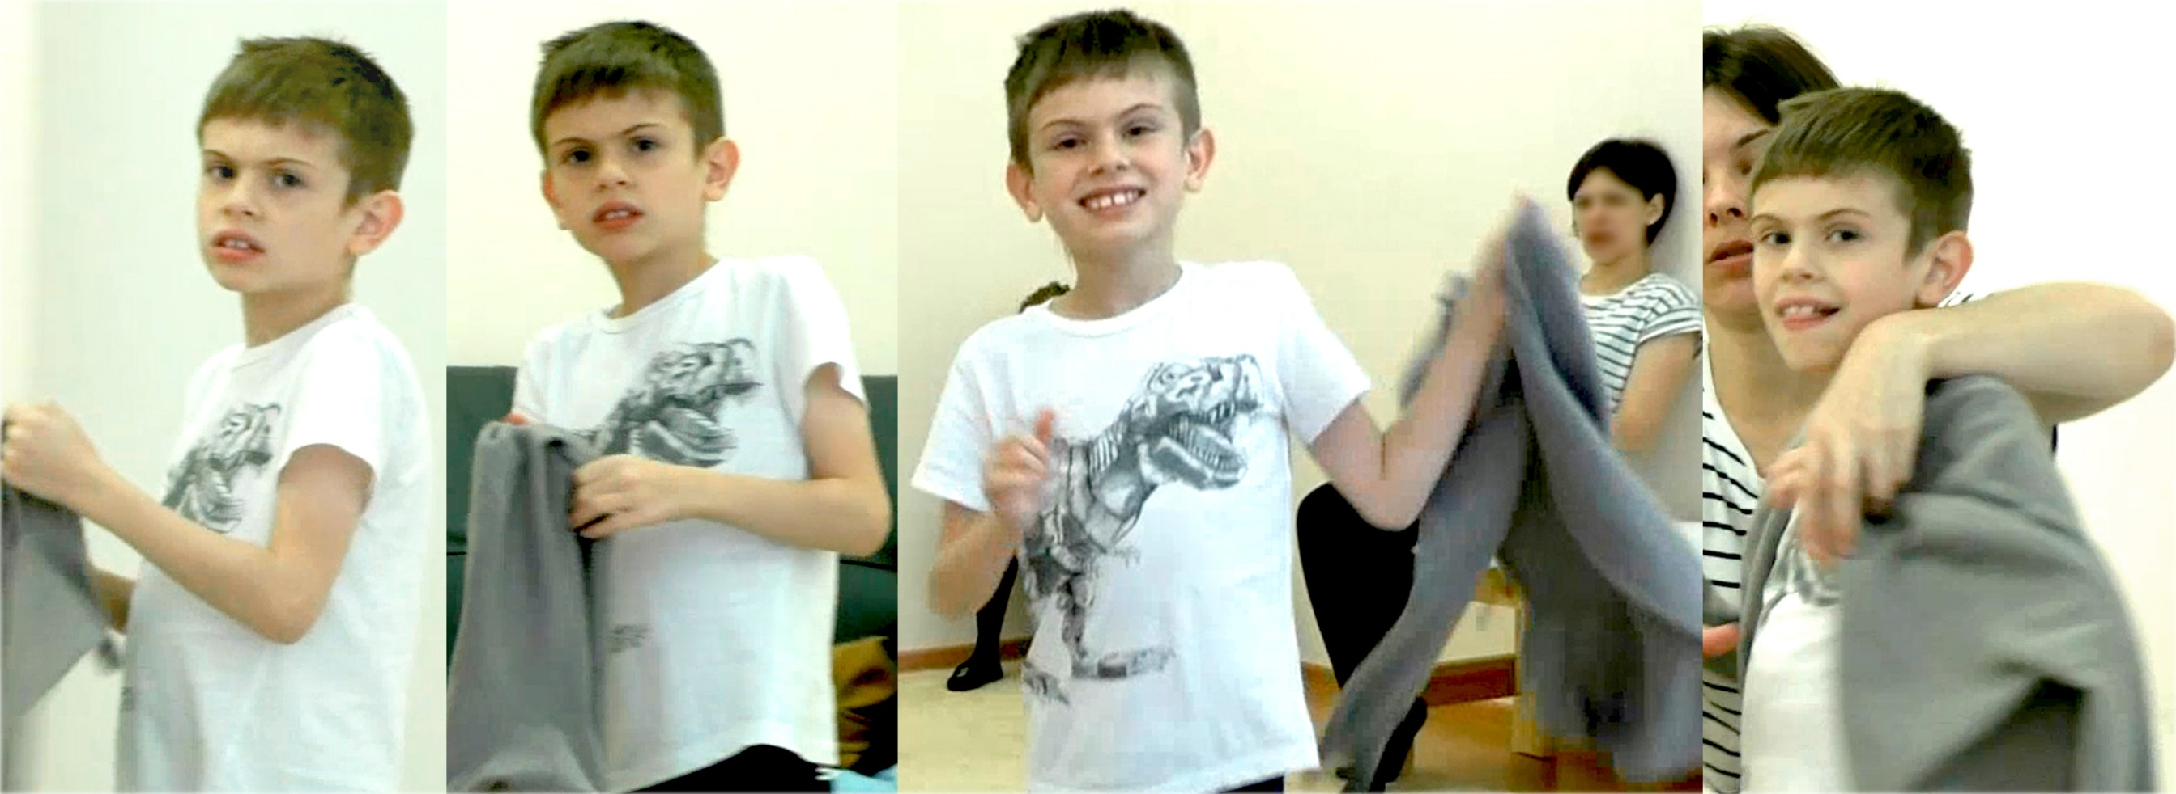
Express assessment on the dynamics of non-verbal communication with an operator: from damage to delay. The boy of 9 years old.
Notes:
От АПК симбиотического к АПК экспансии, АПК игровому-диалогическому и АПК образно-ролевому.
От повреждения к задержке.

Slide 13
Academic disciplines and types of work with child development videos
Academic disciplines
Work with video
Basic courses:
1. Disorders of mental development in children.
2. Emotional and personal disorders in children and adolescents
3. Clinical and psychological studies of early development
4. Professional supervision of child clinical psychology
Additional education and advanced training courses:
1. Disorders of the development of emotions and behavior:
2. Assessment and psychotherapy of children with autism and emotional disorders.
3. Psychological assistance to children with aggression and behavioral disorders.
Illustrations of dysontogenesis’ variants and transitions between them
Analysis of the cause of violations (in case of instability of behavior or function)
Detailed clinical and psychological analyses of individual sessions and their series
Videos as tests
Independent work of students – collection of video materials on early development and narrow topics

Slide 14
Examples of students' theses based on the collection and analysis of video recordings
Interaction and features of contact between mоther and child in a sample of a conditional norm (in different social levels)
Features of communication between mother and child with autistic spectrum disorders during meals
Non-verbal communication in children with emotional disorders
Dynamics of a child’s behaviour during an interview with his mother about features of his early development
Diagnostic criteria for the regulation of emotions in children of 3-5 years old

