Slide 1
The Effectiveness of VR-based Exposure Therapy on Test Anxiety among High School Students
Zhuoran Si, Kudunige Kuerban, Zhimeng Wang, Xinran Jia, Guangxin Wang
May 2th,2022

Slide 2
CONTENTS
01
02
03
BACKGROUND
REVIEW
STUDY
04
05
CONCLUSION
PROSPECT

Slide 3
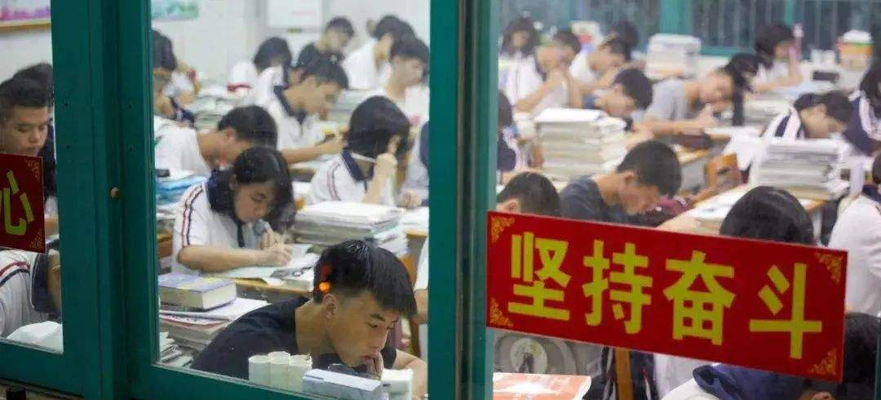
1 BACKGROUND
Nationwide Unified Examination for Admissions to General Universities and Colleges
High Test Anxiety(HTA) Rate ＆ Extent
Detection rate :15%-22% (Thomas,Cassady,& Finch, 2017)

Slide 4
2 REVIEW
The different stages of test anxiety
Before the Test
Worry about the upcoming examination
Distracted by test environment
Test Anxiety
During the Test
Experience physiological symptoms
After the Test
Fear of possible failure or negative evaluation

Slide 5
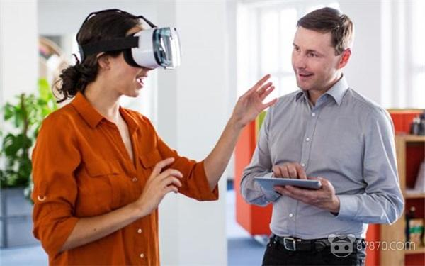
2 REVIEW
Benefits of Virtual Reality Exposure Therapy(VRET)
Immersion
Interaction
Sense of presence
Safety
Controllability ＆ Flexibility
Able to present a more realistic sense of excitement，users can interact with and immerse themselves in the environment.
Complete control over the quality, frequency and intensity of exposure.
VRET has shown effectiveness in treating anxiety, eating disorders, post-traumatic stress disorder, etc.
VRET has great potential in relieving the test anxiety.

Slide 6
2 REVIEW
Problems of existing VRET in Test Anxiety
Innovation of the paper
Treatment effect of VERT in HTA
Previous studies have confirmed the effectiveness of VRET in stimulating HTA in students, but less explored the effectiveness of treatment.
The different stages of test anxiety
Early research conceptualized test anxiety as an unidimensional construct. No study has examined the effectiveness of VRET in the different stages of TA.
The present study investigated the effect of VRET on different stages of high test anxiety, and compared it with gold standard-imaginary exposure therapy.

Slide 7
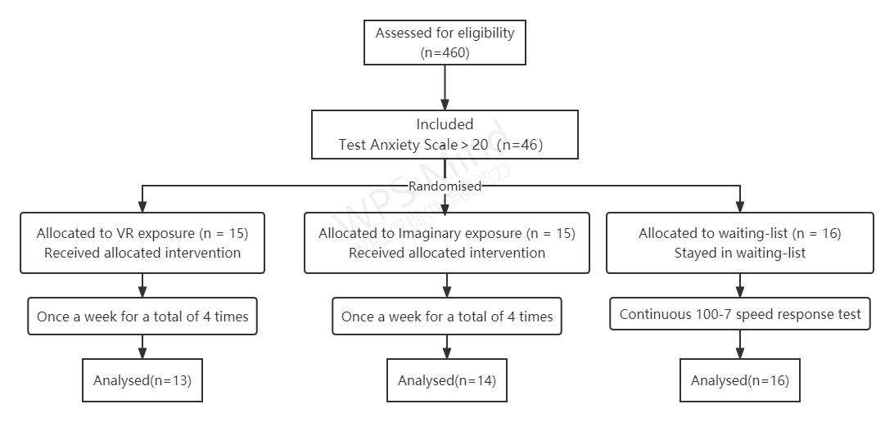
3 STUDY - Experimental Design
Participants[1]: were recruited at Beijing Hongzhi Middle School.
Group: VR exposure, Imaginary exposure, waiting list
Experimental design :Randomized group pretest-posttest.
Time: 4 weeks, once a week with intervention, 30min.
Annotation
[1] The experimental design was approved by the Ethics Committee of the Department of Psychology, Beijing Forestry

Slide 8
3 STUDY - Method
Materials and Instruments
Test Anxiety Scale (TAS)[1]
Subjective Units of Distress(SUD)
Test Context Anxiety Scale
Fear of Negative Evaluation(FNE)
General Self-Efficacy Scale(GSES)
VR equipments: HTC VIVIE Pro Eye
General Summary Indicators
pre-test
Anxiety before the test
mid-test
Anxiety during the test
Anxiety after the test
Annotation
[1] High test anxiety: the scores on the Test Anxiety Scale were ≥20

Slide 9
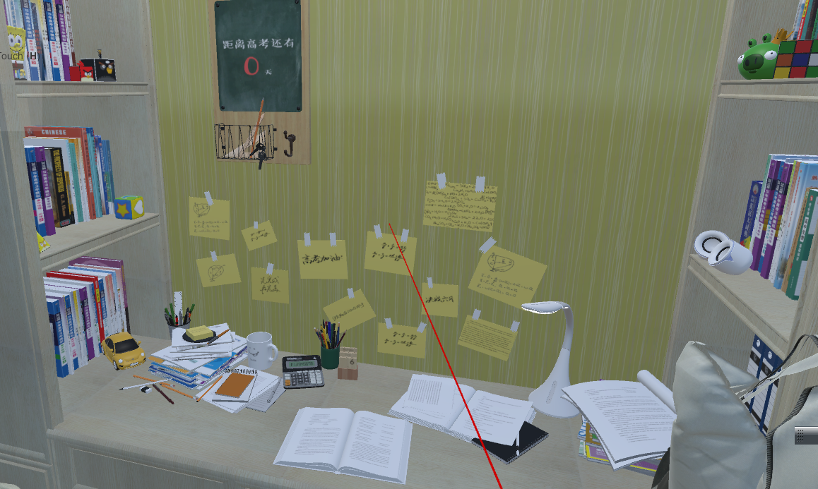
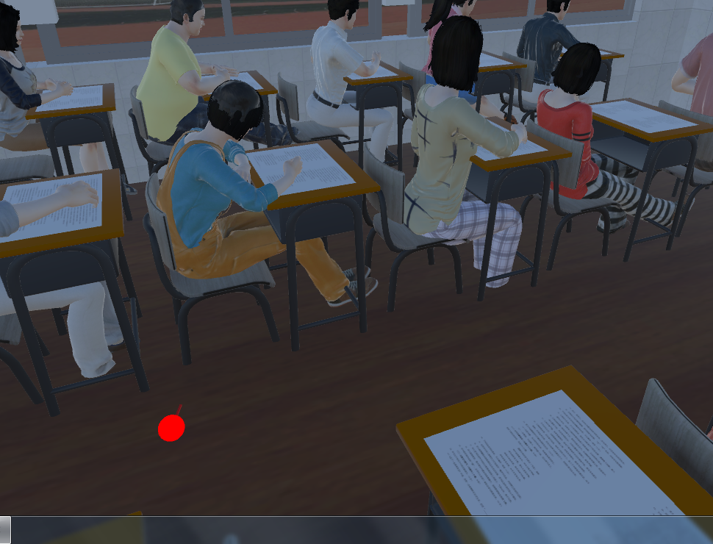
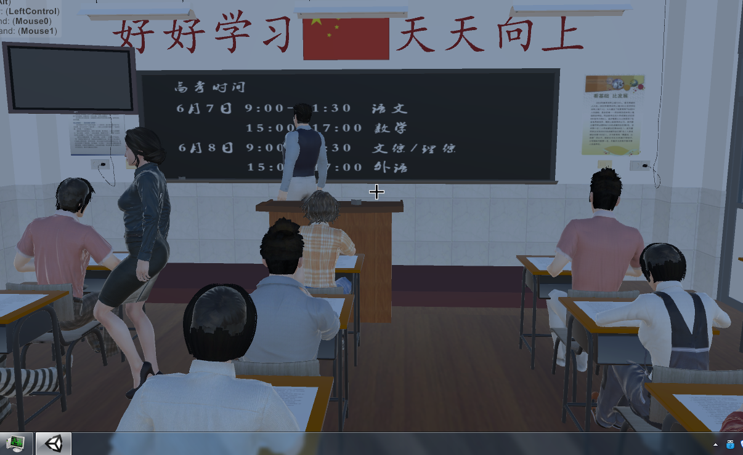
3 STUDY - VR Scenarios
Home Scenes(Before test)
Test Scenes
A bedroom, a table and textbooks.
A countdown sign for the exam.
The waiting scene
Students surrounded by other students talking about the subject, the exam and how they prepared for it.
The exam scene
Teacher announces at start of the exam and the exam ends in 30, 15, and 5 minutes.
Teacher patrolling the exam room.
Irregular and intermittent insertion of the sound of students turning over their papers.
[1]<Virtual Examination System> was jointly developed by the Institute of Information Technology and the Institute of Humanities of Beijing Forestry University

Slide 10
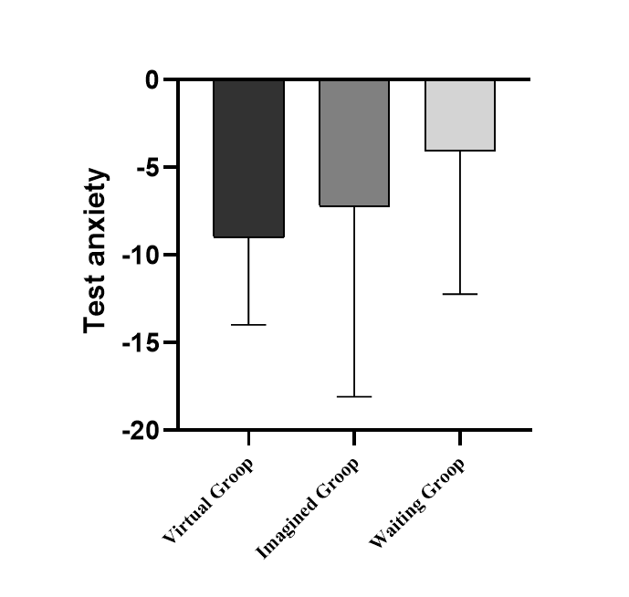
3 STUDY
Test Anxiety (General Summary Indicators)
One-way ANOVA showed that there was no between-group differnce in three groups, [F(2，39)=1.23，p＞0.05，partial η²=0.06].
However, Paired samples t test showed that VR exposure group had higher decline in test anxiety scores. VR group [t(11)=6.27，p＜0.001，d=2.34]; Imaginary exposure group [t(13)=2.49，p＜0.05，d=1.08]; waiting list [t(15)=1.99，p＞0.05，d=0.69].

Slide 11
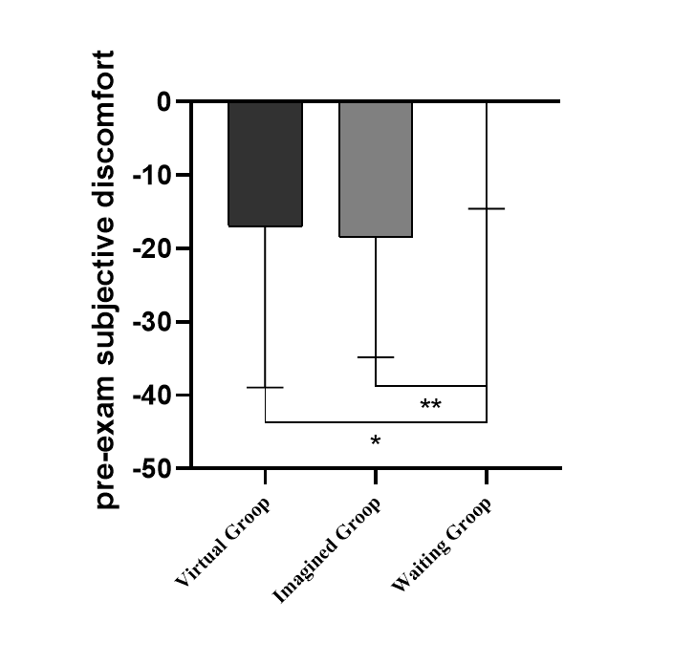
3 STUDY
Test Anxiety (Before the test) - Pre-test Subjective Units of Distress
One-way ANOVA showed differnces in three groups, F(2，42)=5.30，p＜0.01，partial η²=0.20. Both the VR and imaginary groups had significantly higher values of change in pre-test subjective units of distress scores than the waiting list.
Paired samples t-test showed significant differences between pre- and post-tests both in VR group [t(12)=2.80，p＜0.01，d=0.71]and imaginary group [t(15)=4.54，p＜0.001，d=1.07]. There was no significant in waiting list [t(15)=0.04，p＞0.05，d=0.01].

Slide 12
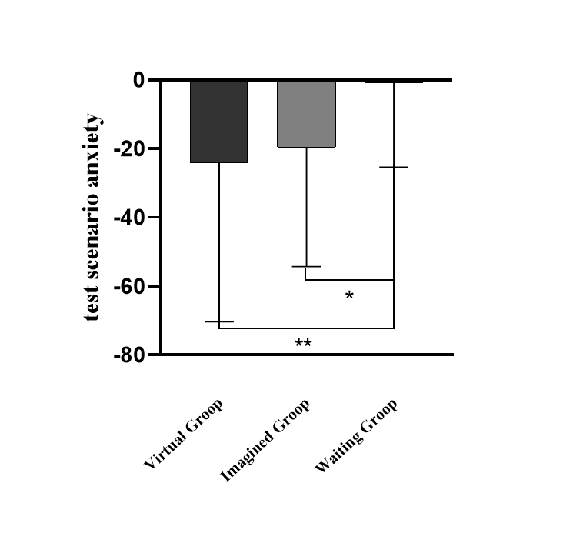
3 STUDY
Test Anxiety (During the test)
Mid-test Subjective Units of Distress
One-way ANOVA showed differnces in three groups, F(2，42)=3.36，p＜0.05，partial η²=0.14.
Paired samples t-test showed significant differences between pre- and post-tests both in VR group [t(12)=5.12，p＜0.001，d=1.12] and imaginary group [t(15)=4.98，p＜0.001，d=1.43]. There was no significant in waiting list [t(15)=1.80，p＞0.05，d=0.36].
Test Context Anxiety
One-way ANOVA showed differnces in three groups, F(2，42)=6.24，p＜0.01，partial η²=0.23.
Paired samples t-test showed significant differences between pre- and post-tests both in VR group [t(12)=4.13，p＜0.001，d=1.14] and imaginary group [t(15)=2.49，p＜0.001，d=1.11]. There was no significant in waiting list [t(15)=0.68，p＞0.05，d=0.10].

Slide 13
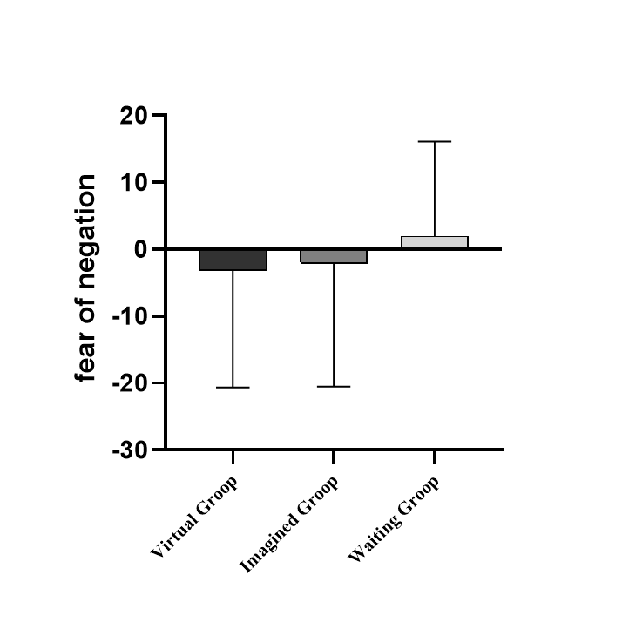
3 STUDY
Test Anxiety (After the test) - Fear of Negative Evaluation
One-way ANOVA showed that there was no between-group differnce in three groups, F(2，42)=0.39，p＞0.05，partical η²=0.018.
Paired samples t-test showed that neither group had a significant difference. Fear of negative evaluation decreased in VR [t(12)=0.65，p＞0.05，d=0.14]and imaginary groups [t(15)=0.46，p＞0.05，d=0.12], however, it increased in the waiting list [t(15)=-0.55，p＞0.05，d=-0.14].

Slide 14
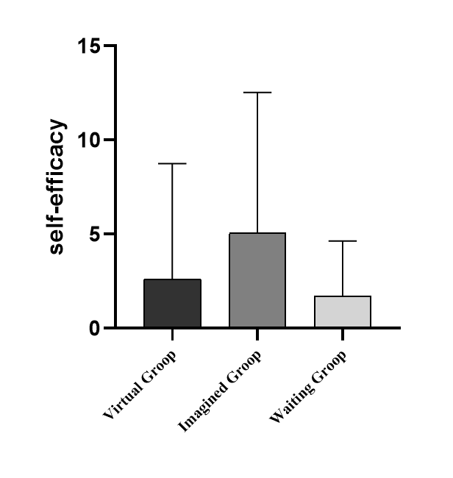
3 STUDY
General Self-Efficacy
One-way ANOVA showed that there was no between-group differnce in three groups, F(2，42)=1.43，p＞0.05，partial η²=0.06.
Paired samples t-test showed no significant difference in VR exposure group [t(12)=-1.54，p=0.15，d=-0.46], while both imaginary group [t(15)=-2.71，p＜0.05，d=-0.97] and waiting list[t(15)=-2.28，p＜0.05，d=-0.51] had a significant increase.

Slide 15
4 CONCLUSION
Testing of The Treating Effective of VRET on HTA
VR exposure and imaginary exposure were effective in evoking negative emotions and cognitions associated with test anxiety, significantly reducing test anxiety,test context anxiety and subjective distress units.
Compared to the imaginary exposure, VR exposure had greater potential to reduce test anxiety and test context anxiety but less improvement in subjective units of distress and self-efficacy. Fear of negative evaluation decreased in all groups, but neither group showed a significant difference.
VR technology allows the design of different exam scenarios to make them more relevant to real life. It can avoid the impact of individual imagination differences on the effectiveness of the treatment.
Since VRET a scenario-based technique, it has a better treatment effect on mid-test anxiety.

Slide 16
5 PROSPECT
Strengths
(1) This study is potentially the first to compare the effects of an intervention to reduce test anxiety include test context anxiety, subjective units of distress and fear of negative evaluation with VRET and imaginary exposure therapy.
(2) The age of our sample. Senior students are harder to obtain research subjects because of the high-pressure learning environment, and the study of them has unique significance.

Slide 17
5 PROSPECT
Limitations
(1) The measures of the mid-test Subjective Units of Distress(SUD) were administered after the intervention.
(2) The data of this study were based on student's self-reports.
(3)The virtual group took the Raven's Standard Progressive Matrices at the end of the intervention, while the imaginary group and waiting list did not.
Future studies
(1) Combine objective measures such as biofeedback and FMRI to collect physiological signals from students.
(2) Investigate the mechanisms of VR interventions for adolescent test anxiety more systematically in terms of emotion and cognition.

Slide 18
Acknowledgement
• Grateful for all the people and things we met in our lives
• Thanks to our academic advisors：Wang Guangxin
• Thanks to the participants：who supported our study
• Thanks to our partners : Si Zhuoran, Kudunige·Kuerban , Wang Zhimeng, Jia Xinran, Chen Guo, Li Yue
• Thanks to the platform：Department of Psychology , Career Guidance Center and Academic Affairs Office of Beijing Forestry University, Beijing Hongzhi Middle School

Slide 19
References
[1]. Liebert, R.M. and L.W. Morris, Cognitive and emotional components of test anxiety: a distinction and some initial data. Psychological Reports, 1967. 20(3): p. 975-978.
[2]. Poorman, S.G., M.L. Mastorovich and M. Gerwick, Interventions for test anxiety: How faculty can help. Teaching & Learning in Nursing, 2019. 14(3): p. 186-191.
[3]. Roos, A., et al., Test Anxiety and Physiological Arousal: A Systematic Review and Meta-Analysis. Educational Psychology Review, 2021. 33(2): p. 579-618.
[4]. Concannon, B.J., S. Esmail and M.R. Roberts, Immersive Virtual Reality for the Reduction of State Anxiety in Clinical Interview Exams: Prospective Cohort Study (Preprint). 2020.
[5]. Maples-Keller, J.L., et al., The Use of Virtual Reality Technology in the Treatment of Anxiety and Other Psychiatric Disorders. Harvard Review of Psychiatry, 2017. 25(3): p. 103-113.
[6]. Carvalho, M., R.C. Freire and A.E. Nardi, Virtual reality as a mechanism for exposure therapy. World Journal of Biological Psychiatry, 2010. 11(2_2): p. 220-230.
[7]. Gamito, P., et al., Presence, Immersion And Cybersickness Assessment Through A Test Anxiety Virtual Environment. CyberPsychology & Behavior, 2009. 12(1): p. p.99-100.
[8]. Sarason, I.G., The Test Anxiety Scale: Concept and Research. C.d.spielberger & I.g.sarason Stress & Anxiety, 1978.
[9]. Spielberger, C.D., W.D. Anton and J. Bedell, The nature and treatment of test anxiety. 2015.
[10]. Roos, A., et al., Test anxiety components: an intra-individual approach testing their control antecedents and effects on performance. Anxiety, Stress, & Coping, 2021. 34(3): p. 279-298.

Slide 20
THANKS
Zhuoran Si, Kudunige Kuerban, Zhimeng Wang, Xinran Jia, Guangxin Wang
May 2th,2022

