Slide 1
Management of the Nativ@s socio-educational project, methodology and identity
Elvira de Armas Cortés

Slide 2
Introduction
Carmona (2008, p. 32):
"The evolution of the Internet has imposed profound transformations on the cultural ecology of contemporary societies, even modifying the majority of concepts that yesterday allowed us to understand the dynamics of the communication process“.
Social immersion in the technological revolution altered:
The way we communicate
The generation of knowledge
The processing of information
Notes:
We find ourselves in a global and digital world, in which ICTs play a transcendental role and multiply the communicative possibilities of users.

Slide 3
Digital natives: The arrival of a new generation
Knows the language of the Internet, social networks, virtual dynamics, video games, mobile phones
Use these tools as their own extensions of their bodies and minds
Are capable of incorporating new initiatives into their daily routines with speed and precision, since they have multiple digital skills
In addition to consuming content generated by other users, they generate their own content and contribute to Internet
They consume less traditional media and work better connected
Notes:
Digital immigrants is an older generation that has had to make an effort to understand this new form of digital language.
These are two generations of individuals, close to each other, who speak different languages ​​online.

Slide 4
Adolescents and identity: Interaction with digital social networks.
Adolescence
Individual acquires greater emotional control.
The desire to achieve autonomy, independence and the search for new pleasurable experiences
Evidence the "adolescent crisis“
The subject's social learning at this stage of their bio-psycho-social development starts from the contexts
The group of peers and belonging to it acquires great significance during this period
Notes:
Erikson (1968)
defines identity as a nucleus in which the self is formed, in a fixed and coherent way, which allows the adolescent to interact with other individuals present in their environment.

Slide 5
Adolescents and identity: Interaction with digital social networks.
Digital social networks
The digital social networks offer them a new space for socialization
Are an extension of their world, of the group where they feel understood and with which they identify.
Transforming communication, learning and socialization

Slide 6
Cultural consumption and ICTs
Important impact on the forms of socialization, symbolic environments, consumption and identity processes, among others.
ICTs are changing various social, economic, political and cultural processes.
A new culture is generated around the use of these ICTs.

Slide 7
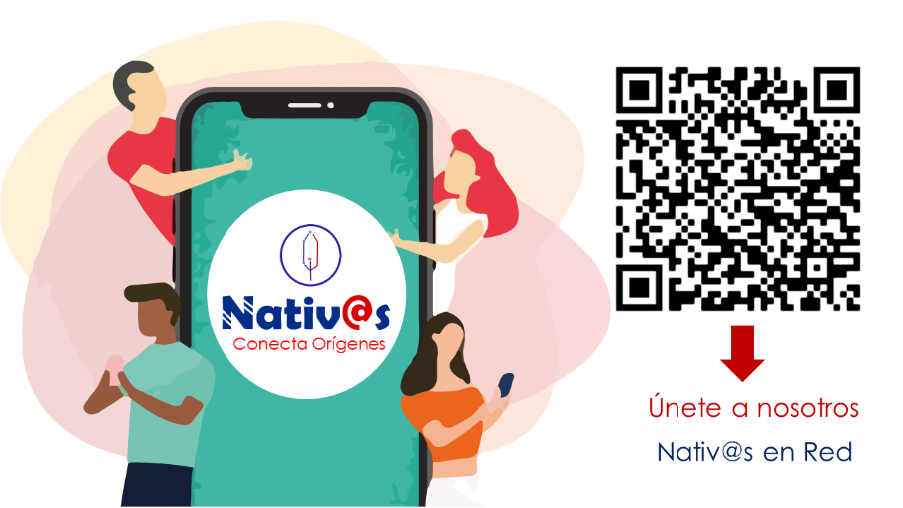
Description of the Nativ@s project

Slide 8
Description of the Nativ@s project
Nativ@s is conceived as a socio-educational network project that promotes the proper use of ICTs in adolescents. Providing knowledge and beneficial tools, through the generation-dissemination of educational and cultural content; necessary to prevent situations that affect the normal development of this age group, due to the harmful practices that arise from the new virtual environment .

Slide 9
Conclusions
The project is currently completing the gestation process, the creation of the technological conditions and carrying out the schedule for the implementation of the workshops in schools for its dissemination.
Our main mission with the adolescent community is to encourage critical analysis of the social reality of digital networks. Contribute to good consumer practices that help strengthen national identity.
Prevent victimization and risk factors for harmful behaviors that can affect the physical and mental development of adolescents.
Engage teens in creating beneficial content for their age group. Constantly approach their needs in the virtual space and communication codes.

