Slide 1
Cultural Congruence and Divergent Thinking in 13–16-Year-Old Teenagers
Ganieva Aisylu Munavirovna
Kazan - 2023

Slide 2
Theoretical basis of the study
This work is based on the research conducted by Bayanova L.F, Minyaev O.G., Daminov I.G., which indicates that normative behavior levels among teenagers differ, and the study by Shumakova N.B., which reveals that creativity in adolescents undergoes qualitative transformation over time.
The data analysis is based on the theoretical foundations of socio - cultural theories (Vygotsky L.S., Bronfenbrenner W., Bayanova L.F., Cazden K.) of the development of a creative personality (Bogoyavlenskaya D.B., Druzhinin V. N., Yurkevich V.S.).

Slide 3
Scientific research design:
Research objective: an analysis of the correlation between cultural congruence and divergent thinking in younger and older teenagers.
Empirical study sample - we presented the results of 272 students of Kazan lyceums for gifted students at the ages from 13 to 16 (M=14.21; SD=0.06). 51% of respondents were male and 49% of respondents were female. Respondents were divided into two groups: younger teenagers and older teenagers based on D.B. Elkonin's age periodization (138/134).

Slide 4
Scientific research design:
The study used reliable, adapted, and valid methods:
the methodology of L.F. Bayanova and O.G. Minyaev "Determining the Level of Cultural Congruence for Adolescents" ;
A.V. Zverkov and E.V. Eidman's questionnaire "Study of Willful Self-Regulation ";
V.I. Morosanova's questionnaire "Style of Behavior Self-Regulation";
H. Zivert’s questionnaire "Determining Creative Abilities",
F. Williams' "Test of Personality Creative Characteristics";
N.A. Baturin and E.L. Soldatova's "Diagnosis of Divergent Thinking".

Slide 5
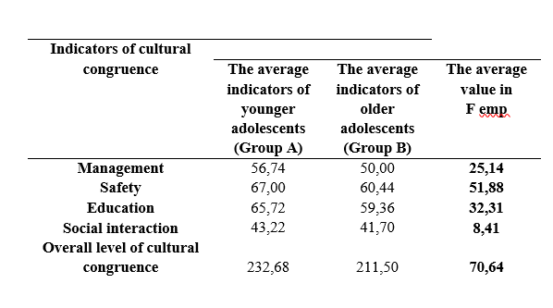
INDICATORS OF CULTURAL CONGRUENCE AMONG ADOLESCENTS
Significant differences in level of cultural congruence in adolescents in the experimental groups are highlighted in bold font (the specified level of significance is p ≤ 0.5).

Slide 6
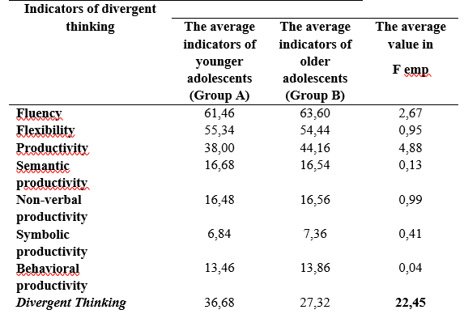
INDICATORS OF DIVERGENT THINKING DEVELOPMENT IN ADOLESCENTS
Significant differences in level of divergent thinking in adolescents in the experimental groups are highlighted in bold font (the specified level of significance is p ≤ 0.5).

Slide 7
Key findings:
The study found that younger adolescents show more cultural primitivity and highly developed divergent thinking compared to older teenagers.

Slide 8
Many thanks for Your attention
ganieva.aisylu@mail.ru

