Slide 1
Research Breakthrough Metaphors of Conceptions of Childhood
Proposal submitted by: Yeny Díaz Cortes / Psychologist
Advisor: Vanessa Acosta / PhD Candidate in Arts and Education, University of Granada – Spain.

Slide 2
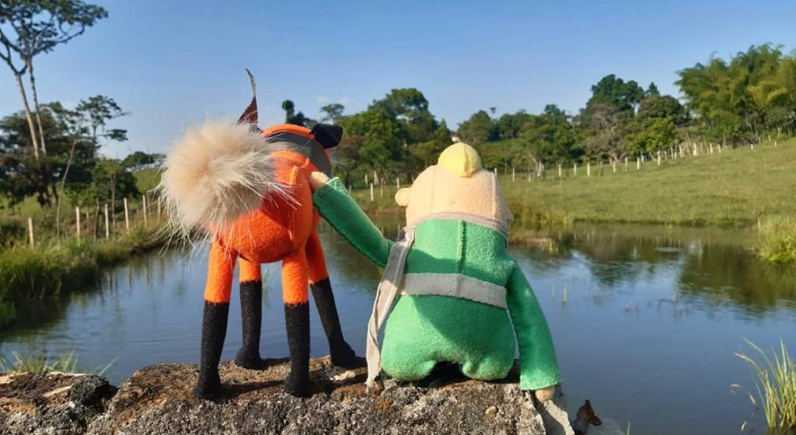
Childhood from childhood.
Metaphors in the narratives of children and adolescents from a protection boarding school in Medellín - Colombia
Diaz. Yeny, (2020) He was nothing more than a fox. Independent photography.

Slide 3
Problem statement
Childhood as a social construction.
The place of institutionalized childhood
Children's voice and agency
Metaphors in speeches.
New social studies of childhood.
Colombian Institute of Family Welfare / Code of Childhood and Adolescence (Law 1098 of 2006)
Lakoff and Johnson's Conceptual Metaphor

Slide 4
Background
The background of this research proposal is presented grouped into trends as follows:
Conceptions of childhood: (Rodríguez, A. 2018)
Institutionalized childhoods: (Borelly, N et al. 2018)
Metaphors in discourse: (Gómez, A; et al (2015)

Slide 5
Problematizing question
What are the metaphors about the conceptions that children construct regarding their own experience as infants, and that they are in a protection boarding school at the ICBF, in Medellín?

Slide 6
Objectives
General objective
Understand the metaphors about the conceptions that children who are in a protection boarding school at the ICBF construct, regarding their own experience as infants, in order to make their voices visible through artistic research methodologies.
Specific objectives
To identify the metaphorical scheme, in the discourse of children institutionalized in an ICBF boarding school, regarding their own conceptions of their experience as infants.
To interpret the implications of the metaphors found in the narratives of children institutionalized in an ICBF boarding school, regarding conceptions of childhood, from sensitive and aesthetic experiences.
Analyze the conceptions that children have of their own experience as infants, who are in an ICBF boarding school, as part of a process of reflection, through artistic research methodologies.

Slide 7
Methodological route
Qualitative approach
Qualitative research is especially interested in the way in which the world is understood, experienced, produced; by context and processes; by the perspective of the participants, by their senses, by their meanings, by their experience, by their knowledge, by their stories" (Vasilachis, I. 2006. p.3-4 ).

Slide 8
Methodological route
Methodology Research based on arts or Research creation.
"Arts-Based Research is an interdisciplinary approach that uses the arts to explore and understand social, cultural and political issues, and to generate new knowledge and ideas" (Barone & Eisner, 2012).

Slide 9
Methodological route
Techniques or instruments
Creative workshops
Field diary/daily collections
Creative writing
Artistic expression workshops
Photo voice

Slide 10
Methodological route
Population
The participants for this research will be children from a protection institution, boarding modality, of the ICBF, located in Robledo Aures, Medellín5, which has care for children in restoration of rights. The selected children will be between the ages of eight to twelve years, which are part of the program called by the protection institution "Seeds" and that their access to the digital world is restricted.

Slide 11
References
Goffman, E. (2001). Boarding schools: essays on the social situation of the mentally ill. 1st ed. 3rd reimp. Buenos Aires: Amorrourtu. P 18.
Lakoff, G., & Johnson, M. (1980). Metaphors we live by. Chicago: University of Chigago Press
Amador, J. (2012). Contemporary child condition: towards an epistemology of childhoods. Pedagogy and Knowledge No. 37 National Pedagogical University Faculty of Education. 2012, pp. 73-87
Ros, N. (2004). Artistic language, education and creation. Revista Iberoamericana de Educación, 35(1), Art. 1. https://doi.org/10.35362/rie3512901
Minncelli, M. (2004). There is no right to public childhoods. Centre for educational publications and teaching materials. 1st ed. Buenos Aires.

