Slide 1
«Forms of control when using distance learning English resources».
MINISTRY OF SCIENCE AND HIGHER EDUCATION OF THE RUSSIAN FEDERATION
Federal State Autonomous Educational
institution of higher education
"Northern (Arctic) Federal University
named after M.V. Lomonosov"
HIGHER SCHOOL OF PEDAGOGY, PSYCHOLOGY AND PHYSICAL CULTURE
Author: Danilovich Ekaterina Alexandrovna
Head: Butorina Anastasia Nikolaevna
Arkhangelsk 2023

Slide 2
Aspects of distance learning and forms of control
test tasks contribute to a better consolidation of the material compared to tasks where a large amount of text is presented
the most interesting when conducting classes, the guys noted the video format of online classes as an alternative to online classes prepared for them on various Internet platforms
assignments from the textbook are subject to greater copying of the answers found on various resources in comparison with the same modified assignments for students

Slide 3
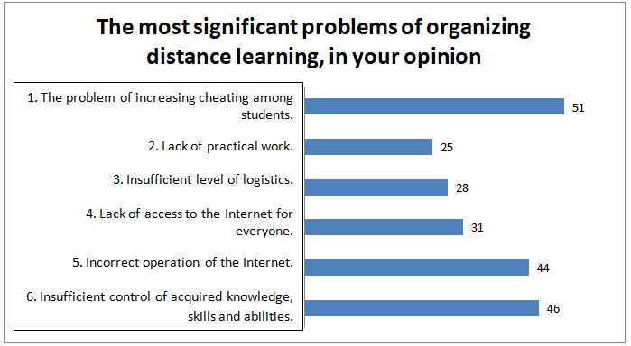
Poll results

Slide 4
Task example
Check the meaning of these verbs in a dictionary. Which four you can see in the pictures? Write down the words, write down the translation next to it, using a dictionary:
Buy –
Sell –
Spend –
Waste –
Lose –
Lend –
Borrow –
Swap –
Save –
Win –
Earn –
Advertise–
Match words with pictures:
Buy, sell, spend, waste, lose, lend, borrow, swap, save, win, earn, advertise.

Slide 5
Task example
Complete the text with past forms from exercise 4.
Last year I (1) … all my pocket money and I (2) … it on a new mountain bike. But I never really used the bike, so I decided to sell it. I (3) … the bike my local newspaper, and a boy phoned me. He liked the bike, and I (4) … it for 260. Then I wanted to buy a computer games console, but i needed some more money! So I (5) … some money from my mum, and then I (6) … a Playstation.
А) Complete the task in the same form as it is presented in the textbook, rewrite the task completely and underline the added words, or write out only the answers, take a picture and attach the file to the chat.
В) Complete the task proposed in the textbook, then read the text with the words already added to it, record the audio, send the audio recording to the chat.
С) Complete the task on the platform LearningApps: https://learningapps.org/view23577909
Take a screenshot of the completed task, send it to the chat for verification and further work.
After checking the submitted completed task in the chat, errors are parsed, if any, in an online format (Web classes, chat classes, etc.).

Slide 6
Educational and methodological recommendations designed to control the use of distance learning resources in English
identification of students' Internet literacy
identification of the level of foreign language proficiency
formation and development of computer literacy skills
formation of skills to work on various online platforms designed for conducting online classes
modification of tasks from the textbook in order to avoid cheating from various Internet sources
adaptation of tasks to the remote format (minimal load of voluminous texts on the screen, a variety of tasks in audio and video formats, etc.)
taking into account the conditions of the possibilities of the Internet and technical means for preparing online classes, several options for completing tasks prepared in advance
the use of various forms of control during distance learning (in audio, video format, sending written work for verification, etc.)
the use of various online platforms and a variety of tasks to increase the motivation and interest of students

Slide 7
«Forms of control when using distance learning English resources».
MINISTRY OF SCIENCE AND HIGHER EDUCATION OF THE RUSSIAN FEDERATION
Federal State Autonomous Educational
institution of higher education
"Northern (Arctic) Federal University
named after M.V. Lomonosov"
HIGHER SCHOOL OF PEDAGOGY, PSYCHOLOGY AND PHYSICAL CULTURE
Author: Danilovich Ekaterina Alexandrovna
Head: Butorina Anastasia Nikolaevna
Arkhangelsk 2023

