Slide 1
Psychomoto, cognitive and emotional development of children in the context of digitalization.
Mamina Tatiana, Head of the Scientific and Methodological Center, “NannyOwl” Group, PH.D in Psychology, Senior teacher of Department of Personality Psychology Saint Petersburg State University
Karpinskaya Valeria, Professor of Psychology, Institute of the Human Brain. N.P. Behtereva RAS, The Scientific and Methodological Center, “NannyOwL” Group, leading expert
8 (800) 700-19-34
8 (812) 200-48-46
СОВА-НЯНЬКА.РФ
welcome@nannyowl.ru

Slide 2
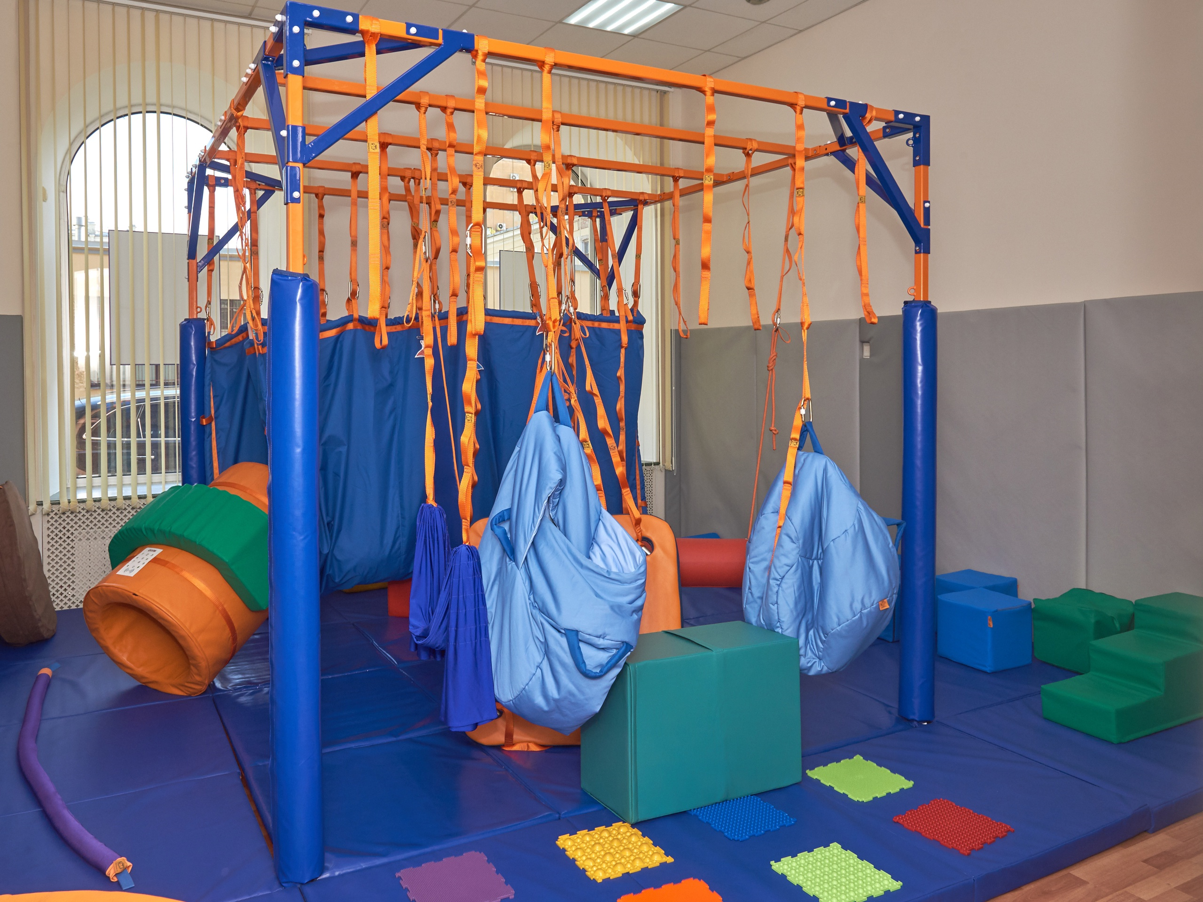
“NannyOwl” Group
NannyOwl : manufacturer and developer of sensory and motor integration equipment
Scientific and methodological center: 1 professor of psychology, 1 PHd of psychology, several psychologists, neuropsychologists, post graduate students, master students. Our center provides practical studies for students of St. Petersburg State University. We have published more than 15 articles and abstracts in the psychology magazines, speeches at conferences, master classes, webinars, popular science texts.
Scientific research bases: Childen’s Center of sensory and motor integration “NannyOwl”, Children's polyclinic department No. 37, Kindergarten No. 90

Slide 3
Problems of diagnosing the cognitive development of children
The break between theory and practice
The lack of clear criteria for diagnosis, lack of objectivity, prevalence of questionnaires and surveys
The historical problem
Return of movements to diagnostics.
Movement is a reflection of cognitive development.
Theoretical base of recognized psychologists and physiologists, a set of tasks with a scaling system

Slide 4
Comparative analysis of motor and sensory skills of children
Mamina T. M., Karpinskaya V. Yu. Sovopraktika. Diagnosis: a guide to diagnosing sensory and moto skills. - St. Petersburg. : Nestor-History, 2021
Ozeretsky N. I. Study of motor talent. Irkutsk: Power of Labor, 1929

Slide 5
Test "Labyrinth-train"
Test "Labyrinth-train” reflects the ability to keep the trajectory, act accurately and be aware of the boundaries at the current moment in time. In this task, one cannot use a pen or pencil, since they are tools and can distort the result, all actions are carried out directly with a finger.

Slide 6
Test "Equilibrium” 1&2
A set of test tasks determines coordination within the boundaries of the child's own body and in space

Slide 7
Test "Cat and Mouse"
The test is necessary to assess the ability to perform precise actions when working with one and two hands at the same time.

Slide 8
Quantitative data on the motor activity of children aged 5-6 years in the 1930s and 2021s.
The time for solving sensory and motor tasks by children who passed the test in 2021 reduced in comparison with children who passed the test in 1930. The temporal characteristics of the hand and the characteristics of the musculoskeletal system in our children should be improved, the children began to complete tasks faster.
At the same time, the accuracy characteristics have deteriorated, children make more mistakes when performing tasks where it is necessary to accurately correlate space and action.
In children, there is a decrease in the accuracy of movements, orientation in the space of their own body, and there is also a deterioration in endurance and balance.

Slide 9
Prospects
Work is underway to identify age norms within the framework of this diagnostic method.
Compare the results of this technique with other methods for determining the development of children
Determine the effectiveness of using sensory and motor integration diagnostics when progressing development and correction plans.

Slide 10
Thank you for your attention!
8 (800) 700-19-34
8 (812) 200-48-46
СОВА-НЯНЬКА.РФ
welcome@nannyowl.ru

