Slide 1
Prosocial behavior of teenagers in social networks
Elena Shmeleva,
Doctor of Psychology, Professor,
Ivanovo State University
Svetlana Lantsova,
Postgraduate student,
Ivanovo State University
Pavel Kislyakov,
Doctor of Psychology, Professor,
Russian University of State for Social, Moscow
Moscow, 1-2 June 2023

Slide 2
Prosocial behavior (PB) in social networks is a manifestation of digital socialization, which includes voluntary behavior in an online environment in order to benefit specific people or promote harmonious relationships with others (Erreygers et al, 2018)

Slide 3
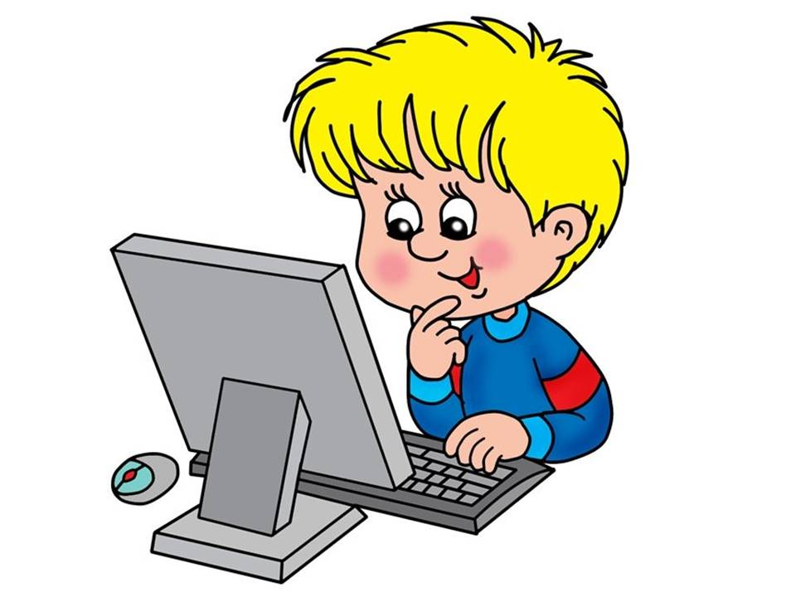
Types of prosocial behavior in social networks:
exchange of resources
exchange of information
emotional support
online help
liking a friend’s post
sending a nice message

Slide 4
Why pro-social behavior on social media is important?
Тhe benefits of prosocial behavior for teenagers:
better academic successes (Gebrino et al, 2018)
to establish a social norm of positive online interactions vs cyberaggression
have better social connections (Jin et al, 2022)
to increase social connectedness
are more likely to succeed in adulthood (Toumbourou16)
to improve relationship quality
feel more satisfied and happy (Aknin, 2012; Son et Padilla-Walker, 2020)
to foster adolescents’ well-being and self-esteem

Slide 5
Research organization
Research
methods
The self-reporting methodology "Online prosocial behavior of adolescents" (OPBS) S. Erreygers, 2018,. scales of performing and receiving prosocial behavior online
The purpose of the study: to evaluate the frequency and manifestations of prosocial experience of adolescents in social networks
Selection
342 teenagers aged 12-19 (M=15.2) from secondary schools and colleges of the Ivanovo region took part in the survey

Slide 6
The main results

Slide 7
The main results

Slide 8
Summary
adolescents have experience of performing prosocial behavior on the Internet above average
adolescents perform prosocial behavior online more often than they receive it in response
teenage girls perform and receive prosocial behavior more often than teenage boys
the most frequent type of prosocial behavior in social networks is emotional support for another and relationship support, the least frequent is an open display of sympathy and help with homework at school
the prosocial activity of adolescents in social networks, as well as in offline mode, is aimed at maintaining interpersonal relationships with peers and is less associated with assistance in educational activities

