Slide 1
Cognitive development of children involved in the digital world to varying degrees
Marina L. Isachenkova
Postgraduate student at Herzen University
Psychologist at the Russian State Hydrometeorological University
Elena I. Nikolaeva
PhD, Professor at Herzen University

Slide 2
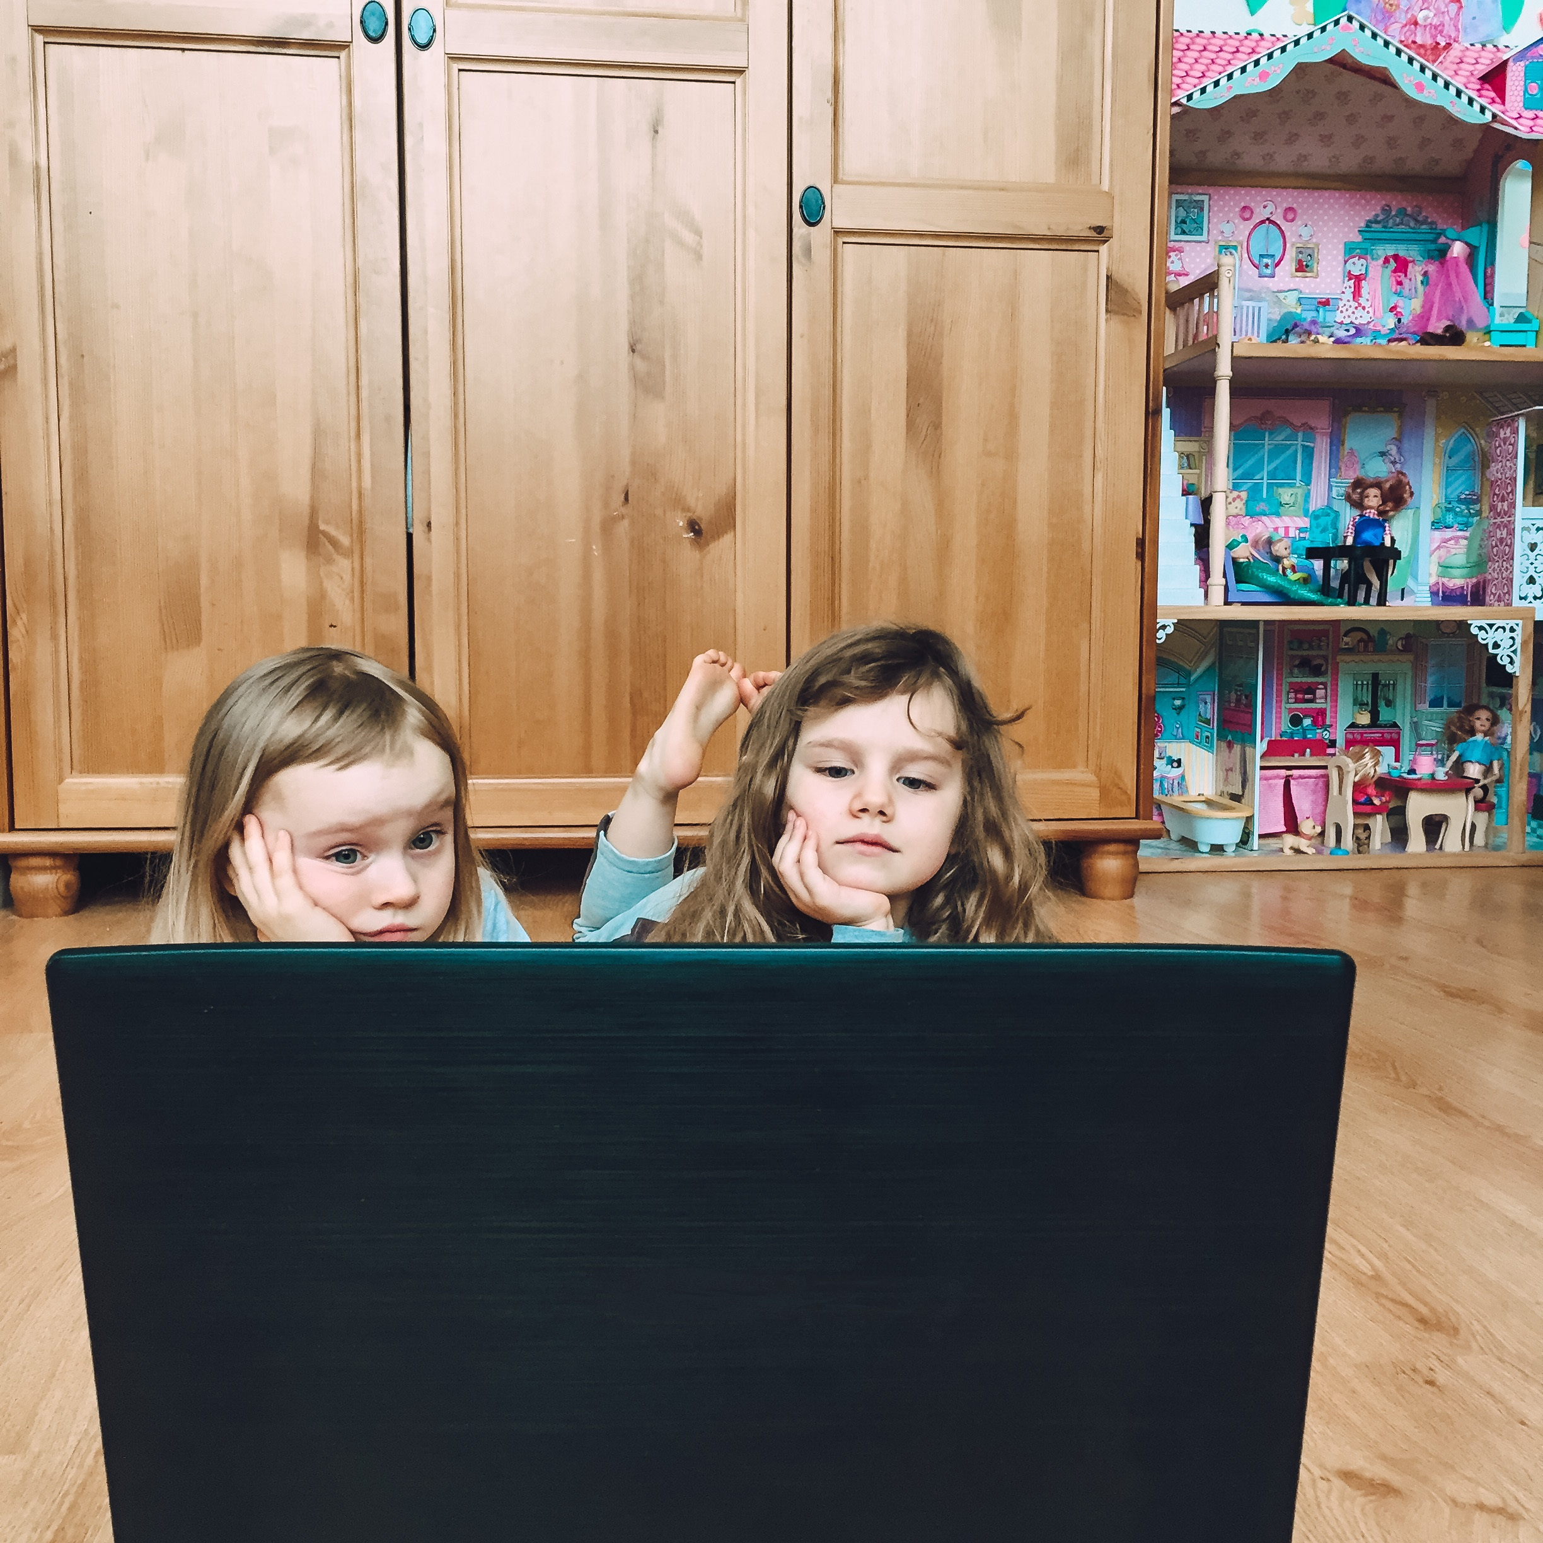
The sudden shift in the child's ratio between real and digital worlds due to the pandemic has raised the question of the benefits and harms of gadgets and the conditions of their use at different stages of ontogenesis. Forced to study online and then do homework using a computer, schoolchildren violated all norms regarding healthy lifestyle.
Photo from the author's archive of the study. The children's parents agreed to its use.

Slide 3
Purpose of the study
to describe the reality of children under 11 in the digital world and to create evidence-based recommendations for teachers and parents regarding the norms of gadget use for different ages and the conditions under which this interaction will promote the cognitive development of a child of a particular age.
Methods
Organisation of the study
An online survey of parents and children was conducted to realise this objective. Two questionnaires were developed, one for parents and one for school-age children. A total of 866 parents and 40 children participated in the survey.
The study was conducted through various social media. Major Russian bloggers were also involved in disseminating information about the study.

Slide 4
Distribution of parents by age group of children
Parents with or without higher education (HE)

Slide 5
The age of the child when he or she was first introduced to the gadget
%

Slide 6
Motives for parents to give gadgets to their children
64.4%
Parent answers

Slide 7
Data on children's time spent with gadgets and on the Internet
%

Slide 8
Number of parents considering how to keep their child safe online
Parent answers

Slide 9
Data on how children respond to parents' requests to put the gadget away
If parents consciously give their children a gadget,
52.8%
the child easily gives it back when parents ask for it

Slide 10
The role of gadgets in child development and parental awareness about it
Do parents feel they have enough information about the benefits or harms of gadgets
25%
8.8%
%
43.9%
51.3%
Parent answers

Slide 11
Results of factor and regression analysis
The ability to hold attention
Child's age
Number
of family members
Attendance at kindergarten and other classes
Ownership of other skills
Ease of falling asleep
Age of initiation into gadgets
The earlier a child is given gadgets, the more likely it is that parents will give them to a child to take a break from the child
The timing of the first encounter with a gadget has nothing to do with self-care skills or the child's moodiness
The more family members raising a child, the less certain parents are that they have enough knowledge about whether a gadget is harmful or useful

Slide 12
Demographic characteristics of the sample among primary school children
%

Slide 13
Do primary school children have their own gadget?
Having your own gadget
(the entire sample)
Having your own gadget
(Boys)
Having your own gadget
(Girls)

Slide 14
Interaction of primary school children with gadgets
A social media account
Who manages your social media account?
%

Slide 15
Communicating with school friends online

Slide 16

The main conclusion of the work is that parents are ignorant of the possibilities of today's digital world aimed at creating apps for the cognitive development of the child, and thus accustom the child to the passive absorption of digital information.
Photo taken from an open source.

Slide 17
Thank you for your attention

