Slide 1
“ Russian index of child well-being: implementation experience and development perspectives ”
Elina Illarionova
Head of analytical department of Elena and Gennady Timchenko Charitable Foundation
Anna Ipatova
Senior researcher, RANEPA

Slide 2
Capabilities of the CWB system
The system of indices and sub-indices makes it possible to measure children's well-being from different angles:
Statistical and subjective assessment of well-being, perspective and general index (“one digit”)
Well-being in the field of health, material well-being, security, development
Adult performance in final or intermediate indicators of child well-being, in improving the environment for children, or in the level of financinging and budgeting for children's policies
The well-being of children in the region, in the municipality, at school; well-being in comparison with the average Russian data or well-being in isolation from such a comparison (for the municipal and school levels)
Statistical index of child well-being
developed by MSU (Lomonosov Moscow State University)
27 indicators (official data from Rosstat)
Subjective index of child well-being
developed by RANEPA (Russian Presidential Academy of National Economy and Public Administration)
18 indicators (data from surveys of children 10-17 y.o.)
General index of child well-being
combines the RANEPA and MSU indices according to the unified methodology of z-assessments (MSU)
45 indicators (official Rosstat data + survey data)
Sub-index system by domains and results
joint development (8-10 sub-indices)

Slide 3
Partnership in creating of a child well-being index
Federal State Statistics Service (Rosstat)
Faculty of Economics, Lomonosov Moscow State University
Elena and Gennady Timchenko Charitable Foundation
Institute for Social Analysis and Forecasting RANEPA
Ministry of Education of the Russian Federation
Civic Chamber of the Russian Federation
Commissioner for Children's Rights
Agency for Strategic Initiatives
Moscow State University of Psychology & Education

Slide 4
Statistical index of child well-being
27 indicators based on official statistics and sample surveys published by Rosstat. Developed at the regional level
16 “positive” indicators measuring progress in child well-being and 11 “negative” indicators measuring failures in child well-being (the inverse values are when when evaluating the position of the region)
An index (sub-index) exceeding zero is good. Less than zero - there is a need for improvement
We do not assign special weights to different indicators and domains, given that all indicators are equally important for the well-being of children
The methodology of z-assessments - an indicator of deviation from the average (average Russian values of indicators)

Slide 5
Statistical index of child well-being
Sub-indices by domains. Moscow, 2020
The value of the Statistical index child well-being in 2020 = 0.71 (the position of the region is better than the average Russian level)
However, for individual domains, the region may fall behind
Source: calculated by the authors based on Rosstat data

Slide 6
Statistical index of child well-being Sub-index "Development" Moscow, 2020
z-assessments for indicators of the domain "Development"
Statistical index of child well-being, Moscow, 2020
Source: calculated by the authors based on Rosstat data
*Federal State Educational Standard

Slide 7
Subjective index of child well-being
is calculated on the basis of adolescents’ responses to the questionnaire
reflects the personal opinion of adolescents about their own well-being
is an integral index that combines 18 indicators of well-being
takes into account the state of children's well-being in 6 areas of their lives (domains)
allows:
to measure child well-being both in the region as a whole and in selected municipalities
to assess the dynamics of the level of children's well-being in general and in certain areas of life
to describe the characteristics of the well-being of certain groups of adolescents

Slide 8
Subjective index of child well-being: 6 domains
1 . HEALTH
No health restrictions
Sports
Eats well
4 . 1. EDUCATION
Interested in lessons
Like learning
Additional classes
Text
Text
Text
Text
Text
Text
Text
Text
Text
Text
Text
Text
Text
Text
Text
Text
Text
Text
Text
Text
Text
Text
Text
Text
Text
Text
Text
Text
Text
Text
Text
Text
Text
Text
Text
Text
Text
Text
Text
Text
Text
Text
Text
Text
2 . MATERIAL
WELL-BEING
High assessment of material situation
Have personal items
Traveled somewhere
4.2 . SOCIAL
RELATIONSHIP
Classmates treat good
Have close friends
Adults are listening
1
4
DEVELOPMENT
2
3
4.3 . SELF-REALIZATION
Satisfied with life
Will achieve a lot in life
There are achievements and successes
3 . SAFETY
Safe at school
Safe on the street
Safe at home

Slide 9
Results
Region | total population | 10-17 years old | Surveyed in 2021 | Surveyed in 2022 | Share
Altai krai | 2 296 353 | 214 608 | - | 35 549 | 16.56
Kaliningrad region | 1 018 624 | 85 401 | - | 7400 | 8.67
Leningrad region | 1 892 711 | 144 587 | 1 986 | 7 156 | 4.95
Republic of Bashkortostan | 4013786 | 388 348 | 2119 | 28 144 | 7.25
Republic of Karelia | 609 071 | 55 046 | - | 6 495 | 11.80
Tambov Region | 994 420 | 75 864 | 1 942 | 14 666 | 19.33
Ulyanovsk region | 1 218 319 | 94 450 | 7 587 | 21 325 | 22.58
KhMAO | 1 687 654 | 178 774 | 9 692 | 12 249 | 6.85
TOTAL: | 13 730 938 | 1 237 078 | 23 326 | 132 984 | 10.75
9

Slide 10
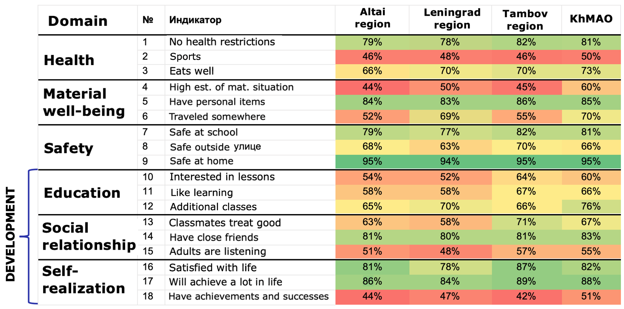
Indicators of child well-being, % of respondents

Slide 11
Subjective index of child well-being: subjective well-being of different groups

Slide 12
Comparison of estimates of children's well-being by statistical and subjective IBI Pilot regions
Pilot region | Rank – Subjective CWI (2022) | Rank - Statistical CWI
 |  | 2018 | 2019 | 2020
KhMAO-Yugra | 1 | 1 | 1 | 1
Tambov Region | 2 | 4 | 4 | 5
Ulyanovsk region | 3 | 6 | 5 | 4
Republic of Bashkortostan | 4 | 3 | 3 | 3
Kaliningrad region | 5 | 5 | 6 | 6
Altai krai | 6 | 8 | 7 | 7
Leningrad region | 7 | 2 | 2 | 2
Republic of Karelia | 8 | 7 | 8 | 8
It is important to measure statistical and subjective RBI separately
Сhildren's grades are below statistical
Leningrad region:
2018 | 2019 | 2020
6 | 10 | eleven

Slide 13
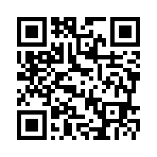
Thank you for attention!
Website of Russian child well-being index

