Slide 1
III International Psychological Forum "A child in the digital world"
About distance education of children and unresolved issues in e-learning at school
The purpose of the report: To reveal unresolved issues in distance learning of children and to justify the need for a dialogue of specialists responsible for the child's childhood at school (teachers, methodologists, psychologists, managers) and also for the development of information technologies in school education.
Suvorova G.A.
Doctor of Psychology, Professor, Director of the Department of Psychology, LLC Psychological consultation "Dialog"
suvorovaga@mail.ru
+7-967-017-70-97

Slide 2
About distance education of children and unresolved issues in e-learning at school
Intensive development of psychological science in education has led to the development of artificial intelligence and distance learning for children and adolescents. Artificial intelligence is a symbol of a technical device (computer, Machine) that, under the guidance of a Person (remotely or directly), qualitatively processes large amounts of information according to certain algorithms for various purposes. A person creates various algorithms for the operation of a Machine. That is, it is the intelligence of programmers who create this artificial intelligence. A person must be very intelligent, have a high level of cognitive abilities. It is important to pay attention to the development of all cognitive abilities in children, the development of their thinking and the formation of intelligence¹. We are talking about the qualitative characteristics of intelligence, about the mental development of children, about their abilities and giftedness.
Computerization at school as the second literacy of schoolchildren is currently taking shape in the trend of absolute digitalization of everything. The introduction of digital technologies into the educational process², unfortunately, is not based on the results of the examination of school textbooks and is often carried out empirically, without taking into account achievements in the field of psychology of learning. The "transformation" of the educational process is largely spontaneous and is carried out by specialists who have not received serious psychological and pedagogical training. There is no clear answer to the questions: What is the purpose of training? What goals do digital technologies teach students in different academic subjects? How many scientific concepts and what concepts are subject to assimilation by students in different academic subjects? How many educational tasks aimed at the formation of scientific concepts in schoolchildren are contained in school textbooks, what is their structure and how do they affect the development of children's abilities?
Suvorova G.A.
Doctor of Psychology, Professor, Director of the Department of Psychology, LLC Psychological consultation "Dialog", suvorovaga@mail.ru
+7-967-017-70-97

Slide 3
About distance education of children and unresolved issues in e-learning at school
How are the concepts to be learned in the learning process related to the objects of the material world? How should the educational material to be assimilated by students adapt to the subject-practical and abstract-formal types of thinking among students and the differences in these types? How many and what concrete and abstract concepts are included in the content of education? What level of intellectual development are modern textbooks and computer training programs designed for?
The use of a computer as an educational tool sharply raises the question of the criteria for the effectiveness of training, i.e., the quality of training, the effort and time spent by teachers and students, financial expenses. There is no scientifically based model of computerization at school, based on a psychological analysis of educational activities and abilities of students. What does the distance learning environment develop for schoolchildren? Does it develop intelligence? What abilities do students develop in the "digital world"?
How do we all understand: What is a child? What are the boundaries of childhood? Is there unity among theorists and practitioners on these issues? The starting point can be considered the Convention on the Rights of the Child (1991). Do we have unity in understanding the "three whales" of education - the development, education and upbringing of a child? A child in any environment, including digital, learns, develops, is brought up by adults (parents, teachers, teachers). If he is the only one mastering the curriculum, then he learns. If he learns the curriculum under the guidance of adults and together with them, then he learns. The result of teaching and learning is learning. If we take an innovative position in understanding learning, then a child can learn if he has a functional psychological system of activity (fPSD according to V.D. Shadrikov³). I.e., a motive, a goal, a program of information activity, decision-making, educationally important qualities (UVK), reflection and a complex system of interrelations between these components. Do the developers of digitalization of education understand this? They don't fully understand it yet. While the control function "overlaps" the training function. There is total control instead of training.
3. Шадриков В.Д. Психология деятельности человека. - М.: «Издательство психологии РАН», 2013.- 464с. (Достижения в психологии)
Suvorova G.A.
Doctor of Psychology, Professor, Director of the Department of Psychology, LLC Psychological consultation "Dialog", suvorovaga@mail.ru
+7-967-017-70-97

Slide 4
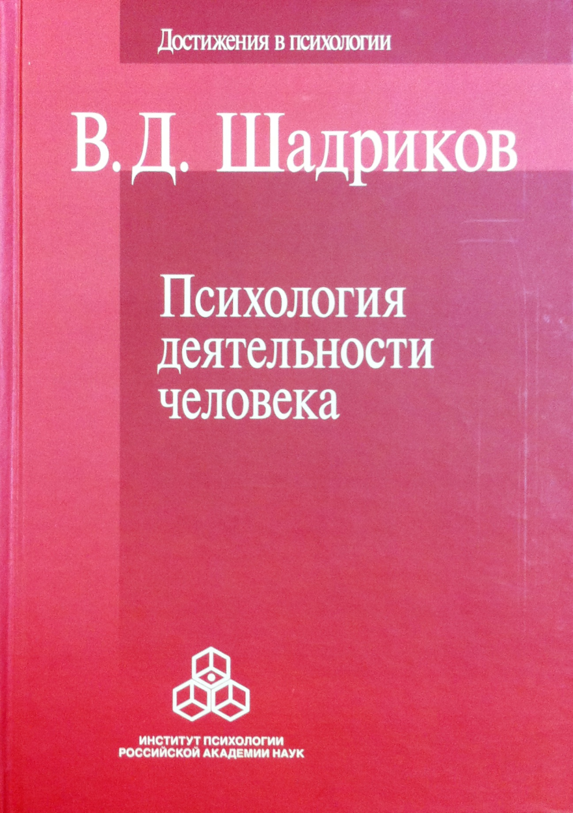
About distance education of children and unresolved issues in e-learning at school
Suvorova G.A.
Doctor of Psychology, Professor, Director of the Department of Psychology, LLC Psychological consultation "Dialog", suvorovaga@mail.ru
+7-967-017-70-97

Slide 5
About distance education of children and unresolved issues in e-learning at school
If we understand the development of a student (person) as the development of his abilities (according to S.L. Rubinstein⁴), the problem of abilities becomes central. Rubinstein S.L. showed in his article a deep connection between thinking and mental abilities. He justified mental abilities as the central theoretical issue of the problem of the student's mental development. He directly linked the development of a student with the development of his abilities. Considering the question of the relationship between development and learning, he noted: mental functions are formed in the process of functioning and significantly depend on the objective content on which they are formed. In a child, in a student, this functioning is inextricably linked with the development of the content of human culture and the system of interpersonal relations established in this society. Mastering the content of culture is accomplished in the process of learning; mastering the system of interpersonal relations of the collective to which it belongs, in the process of education, inextricably linked with learning. The stages of a student's mental development depend on the content that the child learns during training and on the form of communication in which this development takes place.
Elkonin D.B.⁵ highlights in the educational task the educational goal and educational actions in the narrow sense of the word, as well as actions of control and evaluation of the actions performed. In the narrow sense of the word, he refers to educational actions with objects and cognitive actions.
Systems, i.e., the synthesis of cognitive actions, and characterizes the operational mechanisms of abilities. Shadrikov V.D.⁶ identified a universal operational mechanism for the development of all abilities - intellectual operations as an independent class of psychological actions. He notes that thinking is aimed at solving a problem and that any task is solved in a certain way. Distinguishing intellectual operations into a special class of mental actions related to cognition and solving the tasks facing the student, he states that it is intellectual operations that are these generalized ways of realizing thinking and cognition.
4.Рубинштейн С.Л. Проблема способностей и вопросы психологической теории.// Вопросы психологии.1960.№3. С. 3-15.
5. Эльконин Д.Б. Психологические вопросы формирования учебной деятельности в младшем школьном возрасте // Хрестоматия по возрастной и педагогической психологии. М.:МГУ, 1981,стр. 84-86
6. Шадриков В.Д. Способности и одаренность: Монография.- М: Изд-во «Институт психологии РАН» , 2019.-274с. ( Достижения в психологии). Стр. 157-190
Suvorova G.A.
Doctor of Psychology, Professor, Director of the Department of Psychology, LLC Psychological consultation "Dialog", suvorovaga@mail.ru
+7-967-017-70-97

Slide 6
About distance education of children and unresolved issues in e-learning at school
Suvorova G.A.
Doctor of Psychology, Professor, Director of the Department of Psychology, LLC Psychological consultation "Dialog", suvorovaga@mail.ru
+7-967-017-70-97

Slide 7
About distance education of children and unresolved issues in e-learning at school
Shadrikov V.D. identified four groups of intellectual operations: subject-practical operations, perception and memory operations, thinking operations, meta-intellectual operations. These are analysis, synthesis, generalization, classification, comparison, distinction, etc.
Specialists engaged in computerization in the field of education, as well as methodologists and authors of paper textbooks, should possess methods of psychological analysis of various types of activities and, above all, educational activities and abilities - the ability to learn, i.e. cognitive abilities, the ability to desire and want, the ability to feel and experience⁷. Computerization specialists should design the entire educational environment in which a student learns: how he perceives the educational material in different subjects in different conditions, how he comprehends and remembers the material, how he fixes the educational material, how he learns to fluently master the educational material in various situations. To understand how the intellectual development of schoolchildren is carried out in the learning process, it is necessary to conduct a survey of these very abilities in children in different age groups, since there are qualitative differences in intelligence in children in different age groups. So far, no existing training program (distance or on paper) has such data. Can artificial intelligence form all the components of a child's learning activity? What cognitive abilities and how are integrated into the structure of the child's intelligence at different stages of its development?
So far, we do not have a scientifically based methodology for teaching writing and reading to first-graders in a remote format. Those who advocate writing on a computer forget that they have learned to write and read without a computer.
Thank you for your attention!
7. Шадриков В.Д. Ментальное развитие человека./ В.Д. Шадриков.-М.: Аспект Пресс , 2007.-284. Стр. 81.
Suvorova G.A.
Doctor of Psychology, Professor, Director of the Department of Psychology, LLC Psychological consultation "Dialog", suvorovaga@mail.ru
+7-967-017-70-97

Slide 8
About distance education of children and unresolved issues in e-learning at school
Suvorova G.A.
Doctor of Psychology, Professor, Director of the Department of Psychology, LLC Psychological consultation "Dialog", suvorovaga@mail.ru
+7-967-017-70-97

