Slide 1
SEMANTIC ASPECT OF LANGUAGE ACQUISITION IN THE PRESCHOOL CHILD

Slide 2
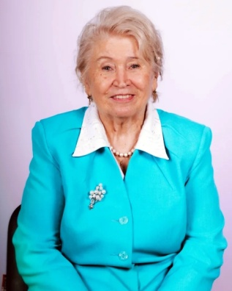
Ushakova Oksana Semenovna
Chief Researcher at the Institute for the Study of Childhood, Family and Upbringing of the Russian Academy of Education, author of the program for the development of speech of preschool children; Doctor of Pedagogical Sciences, Professor, Academician of MANPO
oxu@bk.ru

Slide 3
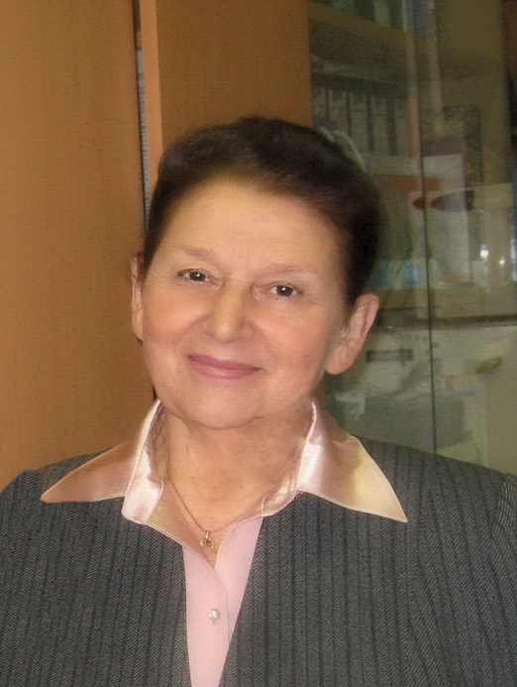
Yashina Valentina IVANOVNA
Professor, Candidate of Pedagogical Sciences, Professor of the Department of Theory and Methodology of Preschool Education Moscow Pedagogical State University, Honorary Worker of Higher Professional Education Of the Russian Federation.
Main research interests: theory and methodology of children's speech development, psycholinguistics; language acquisition in a multilingual environment; professional training of teachers in the field of speech education of children.
yashina.vi@mail.ru

Slide 4
The study of the native language in preschool childhood is aimed at achieving the following goals: the development and education of preschool children, its socialization, the development of intellectual abilities; mastery of language as a means of communication in everyday life; the development of communicative abilities; enrichment of vocabulary and the formation of the grammatical structure of speech; elementary mastery of its basic visual and expressive means, the education of sound culture; the formation of the ability to understand language and speech phenomena, to assess them in terms of compliance with the situation, the sphere of communication; acquisition of competence in the field of native language and speech communication.

Slide 5
At preschool age, the practical development of the native language reaches a high level. A well-known researcher of children's speech, F. A. Sokhin believed that there should be a special work on the development of speech, that improvement of verbal communication with the need includes the vocabulary of the child work on the semantic side of the word. He noted that the development of conceptual thinking of the child is impossible without the assimilation of new words, new knowledge and ideas, and if new impressions are not fixed in the word, the child will not consciously use them in their statements. Further, F. A. Sokhin emphasized that a basic understanding of the phenomena of speech and language may develop if work on the word lead in the logic language (and not only in the logic of the subject relations), it is in the technique of development of speech

Slide 6
it is necessary to increase the proportion of work on the meaning of the word. He proved (and the study of E. M. Strunina confirmed this) that the formation of knowledge and ideas is impossible without the introduction of new words in the speech and mental activity of children, which denote objects, phenomena, their properties and qualities in the relationship. An effective method of disclosing the meaning of words is the use of synonymic and antonymic comparisons. In speech to the child's thinking of the words were related to each other as units of language, special, purely linguistic work is directed on formation at children of representations about the semantic relationship in the area of vocabulary.

Slide 7
The main purpose of speech education is that the child creatively mastered the norms and rules of the native language, was able to apply them flexibly in specific situations, mastered the basic communication skills. On the basis of the formation of the child's speech skills is the development of his speech: understanding the meaning of the word and the enrichment of the dictionary, the assimilation of the system of linguistic concepts in the field of morphology, syntax, word formation, mastering the sound culture of speech, the formation of coherent monological speech.

Slide 8
Work on the semantics of the word, the expansion of the semantic field, the use of associative principle of assimilation of vocabulary, the formation of linguistic generalizations in the assimilation of the grammatical structure of speech develop preschoolers arbitrariness and awareness of speech, that is, the ability to select accurate and expressive means in the construction of coherent statements of different types.
Meaning is the Central category of ontogenesis of speech and thinking, and understanding the Genesis of meaning is one of the conditions for identifying the internal laws of formation and development of human language ability.

Slide 9
Linguists distinguish between grammatical meaning (belonging of a word to a certain class, peculiarities of its combination, changes) and lexical meaning, which is determined both by the correlation of the word with the corresponding concept (which is the core of the lexical meaning of the word), and its place in the lexical system of the language (i.e. different connections of the word with other words).
The main condition for the realization of speech-understanding its meaning, its meaning; and in the language through the action of various associations can create different parallel ways of expressing thoughts. The Association method is one of the most common ways to evaluate semantic fields.

Slide 10
To determine the lexical meaning of the word is necessary:
- to find out its subject-matter and conceptual-logical content;
- to establish how the reality called by the word is connected with those that objectively exist in the surrounding reality;
- to reveal how the defined lexical meaning correlates with another, since the word expresses its meanings not in isolation, not in isolation from the lexical-semantic system of a particular language, but in an indissoluble connection with it, as its constituent element;
- find a distinctive feature that would allow to isolate this value from a number of similar ones.

Slide 11
For the correct understanding of the meaning of words, their exact use in coherent speech, it is necessary at least an elementary understanding of its composition, shades of meaning, the possibilities of combining words. And here a huge role is played by the child's developed "sense of language", it can be formed as an attentive attitude to the constituent elements of the word, which sometimes act as the exponents of the finest shades of meaning that distinguish one word from another. Misunderstanding of semantic shades of the word leads to inaccuracy of their use. Violation of the laws of compatibility of words leads to grammatical and stylistic inaccuracies in speech and errors in word usage. Namely, these qualities of speech determine, first of all, the characteristics of the child's language ability.

