Slide 1
Use of Eye-Tracking Technology in Neuropsychological Assessment of Children: A Report
Mirikwe Winifred Zinachiamaka

Slide 2
1. Introduction 2. Neuropsychological Assessment 3. Eye-Tracking Technology 4. Objectives 5. Conclusion 6. References

Slide 3
Introduction
Childhood and adolescence are characterized by prolonged brain maturation in which both environmental and biological inﬂuences continuously interact to ﬁne-tune brain circuitry involved in cognitive function. (Wade et al., 2020) Interestingly, children’s cognitive abilities improve significantly over childhood and adolescence. We know from behavioral research that core cognitive processes such as working memory and mental attention improve significantly across development (Arsalidou & Im-Bolter, 2017).

Slide 4
It has been well reported that cognitive abilities increase with age up until the third or fourth decade of life.(Clark et al., 2006) According to Piaget, cognitive processes emerge through a process of development which is neither direct biological maturation nor direct learning in the usual sense, since it is a reorganization of psychological structures resulting from organism environment interactions (Kohlberg, 1968).

Slide 5
To that end, the overwhelming majority of research in pediatric neuropsychology has focused on adding to the empirical basis of our understanding of those brain–behavior relationships, as well as cognitive development and profiles in a wide range of disorders. This body of research serves as the foundation of evidence-based case conceptualization and diagnosis in pediatric neuropsychology. However, research on the practice of clinical pediatric neuropsychology, and in particular, outcomes of pediatric neuropsychological services, is far more limited (Dörrenbächer et al., 2014).

Slide 6
Neuropsychological Assessment
Neuropsychological assessment of children is a critical tool used to evaluate cognitive, emotional, and behavioral functioning, often providing insight into the underlying neurological processes affecting a child's development. These assessments utilize standardized tests, observational techniques, and parent or teacher reports to assess various domains,

Slide 7
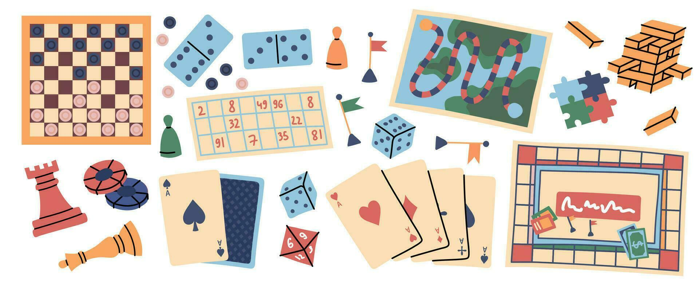
Historically, neuropsychological assessment has relied on paper and pencil-based tests to assess cognitive abilities, and studies conducted with these tests have generated thousands of scholarly articles promoting their strengths and debating their weaknesses.

Slide 8
The introduction of standardized methods of test administration, scoring and interpretation represents one of the most important advances in the past century. At present, scientists and clinicians have a remarkable range of standardized tests from which to choose, but individual tests are often constrained by a lack of adequate normative data or limited coverage of domains of function, leaving signiﬁcant opportunities for further improvement.(Clark et al., 2006)

Slide 9
According to Shepard et al., 1998 We must tailor our assessments accordingly. Because young children come to know things through doing as well as through listening, and because they often represent their knowledge better by showing than by talking or writing, paper-and-pencil tests are not adequate (Shepard et al., 1998). However, it is ubiquitous that typically developing children progressively perform more complex cognitive tasks. This is in part attributed to the development of core cognitive processes such as mental attention (Arsalidou & Im-Bolter, 2017).

Slide 10
Eye-Tracking Technology
In recent years, eye tracking technology has become increasingly more aﬀordable, accessible, and easy to use in diﬀerent environments. Moreover, using eye tracking to measure children’s reading patterns has been proposed as an eﬃcient screening method to obtain a ﬁrst basic assessment of reading skill and potential risk of dyslexia (Gran Ekstrand et al., 2021). For instance, in visual attention assessments, performance on a task is usually measured with self-reports scales or tasks in which the participants need to decide whether or not the target stimulus is similar with the previously presented one (Costescu et al., 2019).

Slide 11
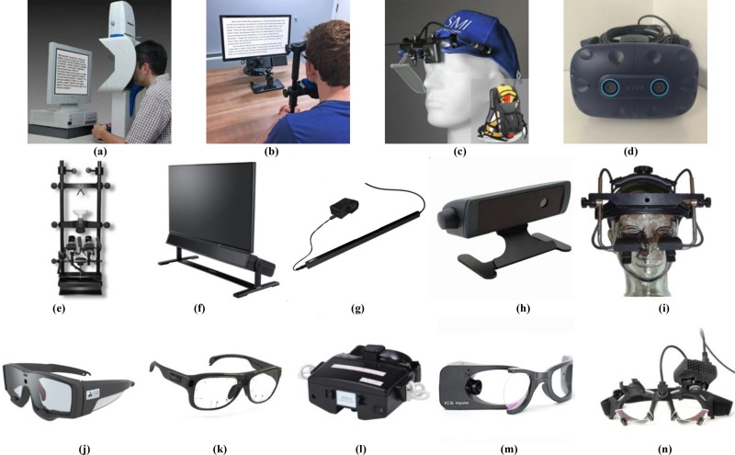

Slide 12
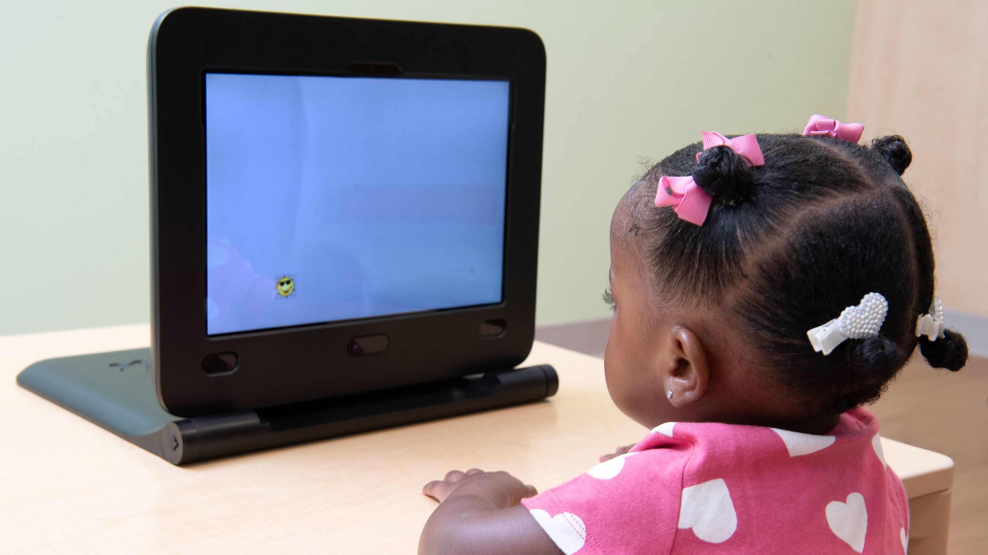

Slide 13
The study of children’s eye movements is difﬁcult for several reasons. One of the problems is keeping a child’s attention focused on the task long enough for them to actually do it. Another is ensuring that instructions are simple enough to be understood by the participants. Frequently, the stimulus used in a laboratory to study eye movements is a small dot or a spot of light (Irving et al., 2011).
Eye movements can also be voluntarily generated by a goal-directed plan, thereby providing a model to study executive/cognitive control of behavior in a direct manner. Cognitive control is exerted in all planned behavior, and it is particularly vulnerable to psychopathology where executive dysfunction is a common feature (Luna et al., 2008a).

Slide 14
Objectives
The aims of a study is to raise questions concerning test feasibility and administration requirements, which may ultimately be deciding factors over psychometric merit when selecting a cognitive test.(Wade et al., 2020)
To explore the use of eyetracking device in measuring eye movement patterns of children during neuropsychological assessment .

Slide 15
Generally, Preschool age marks the passage from infancy to childhood and represents the most critical period for child development. In this period of life, we experience major performance improvements in many EF tasks, in parallel with structural and functional changes of the prefrontal cortex, like the wide pruning of synaptic connections and the maturation of subcortical prefrontal myelination (Scionti et al., 2020)

Slide 16
References
Arsalidou, M., & Im-Bolter, N. (2017). Why parametric measures are critical for understanding typical and atypical cognitive development. Brain Imaging and Behavior, 11(4), 1214–1224. https://doi.org/10.1007/s11682-016-9592-8
lark, C. R., Paul, R. H., Williams, L. M., Arns, M., Fallahpour, K., Handmer, C., & Gordon, E. (2006). Standardized assessment of cognitive functioning during development and aging using an automated touchscreen battery. Archives of Clinical Neuropsychology, 21(5), 449–467. https://doi.org/10.1016/j.acn.2006.06.005
Kohlberg, L. (1968). Early Education: A Cognitive-Developmental View. In Source: Child Development (Vol. 39, Issue 4). http://www.jstor.orgURL:http://www.jstor.org/stable/1127272
Dörrenbächer, S., Müller, P. M., Tröger, J., & Kray, J. (2014). Dissociable effects of game elements on motivation and cognition in a task-switching training in middle childhood. Frontiers in Psychology, 5(NOV). https://doi.org/10.3389/fpsyg.2014.01275
Wade, L., Leahy, A., Lubans, D. R., Smith, J. J., & Duncan, M. J. (2020). A systematic review of cognitive assessment in physical activity research involving children and adolescents. In Journal of Science and Medicine in Sport (Vol. 23, Issue 8). Elsevier Ltd. https://doi.org/10.1016/j.jsams.2019.12.020

Slide 17
Shepard, L., Kagan, S. L., & Wurtz, E. (1998). Principles and Recommendations For Early Childhood Assessments.
Gran Ekstrand, A. C., Nilsson Benfatto, M., & Öqvist Seimyr, G. (2021). Screening for Reading Difficulties: Comparing Eye Tracking Outcomes to Neuropsychological Assessments. Frontiers in Education, 6. https://doi.org/10.3389/feduc.2021.643232
Costescu, C., Rosan, A., Brigitta, N., Hathazi, A., Kovari, A., Katona, J., Demeter, R., Heldal, I., Helgesen, C., Thill, S., & Efrem, I. (2019). Assessing Visual Attention in Children Using GP3 Eye Tracker. 10th IEEE International Conference on Cognitive Infocommunications, CogInfoCom 2019 - Proceedings, 343–348. https://doi.org/10.1109/CogInfoCom47531.2019.9089995
Irving, E. L., González, E. G., Lillakas, L., Wareham, J., & McCarthy, T. (2011). Effect of stimulus type on the eye movements of children. Investigative Ophthalmology and Visual Science, 52(2), 658–664. https://doi.org/10.1167/iovs.10-5480
Luna, B., Velanova, K., & Geier, C. F. (2008a). Development of eye-movement control. Brain and Cognition, 68(3), 293–308. https://doi.org/10.1016/j.bandc.2008.08.019

