Slide 1
Psychosocial impacts of digital devices uses in childhood
Submitted by:​
Cristian Camilo Osorio Ordoñez​
Adrián Marcel García Caicedo​
Mónica Vargas Prieto​
​Corporación Universitaria Minuto de Dios – Rectoría UNIMINUTO Virtual​
Colombia, 2024

Slide 2
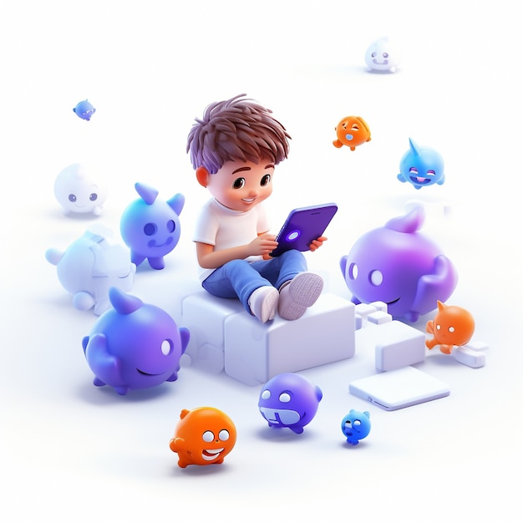
Introduction
We analyze how children's psychological and social development was affected by the use of technological devices, specially in the confinement due to the Covid-19 pandemic context.
We found that excessive use of digital devices is associated with negative impacts on children's mental, physical and emotional health, as well as problems in school performance.

Slide 3
Methodology
With an exhaustive review of academical literature on the subject and the analytics of diverses databases, we applied inclusion and exclusion criteria to select the most relevant studies. In addition, we performed a systematic analysis of the results to identify significant trends and patterns.

Slide 4
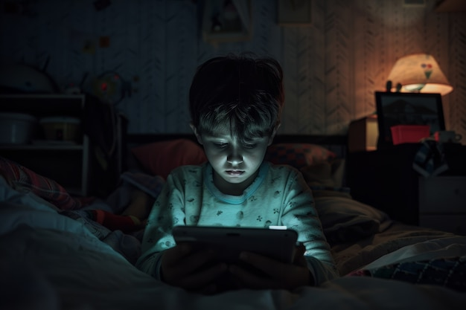
Results and Discussion
The findings revealed major challenges associated with childhood technology use. In particular, we found that been prolonged time in screens is associated with an increased risk of mental health problems such as anxiety, depression and sleep disorders, as well as difficulties in social skill development and academic achievement. Also, we identify challenges for parents and caregivers of children in the digital age.

Slide 5
Conclusions
The use of digital devices in early ages is an important challenge for children's well-being. That is why is relevant parents, educators and health professionals work together to promote a balanced and healthy use of technology, as well as to develop effective prevention and intervention strategies.

Slide 6
References
Araoz, E. G. E., Araoz, M. C. Z., Ramos, N. A. G., & Uchasara, H. J. M. (2021). Adicción a internet y habilidades sociales en adolescentes peruanos de educación secundaria. Archivos Venezolanos de Farmacología y Terapéutica, 40(1), 74-80.
Bers, MU (2018). Codificación y pensamiento computacional en la primera infancia: el impacto de ScratchJr en Europa. Revista Europea de Educación STEM, 3 (3), 08. https://doi.org/10.20897/ejsteme/3868
Chan, T. K., Cheung, C. M., Lee, Z. W., & Neben, T. (2015, January). Why do I keep checking my Facebook? The role of urge in the excessive use of social networking sites. In 2015 48th Hawaii International Conference on System Sciences (pp. 314-323). IEEE.
Chang, F. C., Chiu, C. H., Chen, P. H., Chiang, J. T., Miao, N. F., Chuang, H. Y., & Liu, S. (2019). Children's use of mobile devices, smartphone addiction and parental mediation in Taiwan. Computers in Human Behavior, 93, 25-32. https://www.sciencedirect.com/science/article/abs/pii/S0747563218305831
Comité de los Derechos del Niño de las Naciones Unidas (2021). Convención de los Derechos del Niño. Observación general núm. 25 (2021) sobre los derechos del niño en relación con el entorno digital. https://tbinternet.ohchr.org/_layouts/15/treatybodyexternal/Download.aspx?symbolno=CRC/C/GC/25&a.
Dardanou, M., Unstad, T., Brito, R., Dias, P., Fotakopoulou, O., Sakata, Y., & O’Connor, J. (2020). Use of touchscreen technology by 0–3-year-old children: Parents’ practices and perspectives in Norway, Portugal and Japan. Journal of Early Childhood Literacy, 20(3), 551–573.
Dias, P., & Brito, R. (2021). Criteria for selecting apps: Debating the perceptions of young children, parents and industry stakeholders. Computers & Education, 165, 104134. https://www.sciencedirect.com/science/article/abs/pii/S0360131521000117
Kalabina, I.A., Progackaya, T.K. (2021). Defining Digital Competence for Older Preschool Children. Psychology in Russia: State of the Art, 14(4), 169-185. DOI: 10.11621/pir.2021.0411
Kwak, J. Y., Kim, J. Y., & Yoon, Y. W. (2018). Effect of parental neglect on smartphone addiction in adolescents in South Korea. Child abuse & neglect, 77, 75-84.
https://www.sciencedirect.com/science/article/abs/pii/S0145213417304568
Lugo, T. L. G., Castillo, M. A. S., & Estrada, D. Y. R. (2022). Uso problemático de la tecnología, motivación y rendimiento académico en escolares. Revista ProPulsión, 4(1), 92-106. https://ojs.revpropulsion.cl/index.php/revpropulsion/article/view/78
We thank all the researchers. The contributions of their studies have been invaluable to a better understanding of this multidimensional and complex subject.

Slide 7
References
Ordoñez, C. C. O. (2022). Revisión documental de los planes de emergencia en las unidades hospitalarias y la respuesta funcional por parte del personal de la salud. Revista Sinergia, 1(12), 20-33.
Osorio Ordoñez, C. (2021). Análisis Documental Del Equilibrio En Trabajo Persona Familia Y Su Influencia En La Calidad De Vida Laboral. Poliantea, 16(29), 49–58.
Osorio-Ordoñez, C. C., & Ponce-Palacios, Z. (2023). Explorando el vínculo entre el estrés, la satisfacción laboral y el agotamiento en trabajadores del campo. Poliantea, 18(1).
Papadakis, S., Alexandraki, F. & Zaranis, N. Mobile device use among preschool-aged children in Greece. Educ Inf Technol 27, 2717–2750 (2022).
https://doi.org/10.1007/s10639-021-10718-6
Rivera, W. C. (2022). La enseñanza universitaria en tiempos de pandemia: el uso inapropiado de diapositivas y su impacto en la salud mental y el aprendizaje en estudiantes universitarios. Tecnología en Marcha, 35(1), 301-311.
Sas, O. R., & Estrada, L. C. (2021). Pantallas en tiempos de pandemia: efectos bio-psico-sociales en niñas, niños y adolescentes. Revista Sociedad, (42), 15-29. https://publicaciones.sociales.uba.ar/index.php/revistasociedad/article/viewFile/7013/5866
Soler Lanagrán, A., & Castañeda Vázquez, C. (2017). Estilo de vida sedentario y consecuencias en la salud de los niños. Una revisión sobre el estado de la cuestión. Journal of Sport and Health Research, 9 (2), 187-198. https://idus.us.es/handle/11441/63685
Wang, J. L., Wang, H. Z., Gaskin, J., & Wang, L. H. (2015). The role of stress and motivation in problematic smartphone use among college students. Computers in Human Behavior, 53, 181-188.
Wartella, E. A., Lovata, S. B., Pila, S., Lauricella, E. A., Echevarria, R., Jabari, E., & Hightower, B. (2019). Digital media use by young children: Learning, effects, and health outcomes (child and adolescent psychiatry and the media) (pp. 173–186). https://doi.org/10.1016/b978-0-323-54854-0.00016-3
Wu, A. M., Cheung, V. I., Ku, L., & Hung, E. P. (2013). Psychological risk factors of addiction to social networking sites among Chinese smartphone users. Journal of behavioral addictions, 2(3), 160-166.
Yadav, S., & Chakraborty, P. (2021). Child–smartphone interaction: Relevance and positive and negative implications. Universal Access in the Information Society, 1–14.
We thank all the researchers. The contributions of their studies have been invaluable to a better understanding of this multidimensional and complex subject.

Slide 8
Speakers
Cristian Camilo Osorio Ordoñez​​
Adrián Marcel García Caicedo​​
Mónica Vargas Prieto
Psychologist
Professional in Occupational Health
Master in Occupational Risk Prevention
Industrial engineer
Masters in Strategic Management of Occupational Risks
Master in Information Technology applied to Education
https://orcid.org/0000-0003-3812-0713
https://orcid.org/0000-0002-7711-5004
Thank you for your attention. We are available to answer any questions you may have. We hope that our research will serve as a starting point to future studies and actions aimed at improving the well-being of children in the digital era.
Corresponding author(s): cristian.osorio.o@uniminuto.edu
agarciacaic@uniminuto.edu.co

