Slide 1
Educational multimedia as a means to contribute to the formation of values
Authors:
Lic. Samantha Triana Hitchman
Lic. Jhonathan Villavicencio Rojas
La Habana, Cuba. 2023

Slide 2
Formation of values
ACEBO (2005)
“It is the historical and socio-psycho-pedagogical process that develops in each adolescent, in close interaction with other members of the society in which they live, from the family, school and community context, in which the configuration of value and the beginning and monitoring of the conscious construction of this, with the aim of reaching and enhancing their social life project” ( p.32).

Slide 3
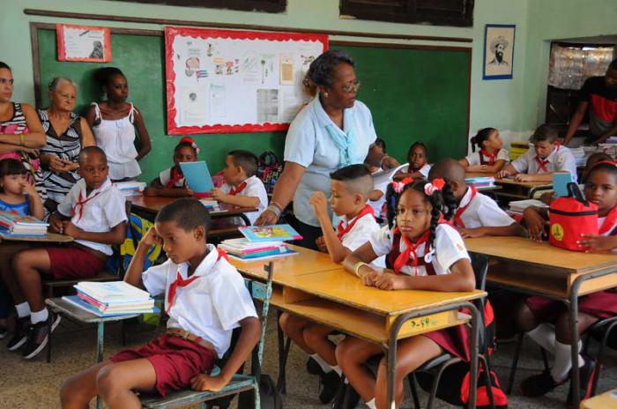
The Jesús Hernández Alfonso primary school as a trainer of values
Population: 200 students
Sample: 20 students y 2 teachers
Degree: 5to
Ages: 10-11 years

Slide 4
José Julián Martí Pérez National hero of the Cubans, patriot, revolutionary who dedicated his life to the fight for the independence of Cuba. José Martí, a man of great purity who wrote incessant texts on various subjects and sowed in them love and the need for justice; educator and pedagogue who inspires with his legacy to human improvement from the education and formation of values ​​and thinking ¨with all and for the good of all¨. A José Martí towards children is to train the future from the past because children are the hope of the world.
José Julián martí Pérez (1853-1895)

Slide 5
In primary school research site
PROBLEM
SITUATIONS
Little systematicity in the pedagogical treatment of the theme of the formation of values ​​from the thought of José Martí that is carried out in the center.
Little knowledge in the students of the values ​​from the thought of José Martí.
RESEARCH OBJETIVE
Develop an educational multimedia that is based on the thought of José Martí for the formation of values ​​in Primary School.

Slide 6
GROUP OF VALUES TAUGHT BY THE MULTIMEDIA.
Modesty
Patriotism
Dignity
Solidarity
Unit
Responsibility
Courage
Honesty

Slide 7
Methods and techniques of investigation
METHODS
Historical-logical
Inductive-deductive
Analytical-synthetic
Modeling
Percentage analysis
TECHNIQUES
Inventory of problems related to values
Survey on the formation of values ​​to students and teachers
Sentence completion for students.
interview with teachers
Observation Guide
Document Review

Slide 8
Educational multimedia definition.
(Hitchman Triana, 2022)
Technological medium that benefits the integration of knowledge, they allow the link between the theoretical and the practical, oriented to a constant communication with society, which allows each participant to acquire experience for the development of habits, skills and abilities. Their qualification responds to the purpose of the information.

Slide 9
Characteristics of the educational multimedia made
Create and guide situations that imply offering students the possibility of developing reflective, objective, critical and self-critical attitudes.
Promote reading in students and knowledge of Martiana's work.
Promote a learning process on values ​​from the thought of José Martí.

Slide 10
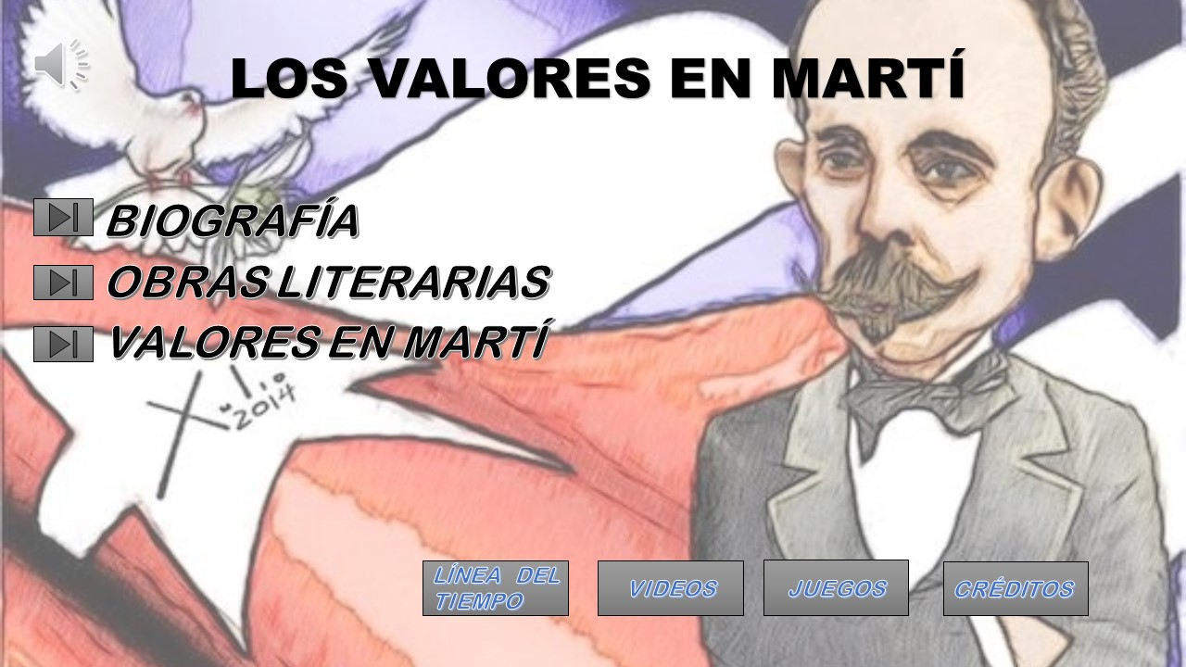
Educational multimedia.
For the elaboration of the educational multimedia, two programs were used: Power Point (belonging to the Microsoft Office 2010 package to elaborate the structure of the multimedia) and Hot Potatoes 6 (developed by the Research and Development team of the University of Victoria, Canada (Trujillo Domínguez, Montesering Puig, Hernández Pérez, 2015), to elaborate the games within the educational multimedia.

Slide 11
Main results after applied
WEAKNESSES
Insufficient information on the formation of values ​​in the files and in the characterization of the group.
The interaction with the multimedia is accompanied by the teacher or a student who previously interacted with her.
Little availability of computers for individual student interaction with multimedia.

Slide 12
Main results after applied
STRENGTHS
Teachers show greater motivation in their students, which helps to carry out the processes.
The technologies used as didactic means contribute to the motivation of students and the consolidation of learning.
Recognition of the values ​​in Marti's works and in his daily life.
Willingness and support of teachers to the activity.
Motivation of students for the study of Marti's work.

Slide 13
CONCLUSIONS
The formation of values ​​as a process supports its methodological theoretical foundations from axiology, pedagogy and psychology linked to the student's approach to the thought of José Martí. The proposed educational multimedia is characterized by the interrelation of values ​​and their formation from the thought of José Martí. Its components and their interrelation propose to help solve the problems encountered from a systemic, dynamic, reflective, educational, transformative nature. With the application of the proposal to the students of the selected sample of the Jesús Hernández elementary school, significant advances were made in the subject of the formation of values ​​from the thought of José Martí, evidencing multimedia as a useful tool for the educational process.

Slide 14
BIBLIOGRAPHY
Alfonso González, G. (July – September. 2005.). Values ​​and meaning of life. The philosophical debate of an era (1940 - 1960), p 90. In Themes. 2005, no 43. Havana.
Blanco Pérez, A (2004) Introduction to the Sociology of Education, Havana, Cuba: People and Education.
Baxter, E. (2003). How and when to educate in values? Havana, Cuba: People and Education.
Chacon, N. (1999). Formation of values. Methodological Propositions. PROMISED. Havana, Cuba: Academy
Crusellas, I, Hernandez. (2010). MEPPIA Multimedia. Thesis presented for the title of Master in New Technologies for Education. University of P del Rio.
FONDEVILA GASCÓN, Joan Francesc (2010). «Multimedia, digital press and journalistic genres in Catalonia and in Spain: an empirical analysis». Communication Studies Journal, Number 7, May, pp. 81-95
Hitchman Triana, S (2022) The formation of values ​​from the thought of José Martí and Fidel Castro in Primary Education. (Diploma Thesis) Faculty of Education Sciences. Enrique José Varona University of Pedagogical Sciences. Havana Cuba.
Trujillo Domínguez, R., Montesering Puig, C., Hernández Pérez, AJ. (2015) Utility of the Hot Potatoes software for the elaboration of interactive exercises. Scientific Information Magazine. Vol91, No.3, Suppl.1, 713-720. Retrieved from http://revinfcientifica.sld.cu

Slide 15
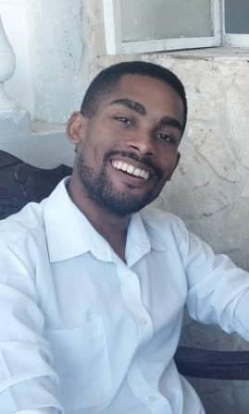
Team Presentation
Lic. Samantha Triana Hitchman.
Email: samanthatrianahitchman@gmail.com
Lic. Jhonathan Villavicencio Rojas. Email: jhonathaneducador@gmail.com
Graduates in Education, specializing in Pedagogy-Psychology. Professors of the Faculty of Educational Sciences, University of Pedagogical Sciences "Enrique José Varona".

