Slide 1
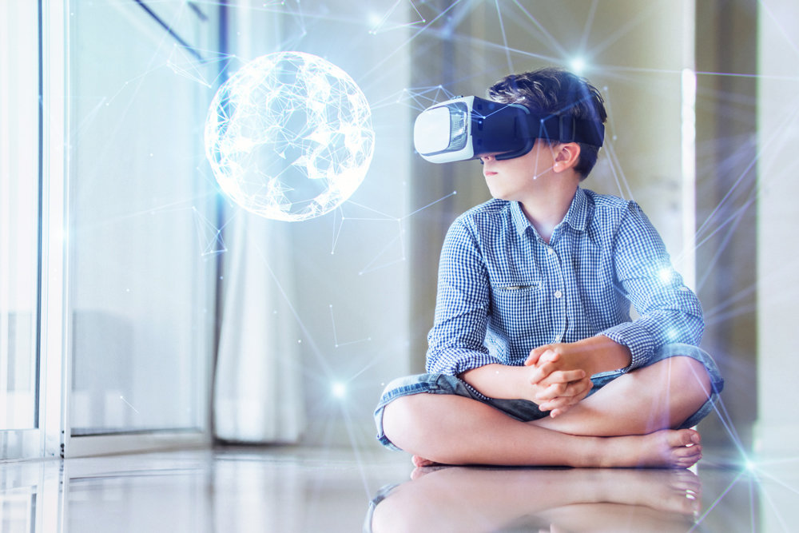
The International Psychological Forum “Child in a digital world”, June 2024
Organization of constructive emotional interaction of preschoolers in the context of digitalization of education
Batenova Yu.V., Ph.D. in Psychology
Filippova O.G., Doctor of Pedagogical Sciences
South Ural State University of Humanities and Pedagogy
Chelyabinsk, Russia
Исследование выполнено при поддержке гранта Российского научного фонда № 23-28-10173, https://rscf.ru/project/23-28-10173/

Slide 2
Relevance
In the modern world, due to the rapid development of information technologies and the great attention to this topic in the field of education, social and emotional spheres of human development are fading into the background. This implies the importance of the development of social emotions in the conditions of digitalization of society. However, these processes can also coexist if the educational process is competently built, starting from preschool age.
The study of the relationship between the active use of digital technologies by older preschool children and the development of social emotions in the learning process.
The purpose of the study

Slide 3
The main results
Test «Diagnostics of children's abilities to partner dialogue» by A.M. Shchetinina.
The study involved 25 children of older preschool age.
In order to obtain quantitative results, four levels of socialization of children were identified at the first stage: high, above average, medium and low.
During the diagnosis, it was found that, in general, the overall level of socialization in children is average.

Slide 4
Continuation of the results
Questionnaire for parents to determine computer addiction in older preschoolers by V.G. Pisarev.
In order to obtain quantitative results at the second stage, a questionnaire was created on the Google Form platform based on the V.G. Pisarev test.
Indicators of severity: 7-11 points – low level of dependence, 12-17 points – average level of dependence, 18-21 points – high level of dependence.
After processing the results, it was revealed that children among the surveyed families have a high level of computer addiction.

Slide 5
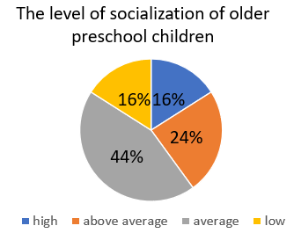
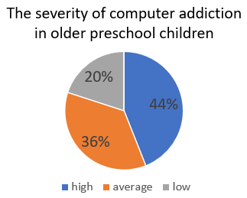
Conclusion of the pilot study

Slide 6
We can’t exclude computers from modern children’s lives
Our study showed quite expected results: the average level of development of social emotions of older preschool children and a high level of severity of computer addiction. Such an imbalance leads to extremely undesirable consequences in the form of:
disorders of the emotional-volitional sphere (aggressiveness, impulsivity, irritability, anxiety, apathy);
increased excitability (predominance of excitation processes over inhibition processes);
demonstrative behavior;
insufficient development of speech, impaired contacts with others, problems with socialization;
disorders in the development of higher mental functions.

Slide 7
We can’t exclude computers from modern children’s lives but we can help them cope with it
Studies also note the positive impact of digital devices on the development of children, but only if smart devices are competently introduced into the processes of education and training. We believe that for the normal development of personality in modern society, it is necessary to find and implement a «golden mean» in this matter. Therefore, there is no clear answer to the question: «Information technologies in education and the development of social emotions: are they complementary or mutually exclusive?» - everything here depends on the attitude of adults, the teacher or the parent, to this problem and their desire to help the child adapt in the rapidly developing modern world.

Slide 8
Teachers and parents should «work together», as the theory tells us, but in real life it is quite difficult to achieve harmonious partnerships. Teachers in preschool educational organizations have a theoretical and practical basis on the psychological features of children's development. Children under 5 years of age are not recommended to use a computer, and, starting from 5 years of age, the time spent at the computer should not exceed 15 minutes. In addition, the lighting is taken into account, at what distance the child is sitting at the computer, the distance of the eyes from the screen. After the activity at the computer, it is necessary to carry out eye exercises.
All this is unlikely to be carried out outside the pre-school, i.e. at home. Therefore, it is the structured interaction of the preschool educational organizations with the family that can serve as the key to solving the research problem.

Slide 9
The reasons why children, in principle, turn to digital devices and spend so much time behind them:
boredom;
lack of organized leisure;
the desire to win, to be better than others;
escape from reality;
the desire to get emotional release.
One of the neoplasms by the end of preschool age is the phenomenon of «subordination of motives». The above reasons arise due to the lack of volitional regulation and cognitive motivation in children at the stage of senior preschool age. That is, it is easiest for a child to turn on the computer and enjoy colorful pictures while in the process of passive listening, without interactive activity and mental load.

Slide 10
On the one hand, this does not contradict the natural course of events, since the game is the leading activity in preschool age. However, the game should also contain educational content that does not contradict the features of the child's not yet formed psyche. On the other hand, the modern world is oversaturated with information and a more correct solution here is to start learning to select only the right ones from preschool age. This leads many modern scientists to say that research activity is already on a par or even predominates over gaming in aspects of the activities and development of modern children.
So, to highlight the part of the statement that information technologies in teaching and the development of social emotions complement each other, we have selected several «keys»:
Competently structured educational process in the preschool taking into account the use of smart devices;
Psychological and pedagogical support of the family, in particular on the use of digital devices by the child;
Active organization of leisure, research activities for children, taking into account the use of digital devices.

Slide 11
Recommendations
So, taking into account the competently structured work of the teacher and the preschool as a whole, our practical recommendations are aimed at helping parents organize their child's leisure time:
Remember about the «golden mean». It is important to saturate the child's leisure time with direct contact with the real world and gradually introduce him to the virtual;
Arrange walks, a family picnic, visit museums and theaters. The experience of watching will help the child not to perceive the computer as the main and only source of information;
Organize joint activities (drawing, modeling, flower breeding, animal care, etc.). The child's research activities will be concentrated in the real world, and the virtual world will remain just an assistant that does not require a lot of time;

Slide 12
Continuation of the recommendations
When you see that the child can subordinate motives, give him the opportunity to choose. If there is a need to find something on the Internet, study, play, then it is important to trust your child and show that his opinion is taken into account. With this attitude, the child himself can be aware of the limits of his activity at the computer and be an active subject of activity.
Parents are the greatest authority for a child. Be ready to show an example of an adult who knows how to allocate his time;
Talk more with your child, create an emotionally safe environment for personal development. Show that talking about the dangers of digital devices is not a ban in order to anger a child, but an attempt to negotiate and take care of him.

Slide 13
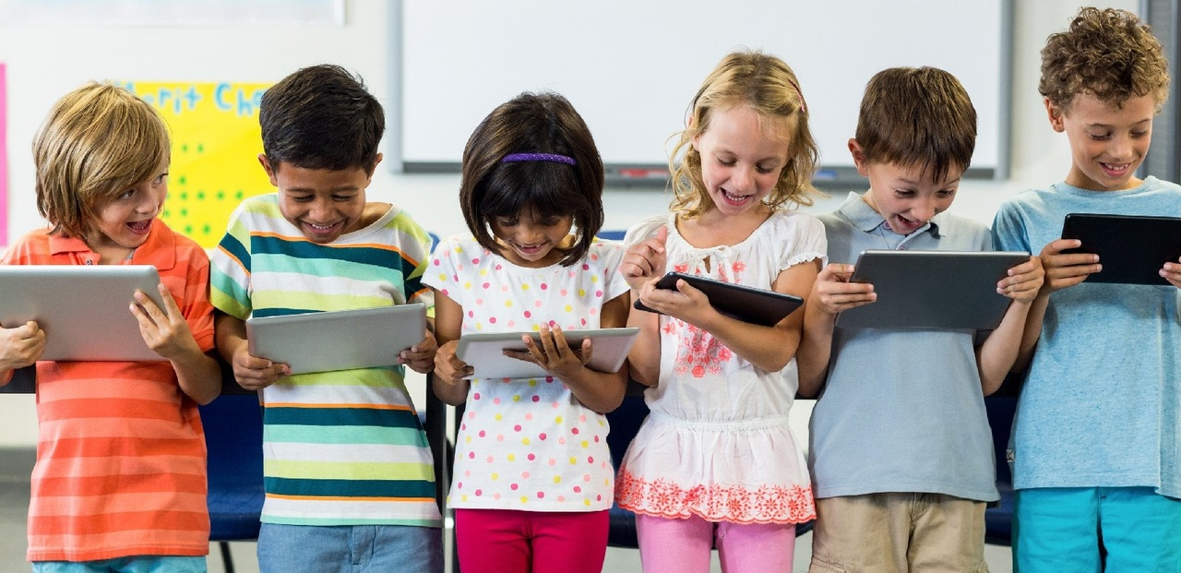
Summing it up:
The results of this pilot study necessitate a theoretical analysis of the characteristics of the higher mental functions of older preschool children and social emotions in the context of the development of a digital society and the development of practical material for organizing constructive emotional interaction of preschoolers in the context of digitalization of education. In this case, the risk of a negative impact on the socio-emotional development of preschoolers is more likely to be reduced without excluding digital technologies from the child's life.

