Slide 1
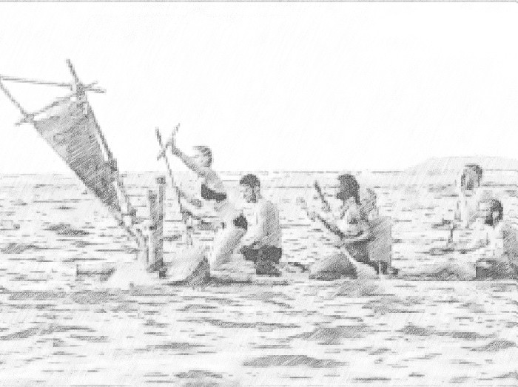
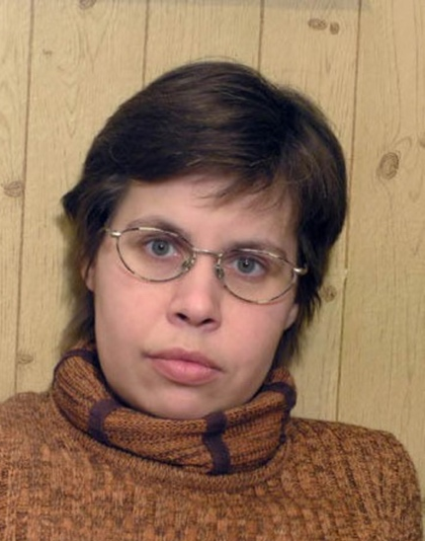
Proportionality of magnitudes' transformations: scaffolding substantial learning cooperation in the digital environment
M. YANISHEVSKAYA, PhD, leading researcher
E. VYSOTSKAYA, PhD, leading researcher
A. LOBANOVA, researcher
Psychological Institute of RAE, Moscow
International Psychological Forum 1-2 June 2022

Slide 2
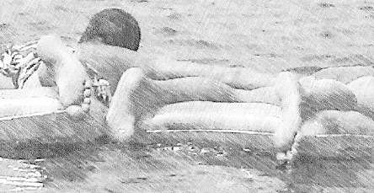
Learning Task Setting: Survivor game
Students join the fans of “Survivor – show” and try to help the team of players, who need to escape the lost island on the buoys (small beach mattresses), which are scattered in the thicket. During the lesson children can participate “online” in the problems and challenges, which survivors face according to the show’s script.
The “intrigue”:
There are less buoys, than needed for all of the team members to escape.
How many people will have to take a certain number of buoys to escape successfully? An accurate calculation is needed here!

Slide 3
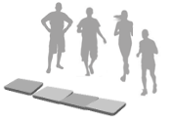
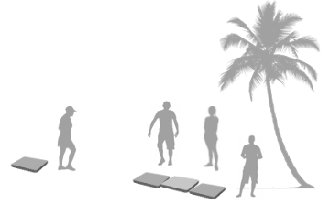
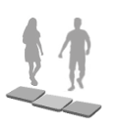
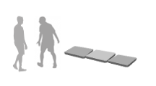
As the storyline unfolds, the “survivors” and also the students understand that they don’t have the means to solve the problem. Thus, the challenge of balancing rafts transforms to the learning task (V.V. Davydov): students in the class have to reveal and test the ways to achieve and preserve balance.

Slide 4
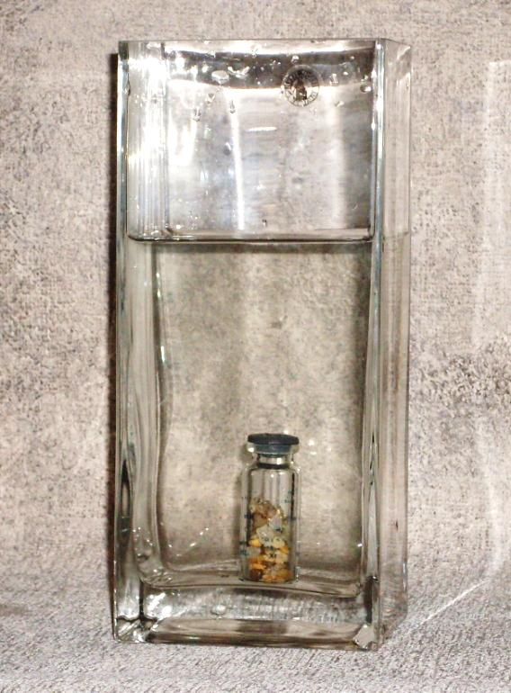
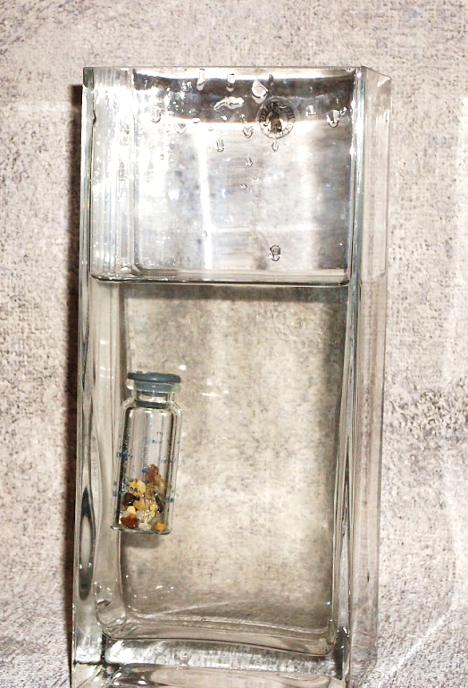
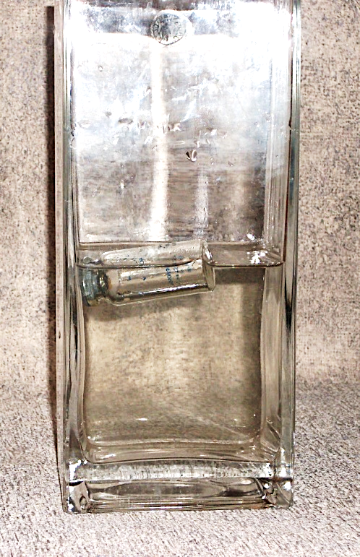
The contradiction between the common and the conceptual vision on buoyancy keeps the tension, frames the promotion within the learning task and justifies the introduction of a special modelling space
floating
balanced
sinking
The notion of the intermediate state of balance between sinking and floating – which is new for students – will be scaffolded by the “Make it float!” computer simulation
Notes:
Students dealt with flotation problem. Their major task was to learn to control buoyancy of a vessel through a series of situations, that demanded to sink, float or balance the given vessel.

Slide 5
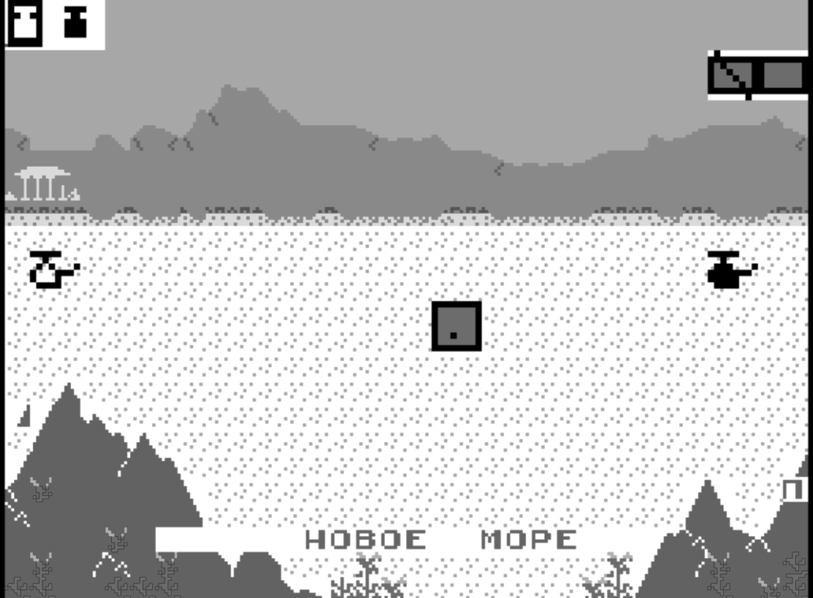
Students proceed to the shipyard and search for the balanced combination of buoys and weights
One in a pair can add or withdraw weighs using this cursor
The second student can add or withdraw buoys using this cursor
one weight unit
A floating vessel, that needs to be balanced
"Make it float!" simulation
New water

Slide 6
“Dots – in – box” model.
can be varied
mass
is the buoyancy changed?
volume
can be varied
Two non-overlapping quantities
forming a ratio
Notes:
The vessel in our computer simulation was presented by a “dots-in-box” model. Essential characteristics of an object (which are mass and volume) were presented with elements that sent the vessel in opposite directions (weighs made it sink and vials made it float)

Slide 7
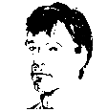
Problem solving by joint actions
floating
assignment:
make it
balanced
in charge of
‘weights’
in charge of
volume units
balanced
students
have to coordinate
their actions
To realize the opposite functions of weight and volume, students switch their roles.
Notes:
The task is presented to a pair of students – each in charge of his own value. While children have to cooperate to get the needed result, they form the idea of buoyancy as a mean of coordination.

Slide 8
The ways to coordinate actions (through composed unit) develop into ways to coordinate magnitudes involved in a proportion and comprise the essence of the proportionality concept.
The tendency of students to take into account only salient changes of absolute values (extensive magnitudes) is overcome as students have to coordinate their actions in order to maintain or change the ration (the intensive magnitude). And they obtain the means to do it within a special modelling space.
The coordination of the magnitudes' transformations in the context aimed at the preservation of buoyancy, leads to comprehension of proportionality between heterogeneous magnitudes of interest (such as mass and volume). Both partners that share the control over the ship's construction have to suggest the exact way to coordinate their efforts, as it is impossible for them to achieve the desired result individually.

Slide 9
“Make it float!” computer simulation:
Is able to deliver the needed meaningful context;
Increases skill level of students while allowing more tasks to be solved during the classes;
Boosts core understanding because the matter is presented in a “purified” form, which is not contaminated by real-life inaccuracy;
Scaffolds the modelling of actions as the first step towards adequate conceptual modelling of objects
Notes:
Flotation problem is a learning context that supports early stages of ratio-concept formation. Compared to the traditional way of teaching the concept of density, it is equally efficient in terms of formal knowledge and far more efficient when it comes to conceptual understanding and real-life situations.

Slide 10
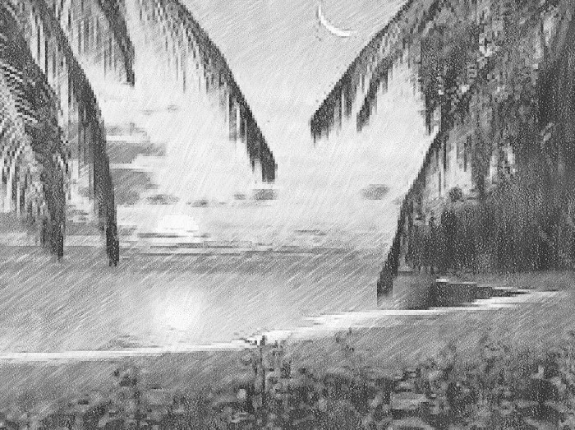
Thank you for attention!

