Slide 1
«Do your own research» and experience of children's philosophizing
Vasilieva Evgeniya
PhD in Philosophy
Тeacher

Slide 2
The author presented the expression "Do your own research" as an opportunity for independent search and selection. Search algorithms are based on search bar keywords and user query history. Because of that users can «fall into the rabbit hole» of misinformation. As the result DYOR has transformed into an ironic Internet meme.
Our main objective is to teach children
-isolate the main and necessary information
-analyze the reliability of the information source
-study(consolidate information)

Slide 3
Risks of the digital space for the effective development and education of children
The conventionality of the digital space with the availability of a large amount of information and contacts can lead to an imbalance of interests and needs, both real and virtual
The algorithm of communication "on demand" differs from the real skills of interaction and building constructive relationships - it does not require the development of emotional intelligence, for example
Risks of manipulative influence of the content of social networks and forums
Dependence on "likes" - thanks to the digital space, the need for social recognition characteristic of puberty gets a wide audience and even "monetization", a powerful magnet and a stress factor at the same time

Slide 4
Overcoming risks of the digital space
We are interested in the formation of critical thinking, the development of reasonable reflection aimed at understanding oneself, one's own system of values, relations with the world, without which the results of the primary message of DYOR are of little value.

Slide 5
Pedagogical practices of philosophy for children: goals and objectives
Philosophy with children is one of the most intensively developing branches of modern philosophy and pedagogical practice, there are centers of "Philosophy for Children" in more than 50 countries.
In Russia, the philosophical Faculty of Moscow State University has become the scientific and methodological center of this problem, where conferences, seminars, and Olympiads on philosophy for schoolchildren are held.

Slide 6
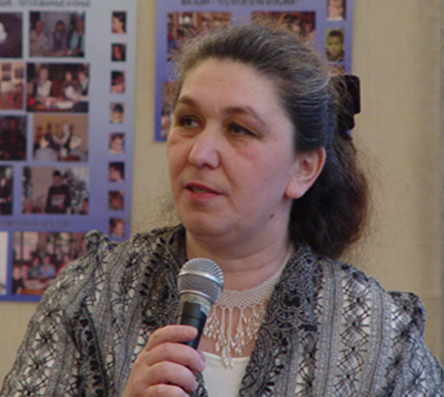
Principles of the author's philosophical methodology for children (L.Retyunskikh)
Preservation and development of a child's natural curiosity
The principle of dialogics is based on the Maieutics (Socrates' method) and involves the activation of the thought process, its stimulation with the help of a specially organized conversation. Philosophical conversation is based on the principle of equality of interlocutors (teacher-student)
Linguistic and communication effect of open dialogue-discussion
Activity and independent position of the participants (the child is the subject of decision–making based on his own conclusions)
The principle of creative problem solving is implemented through the methodology of constructing educational tasks, the performance of which requires not a demonstration of erudition, but independent analysis, own understanding of the problem

Slide 7
The report is illustrated with an article from the children's philosophical newspaper "Owl" No.84
«HOW TO HELP COMMUNICATION?» Vasilyeva Olga, 11 years old
The autumn theme camp in the "Beryozovaya roscha" was dedicated to communication. On the final day of the "Contacts and Conflicts" class, we looked into the reasons for successful and unsuccessful communication: we talked about etiquette and its differences in different cultures, about understanding and interest during communication. It was very interesting to give examples of conflicts and look for ways to solve them. All the guys agreed that it is better to avoid conflicts and quarrels, but it does not always work out. That is why we decided to make a universal set of special means of emergency assistance to the participants of the conflict.
FIRST AID KIT FOR CONFLICT PREVENTION
* Soothing spray * Scissors for «cutting off bad thoughts» * Lotion to «disinfect bad memories» *
* Warming tea of mutual understanding * Positive Vitamins * «Mutual disposition» pills *
* Injection of sleeping pills «Tomorrow is another day» *
Of course, you realized that you can't buy such drugs in a pharmacy. However, they can tell you how to extinguish the conflict. At the end of the lesson, we played a super-conflict and applied almost all the medications. And as a result, we had great fun! It's just that humor and fun glue the company together better than any Band-Aid.

Slide 8
"Why does the child philosophize?"
Cognition as the essence of the world of Childhood and the world of Philosophy is combined in the child in the form of initial interest – curiosity – a semantic coincidence of interest in the world and interest in oneself, when philosophizing becomes possible.
It is vital for a child to explain the world to himself so that it is clear and convenient to be in it. Since this is his own discovery, it dispenses with resentments, internal and external conflicts.
The environment of open and confidential discussion implemented by the method of philosophizing creates the adoption of a style of constructive interaction with others and the information environment.

