Slide 1
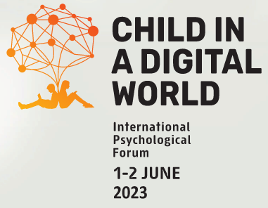
Parental Attitudes Towards the Use of Digital Devices in the Family for the Development of Older Preschoolers
Belova, Elena
Psychological Institute of the Russian Academy of Education, Moscow, Russia, elenasbelova@mail.ru
Shumakova, Natalia
Psychological Institute of the Russian Academy of Education, Moscow, Russia, n_shumakova@mail.ru

Slide 2
Relevance
At preschool age of children, parents have a crucial influence on their development.
In this regard, the study of the issues of childhood digitalization determines the importance and relevance of their consideration in the context of family education.

Slide 3
Aims
To study the attitude of parents to the use of digital devices in family for the development of children of older preschool age;
To analyse the influence of digital devices use in family education on intellectual development of children.

Slide 4
Methods
Participants: 273 pаrents (predominantly mothers: 233 mothers, 40 fathers) and their children of 6-7 years old (Mage=6.78, SD=0.33; 137 boys, 136 girls). All preschoolers and their parents live in Moscow.
Methods: survey of parents (included questions about both parents); Express-Diagnostics of Intellectual Abilities and special technique for revealing the creative and intellectual potential were used for children.

Slide 5
Methods
Survey of parents
using a specially designed questionnaire, including questions about the use of digital devices for the development of the child at home (frequency, time, programs / games); each questionnaire included questions about the position of both the father and the mother.
Diagnostics of children intellectual development
Test of intelligence: Express-Diagnostics of Intellectual Abilities (blank technique EDIA);
special technique for revealing the creative and intellectual potential were used on the game lesson.

Slide 6
Results
96% of parents consider it possible to use a tablet / computer for the development of a child, believing that, when used wisely, digital devices contribute to the cognitive development of preschoolers.
Among the parents who are positively disposed towards the use of digital devices, groups were identified according to their position on how often a tablet / computer should be used for the development of a preschooler: group 1 - rarely; group 2 - moderately; group 3 - often (see Fig. 1).
The coincidence of the positions of both the fathers and the mothers was observed in 64.88% of families, while almost half of the fathers (53.8%) and slightly less than half of the mothers (43.1%) were in favor of rare interactions of a child with digital devices.

Slide 7
Results
Fig.1. The use of digital devices for the development of older preschoolers in family: the opinion of parents

Slide 8
Results
Fig.2. Computer programs / games used by parents for the development of older preschoolers

Slide 9
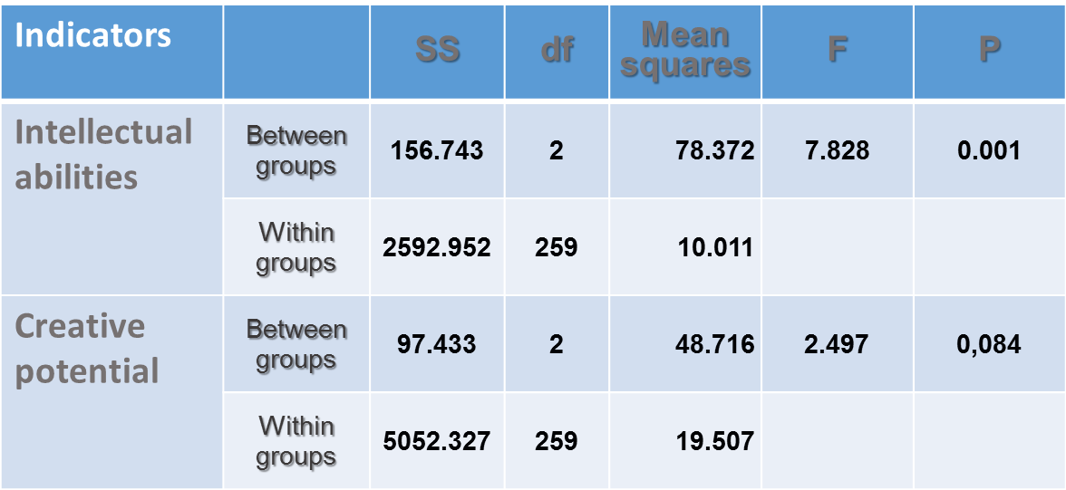
Results
Table 1. The impact of frequency of using digital technologies in family education on older preschoolers’ intellectual abilities and creativity: Univariate analysis of variance (ANOVA)

Slide 10
Conclusions
The attitude of modern parents to the use of digital devices for the development of older preschoolers is characterized by a variety of opinions. But the majority of parents (96%) positively assess its influence on the preschoolers’ development.
Three groups of parents were identified according to their opinion on how often a preschooler can interact with a digital device: often, moderately, and rarely. The consensus of both parents was observed in 64.88% of families.
An analysis of the parents’ choice of digital content showed that they are mainly aimed at developing the child’s cognitive sphere by computer programs developing logical thinking (69.8%), memory (50.7%), etc.
The diagnostics of the children development showed the importance of the frequency of a digital device use for their intellectual development: it is higher in children of those parents who considered it better for preschoolers to use digital devices 1-2 times a week for developmental purposes.

Slide 11
Belova, Elena elenasbelova@mail.ru Shumakova, Natalia n_shumakova@mail.ru
Thank you for your attention!

