Slide 1
“PLAY WITH FORI” AN INNOVATIVE EDUCATIONAL PROGRAM FOR SOCIAL-EMOTIONAL SKILLS DEVELOPMENT IN BULGARIAN PRESCHOOL EDUCATION
Assoc. Prof. Sevdzhihan Eyubova, PhD
BULGARIA

Slide 2
Shumen is
the tenth largest city
in Bulgaria.
The Episkop Konstantin Preslavski University of Shumen
www.shu.bg

Slide 3
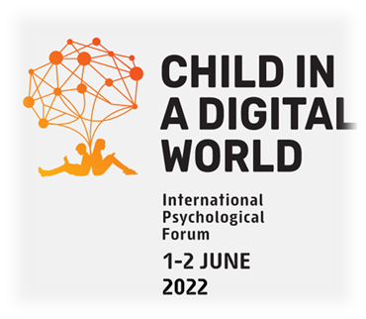
AIM & OBJECTIVES:
AIM
To present the innovative educational program “Play with Fori”
OBJECTIVES
To define the concept of emotional literacy
To describe and discuss the preliminary research results
To analyse the effectiveness of the educational program “Play with Fori”

Slide 4
The concept of emotional literacy
Steiner (1984) defines emotional literacy as the ability to experience a variety of emotions at a variety of intensities, with knowledge of the causes for these feelings.
In order to develop emotional literacy (Steiner & Perry, 1997) we have to:
be able to recognize, differentiate and name the emotions
manage and regulate different emotional states in ourselves
be socially proactive and help others regulate their emotional states which provides the basis of the empathy.

Slide 5
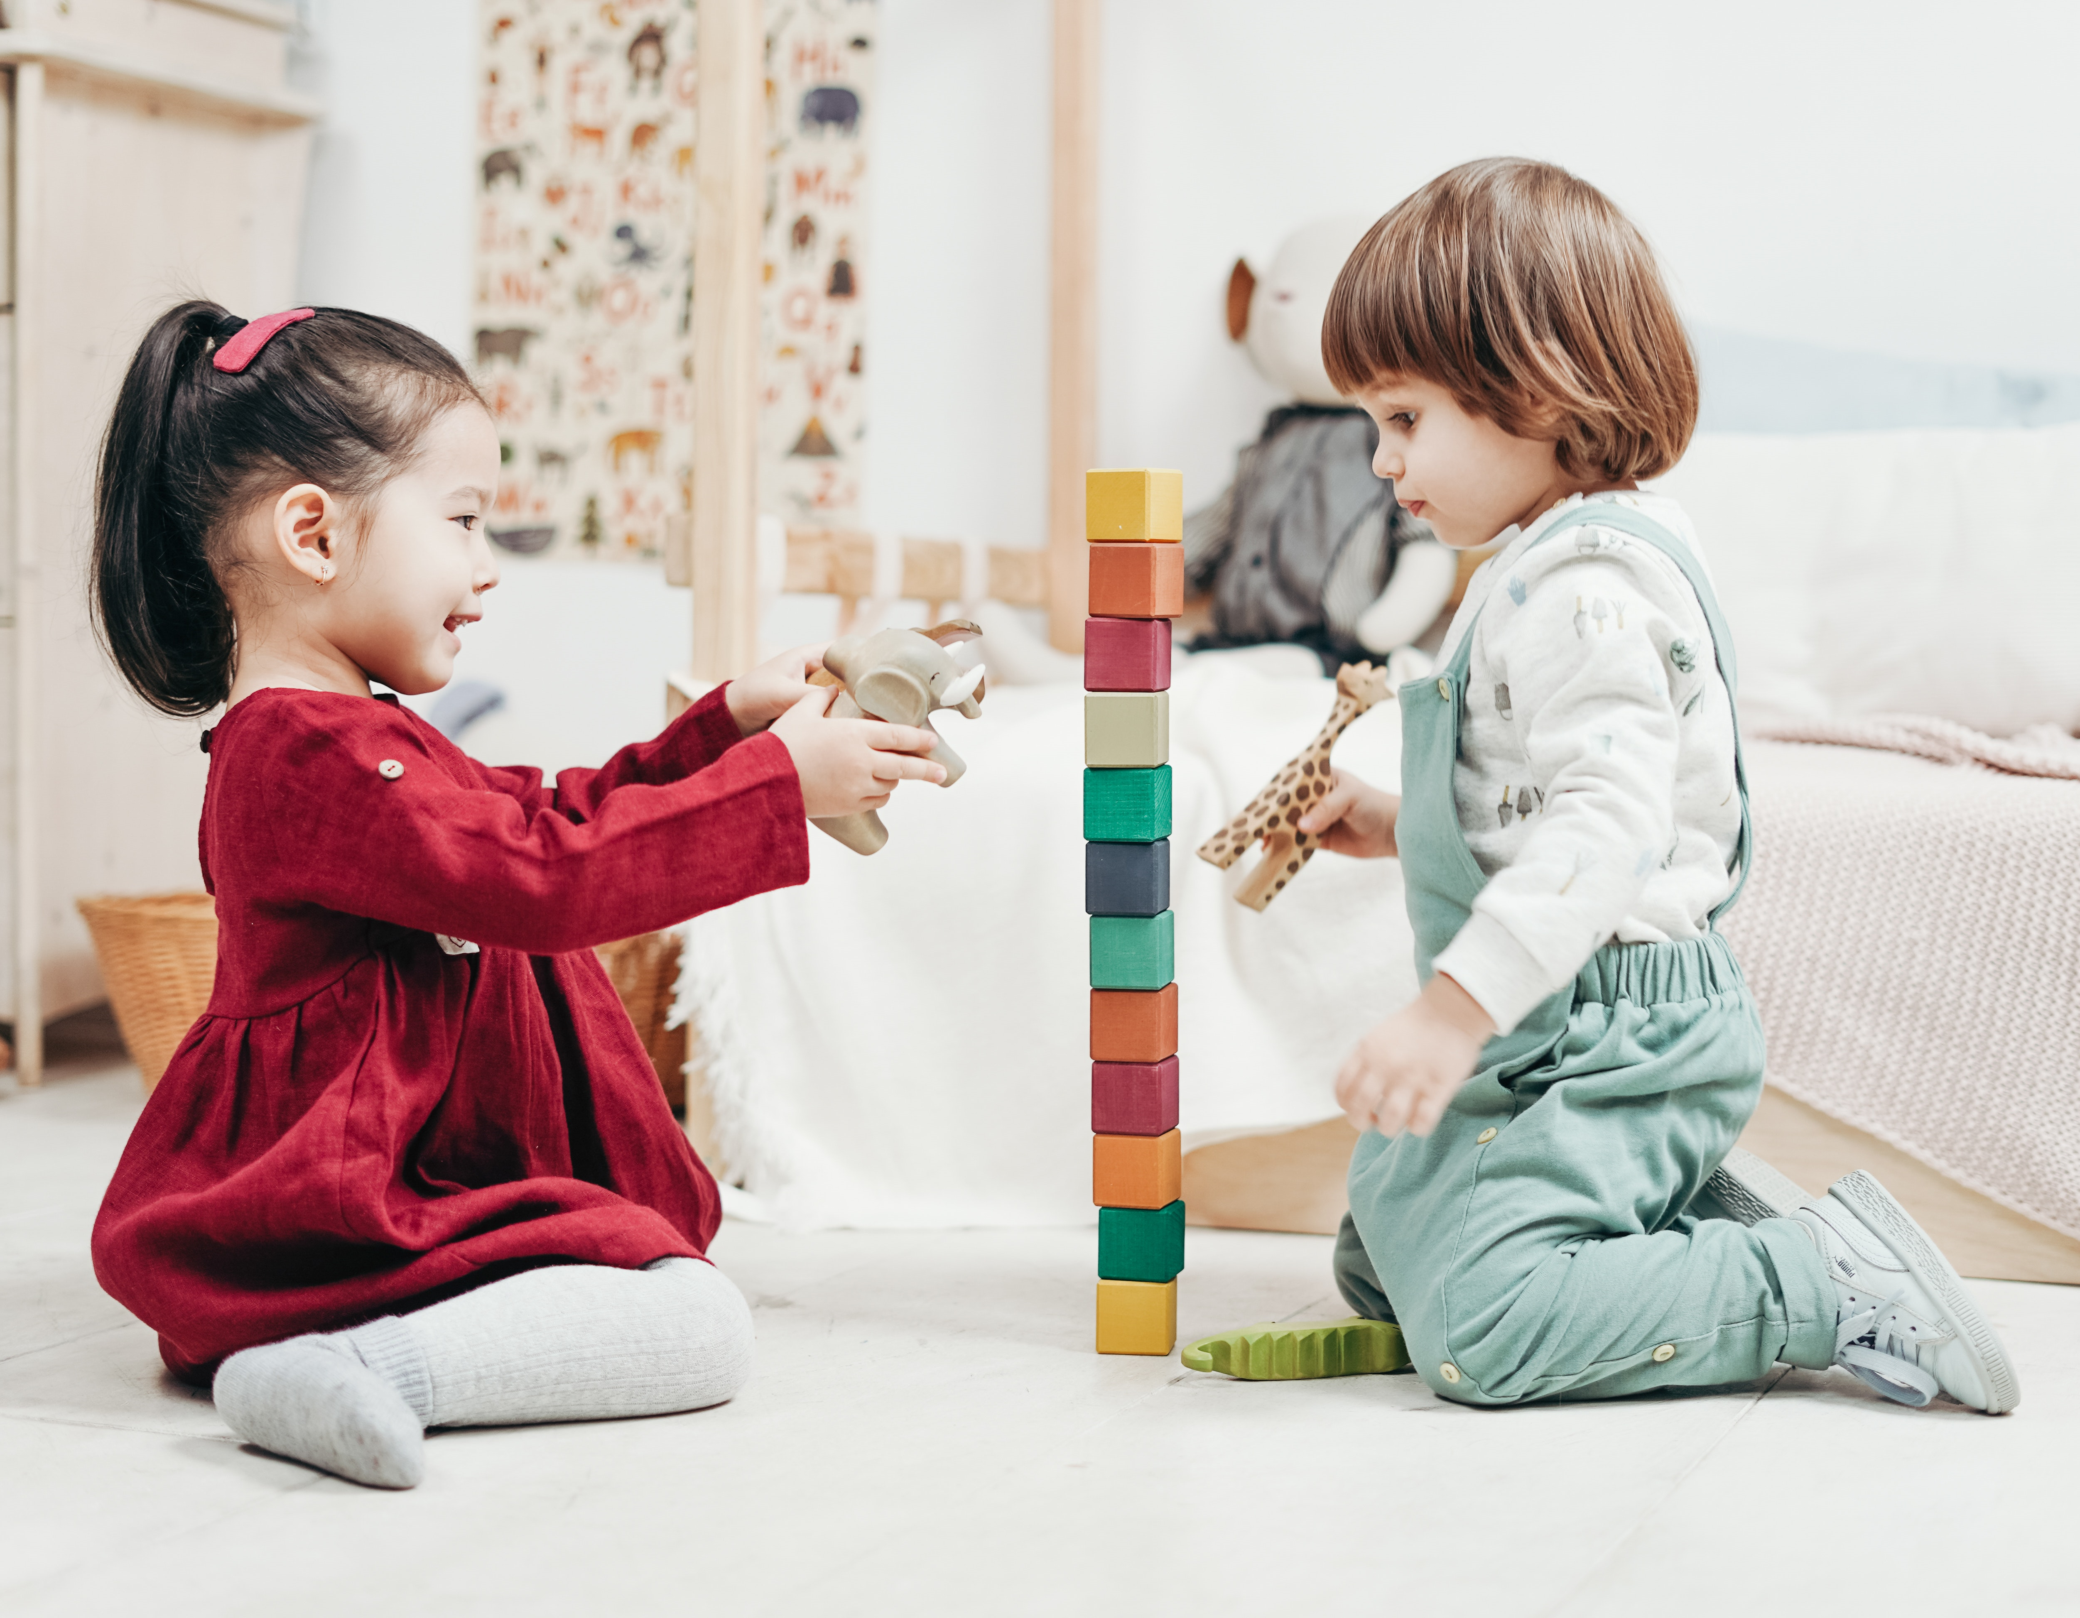
Characteristic of preschool age
intensive period for development of social competencies
marked by major life transitions
children learn to accept others point of view
they are interested in the emotions of others
start to make friends by themselves
they use their verbal skills more often in social interactions

Slide 6
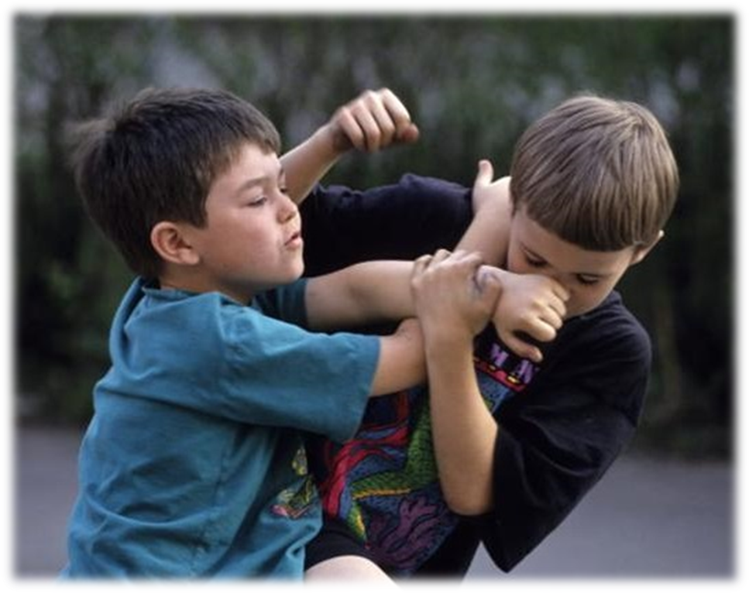
Children with emotional literacy deficits are more likely to experience:
Izard CE, Fine S, Schultz D, Mostow A, Ackerman B, Youngstrom E. Emotions knowledge as predictor of social behavior and academic competence in children at risk. Psychological Science. (2001);12:18–23.
difficulties to connect with peers, teachers and significant adults;
risk of developing internalized behavioural problems (anxiety, depression);
tendency to use aggression to express their needs;
isolation and rejection from others;
learning difficulties.

Slide 7
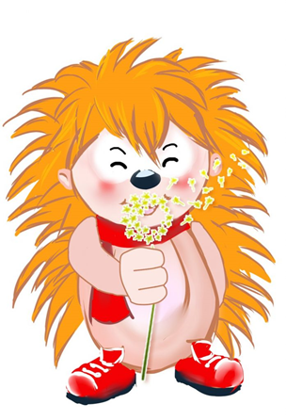
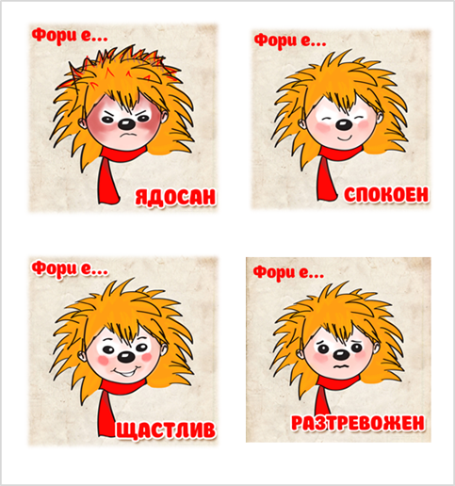
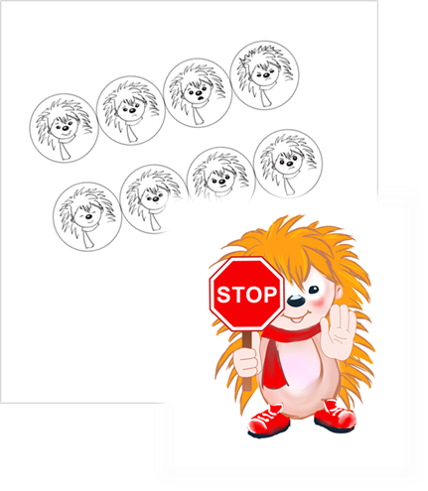
10 MODULES for 10 WEEKS / once a week +50 DIDACTIC GAMES 8 BASIC EMOTIONS 2 ASSESSMENTS WITH PICTURE TEST
PLAY WITH FORi
PRE-ASSESSMENT
M2
M3
M7
M6
M5
M4
M8
POST-ASSESSMENT
M1

Slide 8
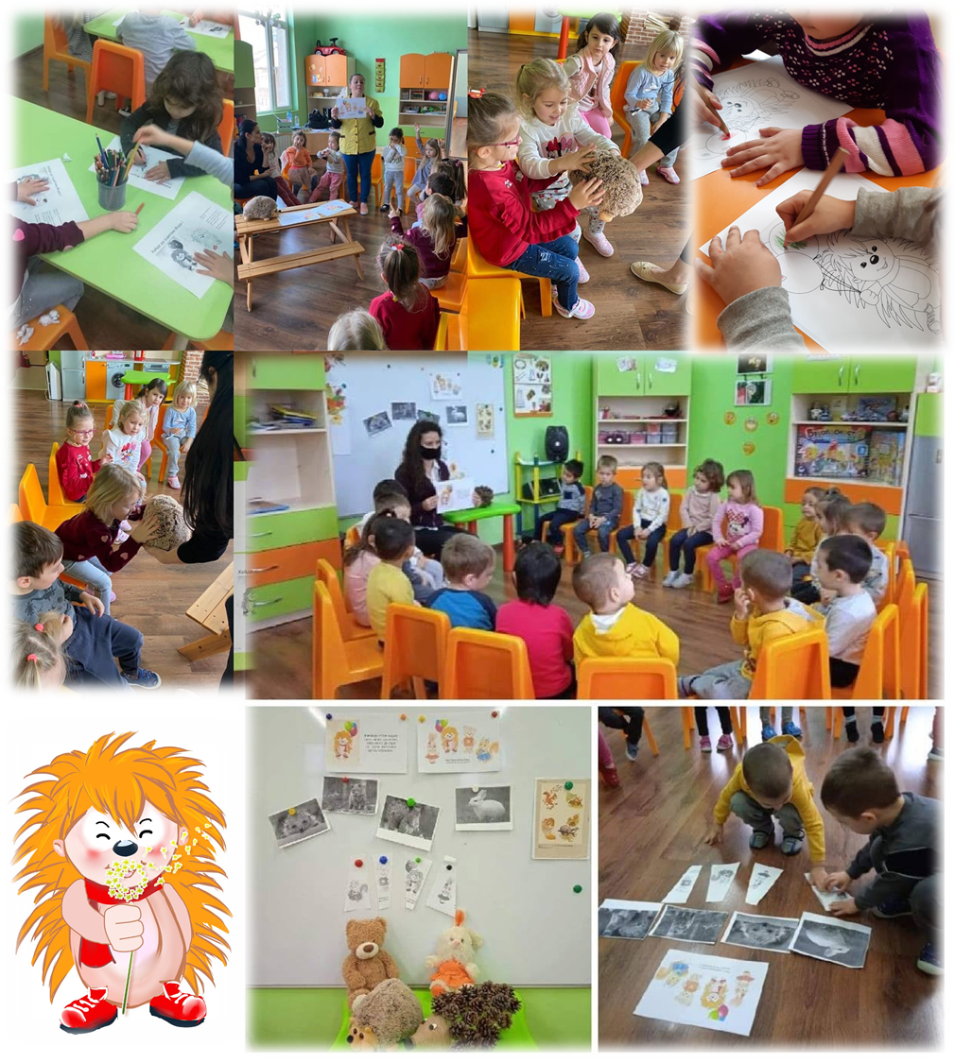
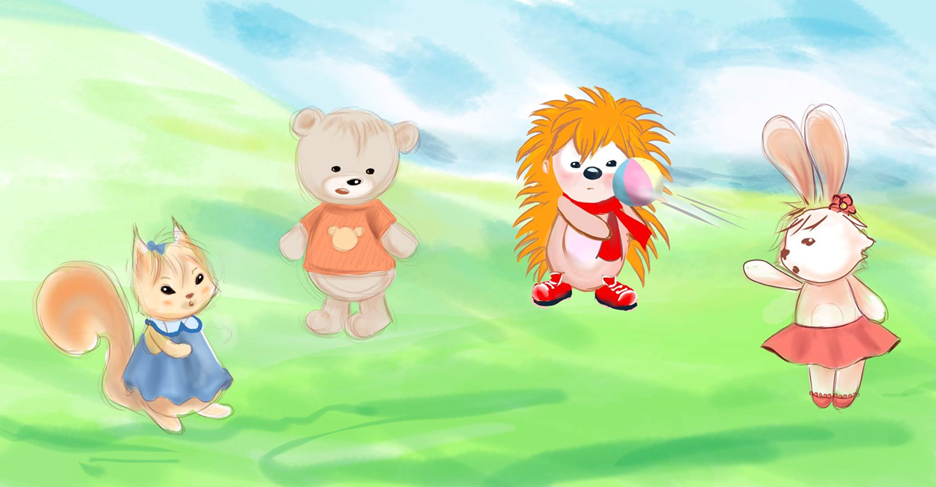
The program begins with the story and situation in which the main character Fori the hedgehog finds himself, the emotion he feels and the related facial expression, as well as his attempts to deal with the situation.

Slide 9
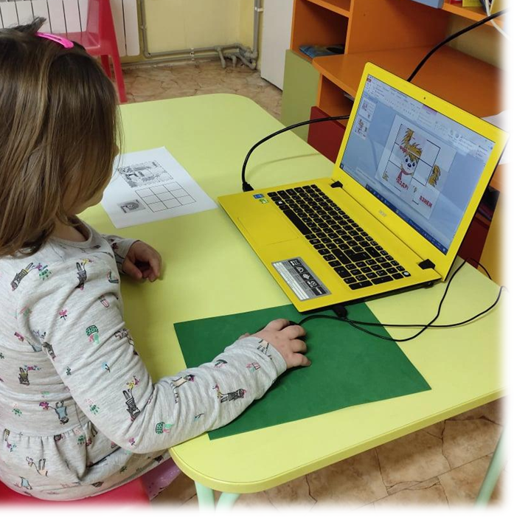
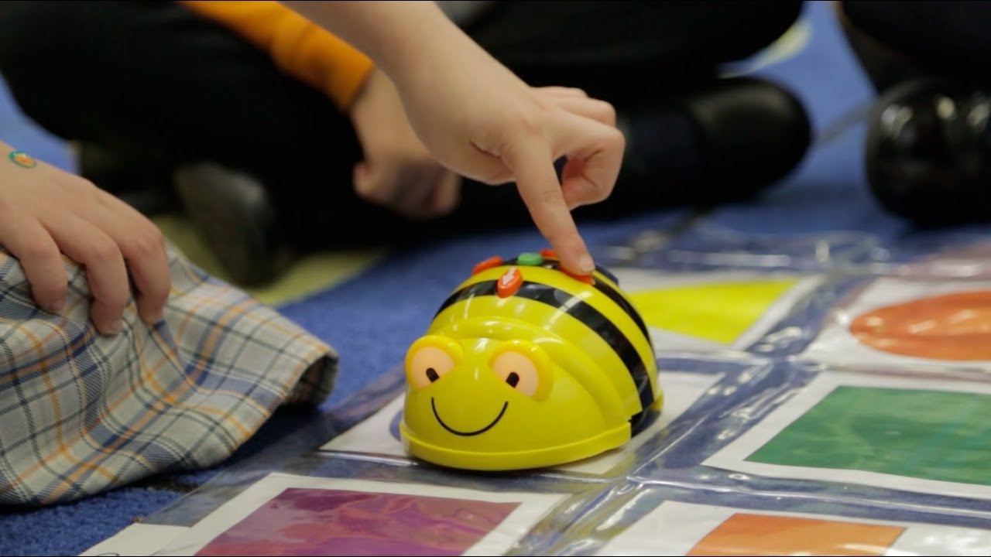
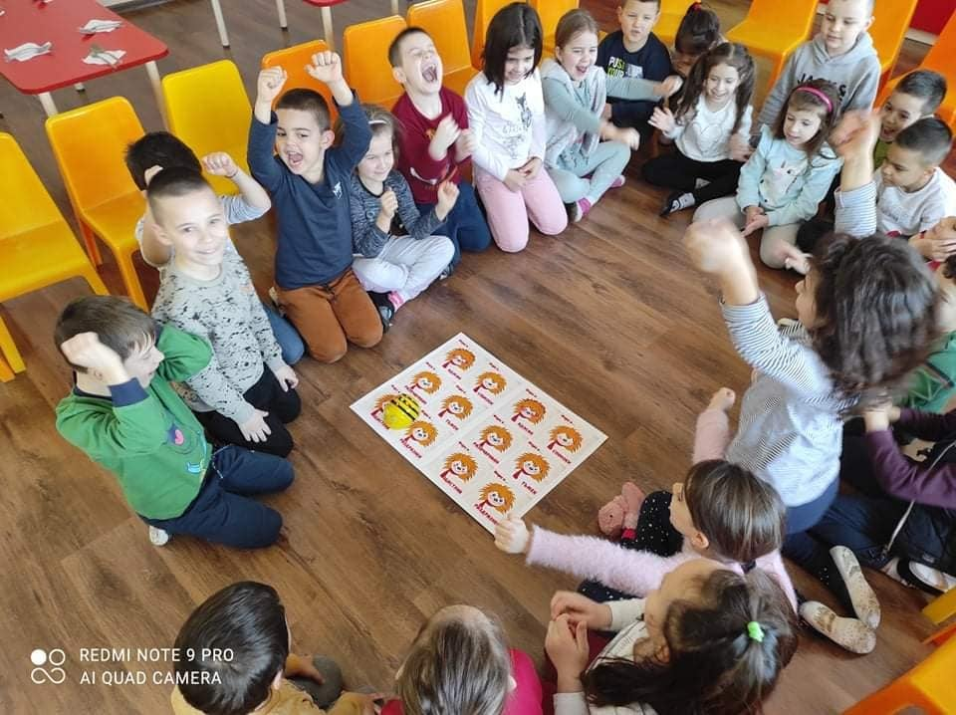
PLAY
WITH
FORi
Half of the content of the educational program is digitalized
and provides opportunities to combine the learning experience with different devices – laptops, smartphones, interactive boards, Bee-Bots.

Slide 10
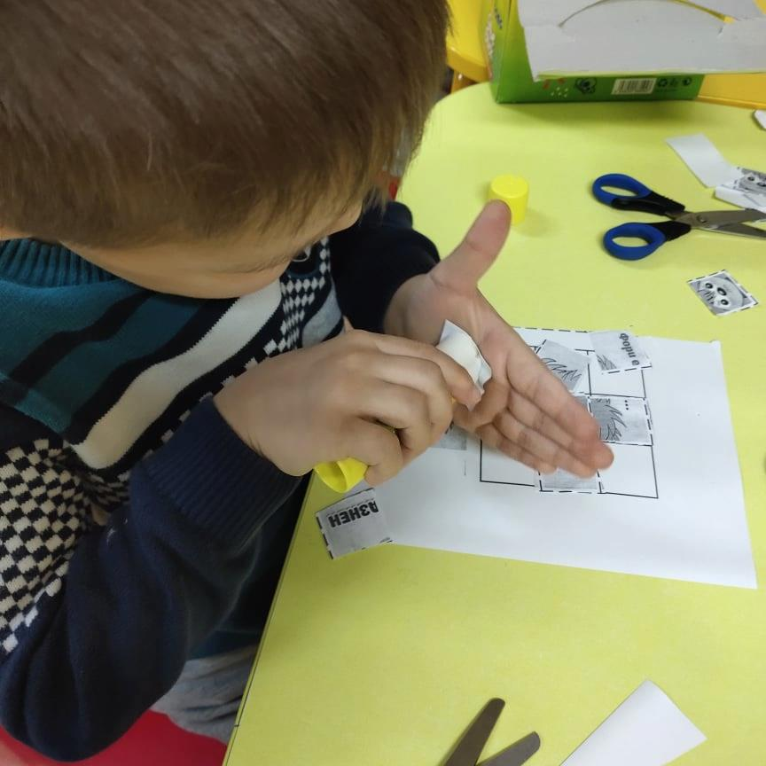
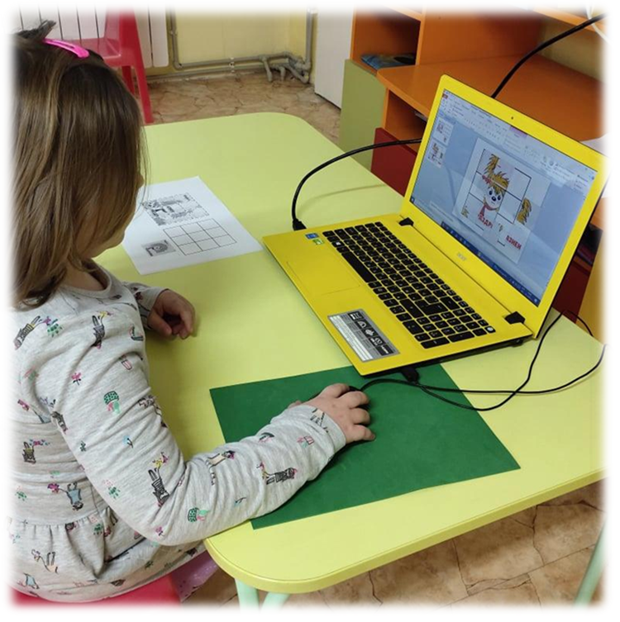
Thanks to Fori, children can easily progress in the world of emotions and this happens while having fun. They learn words about emotions, recognize them, practice their motor skills for cutting, gluing and constructing. Teachers also combine the emotional literacy lesson with digital competences because some of the tasks could be performed in a digital environment.

Slide 11
PURPOSES OF THE STUDY:
to explore the level of emotional literacy in four different age groups
to conduct pre- and post-assessment of the emotional vocabulary of children using short picture test of the Fori`s facial expression
to examine the effectiveness of the educational program "Play with Fori" by comparing the results before and after the end of the program
to gather information about changes in children's behaviour through teacher's diaries

Slide 12
RESULTS
n=150 preschoolers,from 3 to 7 years old, from 4 preschool groups
Mean age in months – 63.88
53% girls: 47 % boys / 52 % live in town
in 75% of the children (n=113) there was an increase in emotional vocabulary through a higher number of correct answers in the final assessment
during the administration of the picture test, children most easily recognize sadness, secondly happiness, and thirdly anger.
respondents found it most difficult to recognize “calmness” (less than 1% succeed)
ANOVA - no difference between age groups
the reliability of picture test is good, Cronbach's Alpha is 0.78

Slide 13
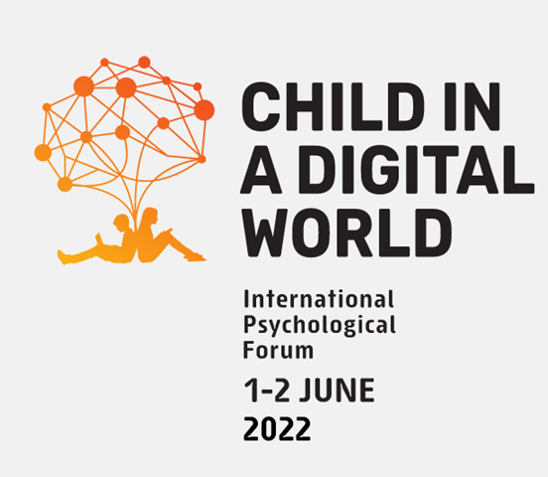
CONCLUSION
Teachers report improvement in language skills in relation to emotions, reduced rate of aggressive behaviours and improved social skills of children.
"Play with Fori" not only improves children's vocabulary in terms of emotions, but also helps children manage various difficult emotional states and behaviours.
The educational program “PLAY WITH FORi”, based on emotional literacy and facilitated with interactive technologies, not only supports cognitive development and communication skills but also promotes socialization and this way impacts the quality of life of children.

Slide 14
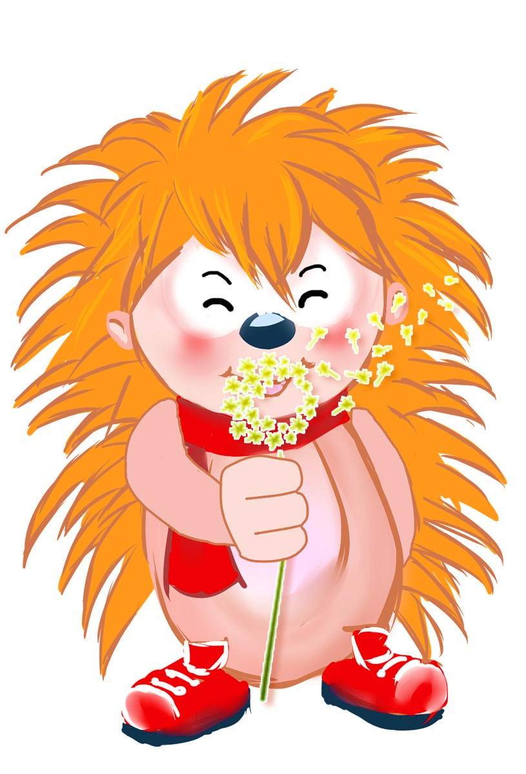
YOU CAN LEARN MORE ABOUT THE PROGRAM “Play with Fori”:
БЛАГОДАРЯ
Thank you
Gracias
WWW FB E-mail

