Slide 1
Study of the “Human- Digital Environment” System: Development of the Child’s Psyche
Moll Elena
Professor, CCTM ММК
St.Petersburg
1 -2 June 2024

Slide 2
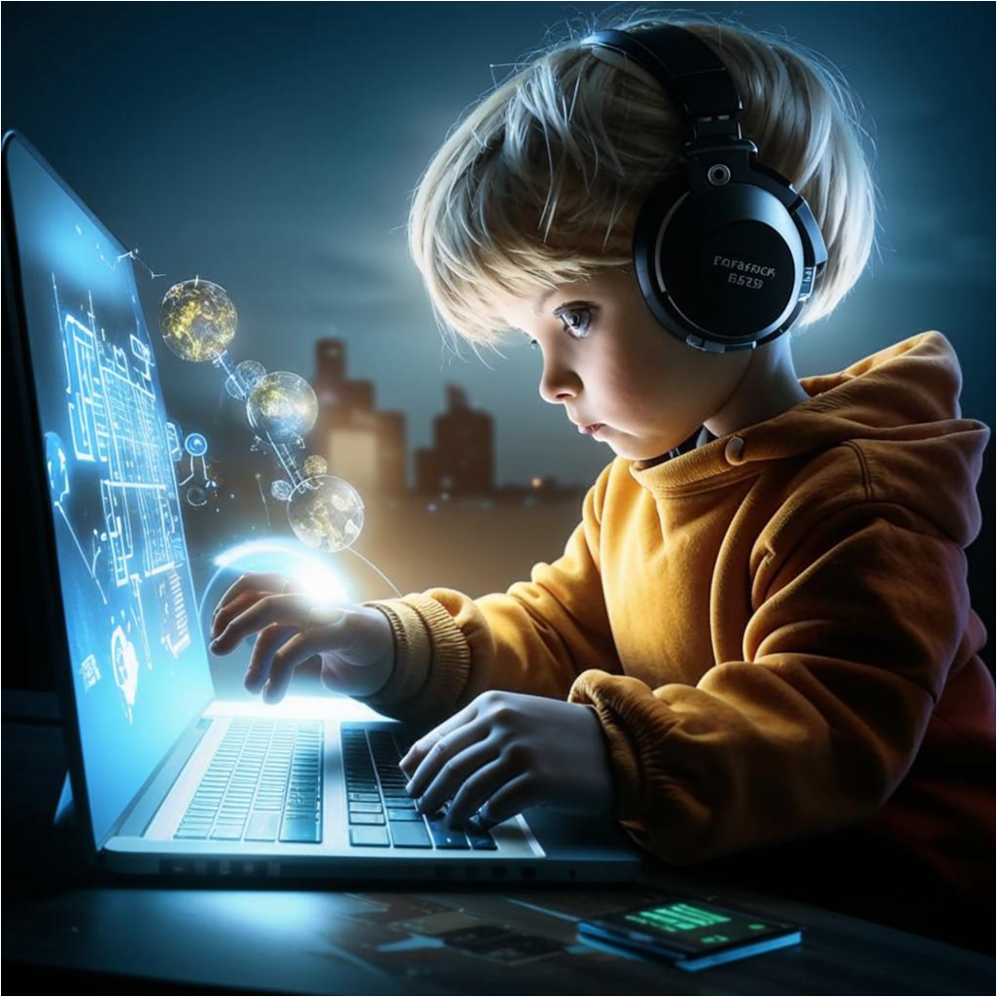
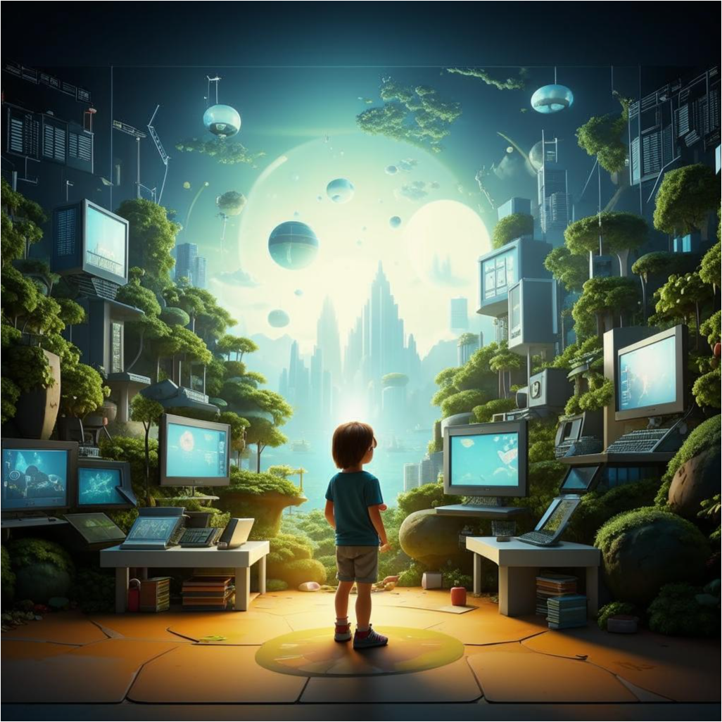
CHANGING the ENVIROMENT
SPATIO-TEMPORAL CLUSTER
- Imitation of the objective real world, the loss of its material components
- Distortion of the real world by creating augmented reality
Personalize Virtual Environments
The Existence of Social Virtual Reality
Creation of interactive environments synthesized by technical devices
INFORMATION CLUSTER
Increase in the amount of information
Increase in the speed of information transfer
Decrease in the quality of information
Expand information storage offerings
Redistribution of the amount of information received from different analyzers
. TASK CLUSTER
Reduce the number of tasks Changing the nature of intellectual tasks Faster switching between different tasks

Slide 3
MAJOR CHANGES IN THE SYSTEM
Managerial Impacts
Information cluster
Extheorization
PERSON Transactional Memory "Branded" consciousness Clip thinking Network identity
Spatio-temporal cluster
Behavioral models
Task cluster
Accelerate feedback

Slide 4
Average time to include ICT in life activity

Slide 5
Structure of ICT inclusion in vital activities depending on age

Slide 6
ONTOCIBERGENESIS
individual development of a person in an environment, an integral part of which is the digital component, which in turn develops according to the laws set by him, from the moment of inclusion of ICT in his life activity to ICT death

Slide 7
Tasks of the current stage of research
Recognizing the relationship between human development and ICTs Transition from a passive study of the psychological consequences of the widespread introduction of various types of ICT to the study of ontocybergenesis Interdisciplinary integration of scientific knowledge for the study of the "human-digital environment" system More active influence on the formation of the digital environment

