Slide 1
Prerequisites for the formation of the concept of number in the senior preschool age
Anastasia Sidneva, PhD,
Lomonosov Moscow State University, Moscow, Russia
asidneva@yandex.ru
This study was supported by the Russian Foundation for Basic Research, grant № 21-18-00584

Slide 2
Problem
All over the world - a tendency for a child to study mathematics more and more early (Göbel et al., 2014; Schneider, Grabner, Paetsch, 2016)
But mostly the mathematical development of a preschooler is understood as the assimilation of the order and numbering of numbers and operations with them
Such an introduction to mathematics leaves aside the question of whether children understand why numbers are needed at all?

Slide 3
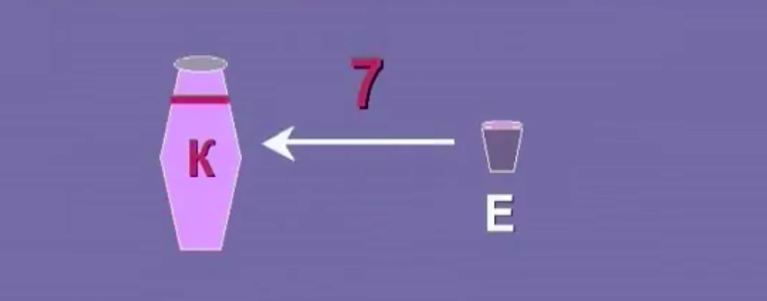
Cultural-Historical Activity Theory
Possibility of forming a different, more reasonable (and more general!) idea of the number - as a result of measuring quantities
Quantities:
length
area
volume
mass…

Slide 4
According to CHAT we also need to organize specific child actions
1) Selection of the object of the same quantity (length, area, volume) as the original one, based on direct comparison
2) Selection of the object of the same quantity by means of the third mediating value (in case of impossibility of direct comparison);
3) Selection of the object of the same quantity under the conditions that the the third mediating value is less than value to be measured (a measurement is required)

Slide 5
How can we teach math in the senior preschool age?
taking into account the specifics of this age?
role-playing games
games with rules
constructive activity (modeling, application, drawing, designing)
interest to listening and creating of fairy tales and stories

Slide 6
Three groups of teaching tools
Samples/examples (instructions of rules that are set through “we agreed that” or “it’s common to” formulas)
Models (schemes, maps, plans and other objects allowing demonstrating significant relationship between objects)
Symbols (a magic wand, a fairy-tale letter, etc. – a child distinguishes and retains significant relationship through his/her emotional attitude to the created situation).

Slide 7
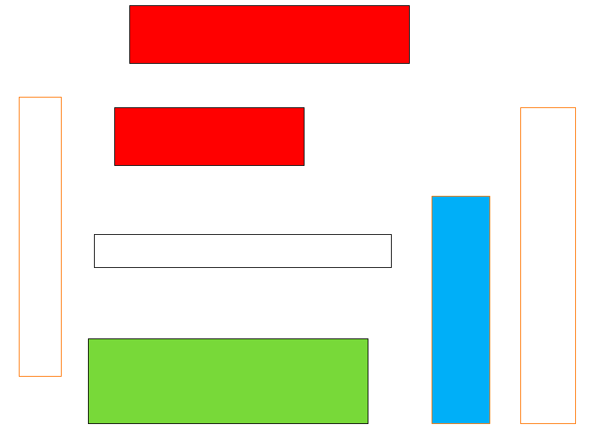
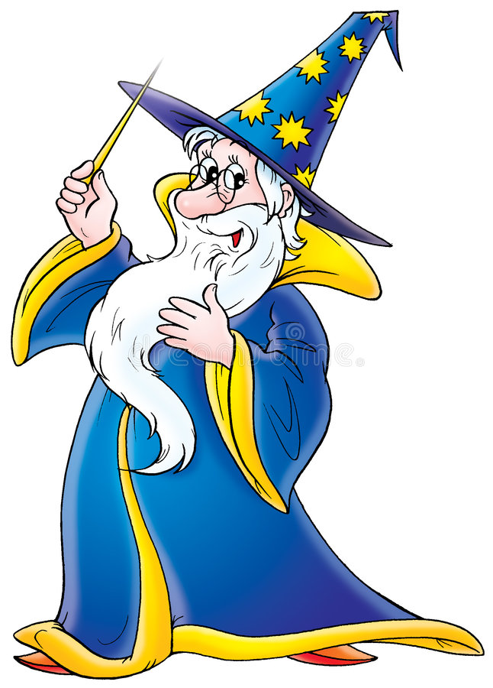
TRADITIONAL
MODELLING
SYMBOL
Find a rectangle of the same length as the upper red!
The windowsill has broken at our window, let's find the right length of the windowsill first in the drawing, and then in the room!
Help the wizard choose a case for a magic wand, otherwise it won't work!
EXAMPLES OF THE TASKS IN DIFFERENT PROGRAMS

Slide 8
Procedure
Four educational programs aimed at the formation of basic mathematical concepts of length, square, volume (each program included 20 classes, 20 minutes each).
They were similar representation-wise and in the actions performed by children, but differed by the type of applied means (visual example in two cases, model, and symbol).
For equalizing of the groups:
Math level assessment (ability to understand and use quantities). The special diagnostic toolkit was developed (3 types of tasks (3 actions) for each value (length, square, volume))
Executive functions’ assessment (inhibitory control, working memory, cognitive flexibility) (NEPSY test)
Level of intelligence assesment (Raven Progressive Matrices)

Slide 9
Sample
6-7 year old children (average age 6.4), N=52
All of the participants attended pre-school kindergarten groups. Each program consisted of 20 classes, 20 minutes each.
They were organized three times a week in groups of 3-5 children.
Program | Number of children
Modelling | 13
Symbolic | 14
Traditional | 12
Traditional with fairy-tale characters | 13

Slide 10
Results
No significant differences were found between the programs both for the total score and for each values (N. Kraskell-Wallace, p > 0.05 )
Significant differences were found between pre- and post-tests for all skills, length and area, as well as for the total score for all programs (ANOVA with repeated measurements, p < 0.05)

Slide 11
Conclusions. Limitations.
The type of the tools used in the organization of psychologically and objectively adequate actions in the formation of the concept of quantity did not play a fundamental role. That is, the key condition for the growth of mathematical skills were the actions of children.
Limitations:
Sample, only 12-14 preschoolers in each approach;
Absence of a control group;
Imperfection of diagnostic tools;
Features of the developed programs
It is necessary to work on improving these four programs from the point of view of a more explicit representation in each of them of the features of the tools used – samples, models and symbols.

Slide 12
Thank you for your attention!

