Slide 1
Professors labor activity changes in the context of distant technologies applying
Elizaveta Pechkovskaia e.m.pechkovskaya@mail.ru

Slide 2
Main parameters of activity changed in distant learning
Duration of labor
Job satisfaction factors
Changing communications with students

Slide 3
Changing the object and subject of labor
According to the method of determining a profession in the system of professions proposed by E.A Klimov, teaching refers to the socionomic system Human-Human. At the same time, during the COVID-19 period, it became part of the signonomic system.
In a signonomic system, the professors becomes an operators of the information system, setting the settings, parameters, not interacting directly with other people.
Profession teacher
Human-Human
Human-Sign

Slide 4
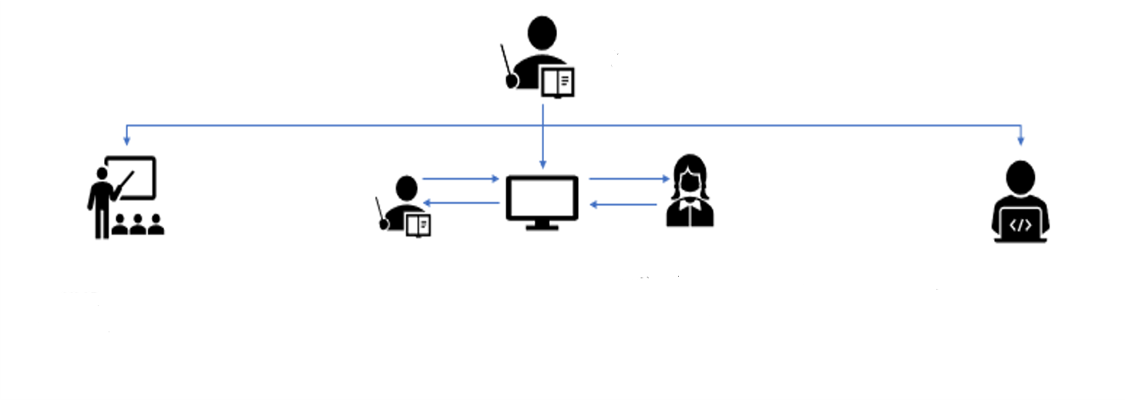
Changing the professional activities and communications of teachers
Professor
Face to face classes
Zoom conferences
Moodle

Slide 5
Changing labor actions when applying MOODLE
Communications
job satisfaction
Working with documents and preparing assignments
Asynchronous communications (interference in providing feedback, chat may not be checked, comments on assignments may not be read)
Complexity of Providing Synchronous Feedback ( BBB )
An alternative to checking handwritten assignments (essays) and the ease of providing asynchronous comments is Google Docs .
Increasing the duration of work of teachers :
Duration of task preparation (in the case of tests and surveys)
The duration of checking handwritten assignments (including error comments)
Study material preparation for the interface
Challenges with group organisation and checking individual academic performance
Dissatisfaction with the duration of the check
Interface and Human Factor Interference
Interface Material Adaptation
Satisfaction with the automation of activities (automated task checking)

Slide 6
Changing labor activities during applying Videoconferencing (on the example of ZOOM )
job satisfaction
Working with documents and preparing assignments
Communications
1. Lack of feedback from students
2. The basis for interaction with the simulacrum is being created - the student's avatar, but it is not known whether he is present.
Increasing the number of slides
Reducing the time of lectures and seminars
More preparation time for Natural Sciences lectures
Decrease in satisfaction due to :
"Black boxes"
Individual application specifics (assistance required for organizing conferences)

Slide 7
Changing the load of teachers in remote form

Slide 8
System Errors Affecting Satisfaction
ZOOM
MOODLE
Not flipping slides
Problems with video / sound
Settings outside the conference interface
The problem of forming groups of students
Difficulty in generating comments for uploaded tasks
Error showing assignments to students
Uploading files for verification

Slide 9
Preferred learning format

Slide 10
Recommended changes when using systems to improve job satisfaction
ZOOM (other video systems)
MOODLE
Mandatory inclusion of cameras and microphones
Establishment of rules for conducting remote classes (sequence of speeches,
Adding tools for reviewing handwritten and uploaded assignments
Adaptation of the interface for loading tasks from other applications without adaptation
Error fixing
Conducting additional courses

Slide 11
Thank you for your attention!

