Slide 1
International Psychological Forum "The Child in the Digital World" Profiling Higher Education in Belarus: Visual Programming and Educational Robotics
Natalia Grigoryevna Dubeshko,
Head of the Department of Preschool and Primary Education
educational institution "Baranovichi State University",
Candidate of Pedagogical Sciences, Associate Professor
Natalia Fyodorovna Zakharchenya,
Senior Lecturer, Department of Preschool and Elementary Education
Baranovichi State University" educational institution
June 1-2, 2025.

Slide 2
Profilization of higher education in Belarus: visual programming and educational robotics
By Presidential Decree No. 375 of November 27, 2023,
The year 2024 has been declared the Year of Quality in Belarus
The search for ways to improve the quality of pedagogical education has conditioned the research activities of the Department of Preschool and Elementary Education of the educational institution "Baranovichi State University"

Slide 3
Profilization of higher education in Belarus: visual programming and educational robotics
STRUCTURAL SUBDIVISIONS
of the Department providing profiling:
laboratory of pedagogy of childhood,
branches of the department (kindergarten and school),
student research association "Creative Design"

Slide 4
Profilization of higher education in Belarus: visual programming and educational robotics
The main research questions of applicants of pedagogical specialties:
"Where to study?"
Establishing the factors of career guidance of school graduates when choosing a pedagogical specialty for higher education
"What, how, and how much training?"
determination of the content, form and terms of higher education in pedagogical specialties
"Who, where, and how long to work?"
choice of the first workplace by graduates of pedagogical specialties of higher education

Slide 5
Profilization of higher education in Belarus: visual programming and educational robotics
Relevance
the study of visual programming and educational robotics in professional education in pedagogical specialties of higher education has a connection
with scientific and practical research supported by
High Technology Park and the Ministry of Education of the Republic of Belarus :
2016 - educational project "Programming - Second Literacy"
for general secondary education institutions
2019 - educational project "Informatics unplugged"
for pre-school education

Slide 6
Profilization of higher education in Belarus: visual programming and educational robotics
PROFILING MODEL
- competitiveness and qualification of graduates of a higher education institution (needs of institutions ordering personnel)
- content of curricula of a higher education institution (specialized competences by profile)
- availability and development of material and technical base of higher education institution (place, time, equipment)

Slide 7
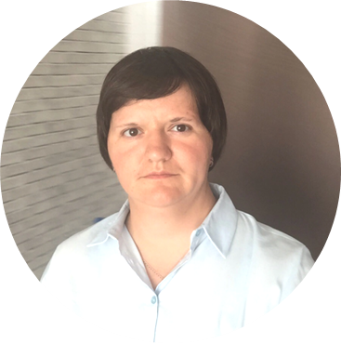
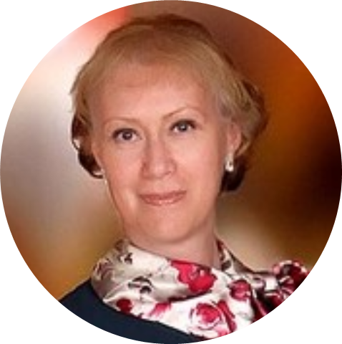
Thank you for your attention!
We invite you to cooperate!
Address: Republic of Belarus aud. 303, building 1, Parkovaya str. 62, 225401 Baranovichi city, Brest region. Telephones: +375 (163) 68-02-12 +375 (29)809-88-89 +375 (29) 727 -74 -18 E-mail: nfzakharchenia@gmail.com dubeshka@mail.ru
Natalia Fyodorovna Zakharchenya Natalia Grigoryevna Dubeshko

