Slide 1
TELEPSYCHOLOGY IN TIMES OF COVID: PROTECTED CHILDREN, ADOLESCENTS AND YOUNG ATHLETES.
Authors:
MSc. Madelin González Figueredo
MSc. Néstor Espinosa Alvarez
MSc. Danay Ramírez González
MSc. Meyli Borges Castillo

Slide 2
INTRODUCTION
FIRST COVID 19WAVE :
Granma was one of the least affected provinces.
March 2020 suspension of classes.
September 2020 resumption of the school year.
SECOND COVID 19 WAVE :
February 2021 suspension of classes.
Increase in cases in Granma and throughout the country.
November 2021 resumption of the school year.

Slide 3
INTRODUCTION
COVID-19
New rules of coexistence
Physical distancing
Creativity in the search for feasible methods to solve the problems caused by the pandemic on an individual and collective level.
School closures

Slide 4
Provincial Center of Sports Medicine. Granma. Cuba
Investigation System
Important and personalized information from athletes and their families.
Command post
Processes and evaluates information for decision making
Department of Psychology
Determines the psychological intervention that will be carried out in each case.

Slide 5
Generalization of psychosocial survey to understand the impact of COVID 19 on the Cuban athletic population.
Provided information on the use of social networks by athletes
GRANMA CONCLUSIONS:
The negative psychological manifestations that predominated in the Granma athletic population during the COVID-19 pandemic stage were: constant worries, lack of motivation or desire to exercise, difficulty concentrating, uncertainty in the future, anguish, tension, sadness, confusion and fear, lack of motivation or desire to do daily activities, headaches, muscle tension in the neck or back, appetite disorders.
The behavioral strategies to confront the situation caused by COVID 19 that predominated were: family support, carrying out sports-related activities, mainly physical preparation planned by the athletes themselves and by the coaches.
There was a predominance of athletes who considered that they had the necessary psychological tools to face the situation caused by the pandemic, confidence that it would pass, they could organize their lives as before and re-plan sports goals that responded to their aspirations.

Slide 6
Most frequent psychological manifestations reported to the Command Post by families
Anxiety
Aggressiveness
Sleep disorders
Parental difficulties in managing children.

Slide 7
SCIENTIFIC PROBLEM:
How to implement psychological care interventions to athletes and their families during the isolation stage due to the COVID-19 pandemic?
GENERAL OBJECTIVE:
To provide to athletes, coaches and their families psychological care interventions according to the needs of the COVID-19 pandemic stage.

Slide 8
RELEVANCE OF TELEPSYCHOLOGY

Slide 9
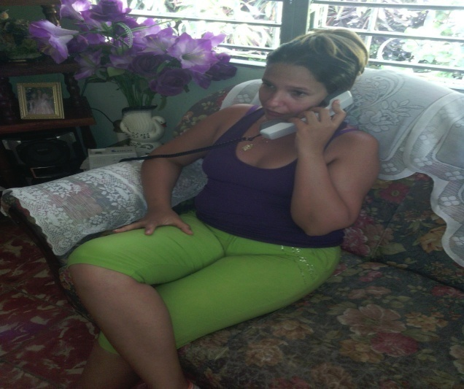
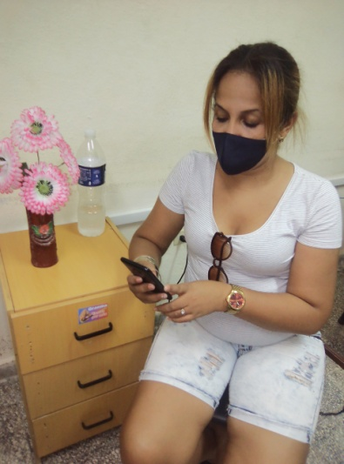
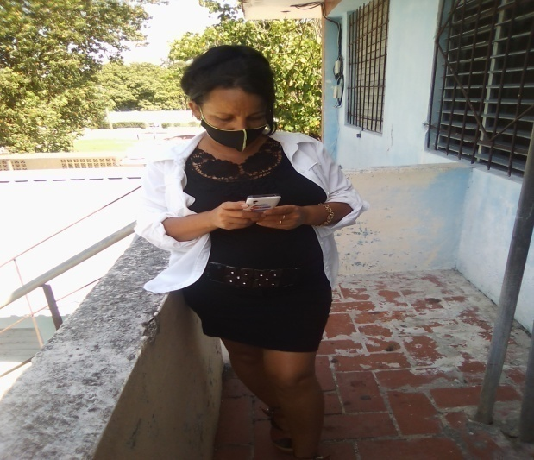
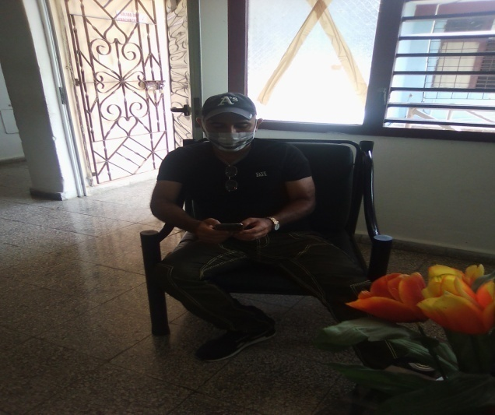
TELEPSYCHOLOGY
Provision of psychological services using information and telecommunications technologies.

Slide 10
This form of mediation with the athlets, parents and trainers became essential in times of COVID-19 as it guarantees the continuation of care professional services. It was a challenge for psychology specialists who are more accustomed to face-to-face interaction, which is why It requires commitment and responsibility with the actions to be carried out.

Slide 11
PSYCHOLOGICAL INTERVENTION
Psychological guidance and help
Direct Form: (landlines and mobile phones, Facebook and WhatsApp)
Indirect Form: two WhatsApp Groups

Slide 12
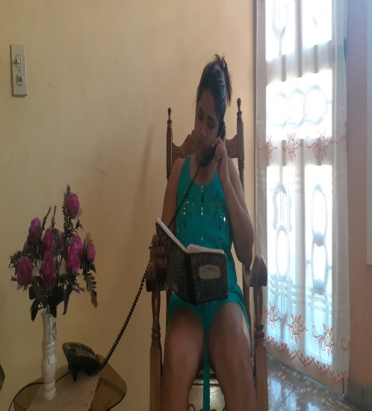
DIRECT FORM:
Athletes and their families.
COVID-19 positive.
Suspects of COVID 19 from isolation centers with not possitive coronavirus diagnosis.
Who reported the presence of some psychological manifestation.

Slide 13
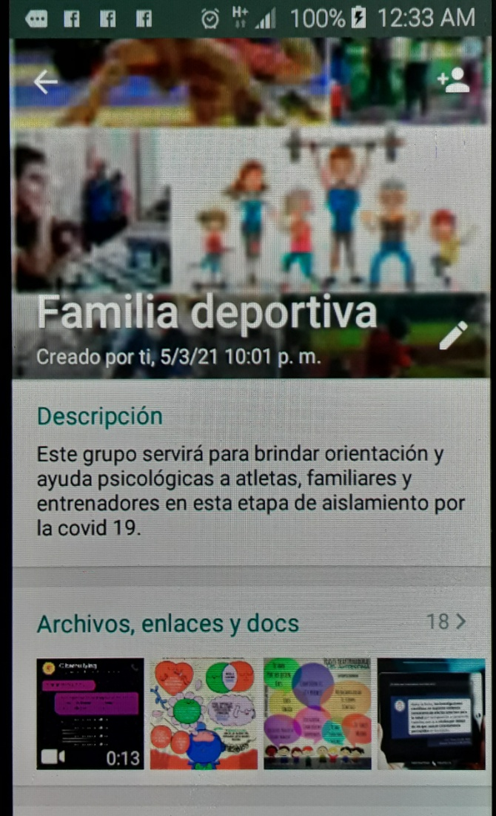
INDIRECT FORM

Slide 14
The social network selected to assist the largest number of people was WhatsApp.

Slide 15
TOPICS ADDRESSED
Parents of athletes

Slide 16
TOPICS
Family education and limits to our children
Sleep disturbances
Video games, internet and social media
Image of the self in boys and girls
The crisis of adolescence
Functions of the family and its relationship with children
International family day
The depletion. Guidance for the family
What do parents need to know about their children?
Anxiety in children and adolescents in social isolation
The self-esteem
Seven steps to positive parenting
The use of new technologies by adolescents
Grandfathers and grandmothers
Positive thinking
TOPICS
Measures to protect children and adolescents from Covid-19 in the family environment
Managing our children's emotions
Caring for children and adolescents at home
Perception of risk in the face of Covid-19
The role of women in the family
How to listen to our children?
Harmonious relationships in the family
Suicidal behavior in adolescents
Sexuality in children and adolescents
Child sexual abuse
Care and self-care as ways to face the disease
Infodemic
Sleep in children and adolescents
Activities to do as a family in times of pandemic.
Hygienic-sanitary measures against Covid-19
Perception of risk in the face of Covid-19
Adequate control of emotions
Family coexistence and intrafamily relationships

Slide 17
TOPICS ADDRESSED
Sports family

Slide 18
TOPICS
Sport is preservation of health.
Current situation of Covid-19 and its relationship with sports training.
Tips for confronting Covid-19.
Acceptance and adaptation of the changes associated with Covid 19.
Negative emotions in threatening situations: How to deal with them?
Perception of the risk of contracting the disease.
Assessment of the danger of getting sick, associated with the behaviors assumed during the confinement period.
Suicide prevention.
Organization and maintenance of daily routines during isolation.
Smoking
Risks that occur during adolescence
Who did she tell when she was pregnant?
Responsible health
Wise phrases
Planning and organizing free time from isolation
Planning and organizing free time from isolation
TOPICS
Use of social networks as a way to maintain social contact with others during quarantine.
International family day.
Activities to do as a family in times of pandemic.
Pandemic fatigue in adolescents
The comment and the gossip
Tips for changing routines in times of pandemic
Where does health come from?
The self-esteem
The science of meditation
Grandfathers and grandmothers
Recommendations for working with WhatsApp
Control of negative states and emotions
New ways to train, maintaining sports skills
Self-responsibility in compliance with health and hygiene measures
Care and self-care as ways to face the disease
Infodemic
Sleep, tips for a restful sleep
Sex vs Covid-19
Discipline in compliance with the technical instructions of the coaches

Slide 19
ACCEPTANCE AND EFFECTIVENESS: Opinions of athletes, parents and coaches (Colleted data from social network)
Mamá de David:
Okay. Thank you so much.
Profe Evelin:
Thank you very much, it's better this way. Greetings to all
Profe Evelin:
Thank you very much for the advice given
Mellizos Yanet:
Everything discussed here is very good, thank you very much.
Mama natac:
I have a colleague who has a child in the EIDE and wants to be in the group, could you explain it to me?
Mamá de David:
The topic is very interesting. Thank you
Mellizos Yanet:
Thank you very much to all those who in one way or another support the training of our children.
Lucha P:
THANK YOU so much
Dep atlet:
Made Thank you for your words
Dep boxeo:
Thank you doctor, your teaching is very good, we will continue to stay in touch.
Dep Jud:
Greetings Madelin, all your comments are very nice, full of reflections, emotional and above all instructive, congratulations
Mamá de David:
The important thing is the help that the psychologist can provide you as a professional. The topics addressed in the group are very useful in the daily life of our children and in their training as athletes.
Mellizos Yanet:
I really appreciate everything that is guided here, it is very helpful to us, although my children have a very concerned psychologist who always calls us. Thank you.
Dep esg:
Good reflection. The advice served as an example for everything.
Atletismo Lidice:
Ok... thank you very much and nice gesture, I'm sure this form and means of communication with you will be super important.
Triat Soannys:
Yes, health is my greatest medal. Because if I am not healthy and strong I cannot fulfill my dreams
TWD Isaia:
Interesting group to interact, share and learn healthily.
Padre:
Thanks also to all

Slide 20
Conclusions
The use of telepsychology was successful to provide psychological care interventions to athletes, coaches and their families appropriately during the COVID-19 pandemic stage.
The number of members in WhatsApp groups increased.
There was a positive criterion from the users of the psychology service adjusted to the isolation stage due to the COVID-19 pandemic.

Slide 21
THANK YOU

