Slide 1
CAREFUL LISTENING OF THE CHILD ABOUT THE PLAY IN THE SCHOOL ROUTINE OF CHILDREN’S EDUCATION: an analysis of superior psychological functions.
Aline Patricia Campos Tolentino de Lima
Advisor - Prof. Dr. Joana de Jesus de Andrade
Faculdade de Filosofia, Ciências e Letras de Ribeirão Preto
UNIVERSIDADE DE SÃO PAULO - USP
Notes:
Kerful lissenin of de chaild abaut de plei in de skul rutín of tchildrens edukeixan: en análisis of supírior saikológical fancxans.
ÓTOR – aline...
ÉDVAIZOR –
INSTITÚXAN -

Slide 2
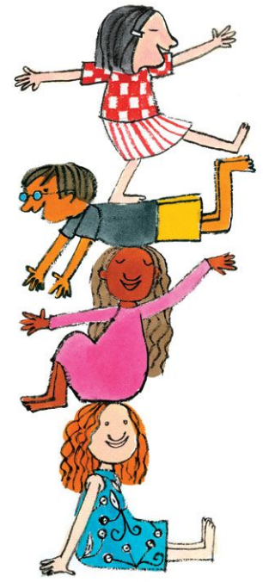
What’s the aim of this research?
This study aims to investigate the development of superior psychological functions during childhood, through the analysis of reports given by the subjects involved in this research (children), and also through the observation of moments in which role-play is established in the school routine in institutions of Children’s Education.
Image by Ruth Rocha
Notes:
Uots de eim of dis risârtch? Dis stâdi eims tu investigueiti de devélopiment of supírior saicológical fancxans durin tchaild-rúd, tru de enélisis of riports guiven bai de sâbdjects invólved in dis risârtch (tchildren), and alsou tru de observeixan of mouments in uitch rol-plei is estéblixed in de skul rutín in instituxans of tchildrens edukeixan.

Slide 3
What methodology was used?
Qualitative research;
Theoretical Foundation of Historical-Cultural dimensions (Dialectic Relation);
Three units of Children’s Education were selected;
Subjects: children aged between 5 and 6 years;
Methodological tools: active observation, careful listening, photographic and video registers;
Field research was approved by the Ethics Committee under the register 4.235.627;
Image by Ruth Rocha
Notes:
Uót metodólodgi uós iuzed?
Qualitativi risârtch
Tioréticol faundeixan of ristóricol-câlturol dimenxans (daialéctic rileixan)
Sâbdjects: tchildren eidjed bituín faive end sics íars
Metodolódjical túls: éctiv obiserveixan, kérful lissenin, fotogréfic end vídeo rédjisters
Fild risartch uos aprúved bai de étics comíti ander de rédjister (fór tu tri faive sics tu séven)

Slide 4
Theoretical Foundation
Psychological functions appear in the development in two ways: elementary functions and superior functions. The role-playing has a determinant influence in the formation of symbolic activity;
Interpretation of social relations, which is a fundamental characteristic of role-playing, takes place according to Elkonin (2009) in a double plan when the child plays with a toy and by herself, in which social relations appear, interpreted by the children.
Starting to show actions as ‘I am the mother’, ‘I am the cook’, ‘I am the driver’, ‘I am the teacher’, ‘I am the father’, ‘I am the doctor’, among other social roles.
Image by Ruth Rocha
Notes:
Tioréticol faundeixan
Saicolódgical fancxans apíâr in de devélopment in tu ueis: eleméntâri fancxans end supírior fancxans. De rol-plein rés a determinant ínfluens in de formeixan of simbólic ectíviti
Interpreteixan of souxal rileixans, uitch is a fundamentol kerecterístic of rol-plein, teiks pleis acórdin to ELKONIN in a dâbol plen uen de tchaild pleis uis a tói end bai rersélf, in uitch souxol releixans apíar, interpreted bai de tchildren
Istartin tu xou écxans és ‘ai ém de móder’, ‘ai ém de cuk’, ‘ai ém de draiver’, ‘ai ém de títcher’, ‘ai ém de fáder’, ‘ai ém de dóctar’, amóng óder souxal rols

Slide 5
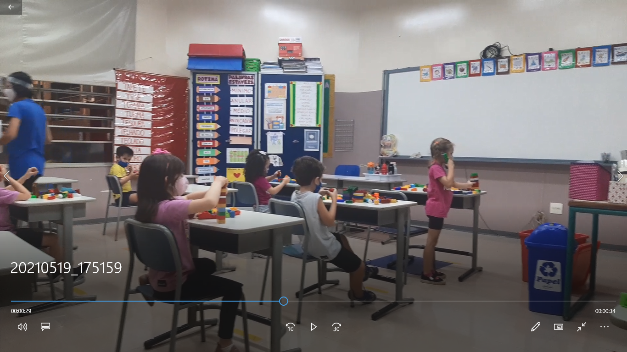
Partial Results
TELEPHONE ROLE-PLAYING
Photographic register
Notes:
Parxol risalts
Télefoun rol-plein
Fotogréfic rédgister

Slide 6
Partial Results
EPISODE 1- “Telephone Role-Playing” (6th day, 14/03/2021, video recorder)
- children sitting individually due to social distancing, playing with building blocks, making phones to talk to one another -
Laura: Bi, bi, bi, bi, bi, bi [...] (imitating the sound of a phone ringing)
Bruno: Hi Laura, how are you Laura... Laura... [...] (Bruno was across the room trying to communicate with Laura, but without answer)
Laura: Bi, bi, bi, bi, bi, bi [...] (continues imitating the sound of a telephone ringing)
Maria Cecília: Hello who is that?
Laura: Hi how are you, it’s Laura, what are you doing?
Maria Cecília: I’m calling you, then.
Bruno: I am working.
Teacher: Time to get our water bottles (and role-playing is interrupted)
Image by Ruth Rocha
Notes:
Parxol risalts
Épisoud uan: télefoun rol-plein (sicst dei, martch fortín, tu táusen eitín, vídeo ricórder)
Tchildren sítin indivíduali du tu souxal distencin, plein uis bildin bloks, meikin founs tu tolk tu uan anóder
LAURA: bi, bi, bi.... (imiteitin de saund of a foun ringuin)
BRUNO: rai Laura, rau ár iu Laura, Laura (Bruno uós acrós de rúm train tu comunikeit uís Laura, bât uidáut énser)
LAURA: bi, bi, bi... (contínus imiteitin de saund of a télefoun ringin)
MARIA CECILIA: relou, ru is det?
LAURA: rai, rau ár iu, its Laura, uót ár iu dúin?
MARIA CECILIA: aim cólin iu, den
BRUNO: ai ém uorkin
TITCHER: taim tu guet aur uóter bótols (end rol-plein is inteRâpited)

Slide 7
What impact may and do results have?
In the episode, we observed that, despite rules established due to social distancing, children found a way to interact and communicate through imagining and role-playing. The telephone role-playing starts with Laura, but gradually other peers also make a phone to communicate to one another.
After analysis of the data collected in field research through children’s interactions during role-playing it was possible to observe that role-playing enables the global development of the children;
Contributing to the development of superior psychological functions through the imagination and symbolic activity.
Image by Ruth Rocha
Notes:
Uót impekt mei end du rizaults rrév?
In de épizoud, uí obisêrved dét, despait ruls estéblixed du tu souxal dístencin, tchildren faund a uei tu interékt end comiunikeit tru iméginin end rol-plein. De télefoun rol-plein starts uis Laura, bât grédueli óder pírs ólsou meik a foun tu comiunikeit to uan anóder.
Éfter enélizis of de déta colékted in fild risârtch tru tchildrens interékxans durin rol-plein, it uós póssibol tu obsêrve det rol-plein ineibols de gloubol devélopiment of de tchildren.
Contríbutin tu de devélopiment of supírior saikolódjical fankxans tru de imedjineixan end simbólic éktíviti.

Slide 8
Closing Remarks
As analyzed in this study, role-playing significantly contributes to the development of superior psychological functions, and therefore it is important that role-playing is present in the routine of Children’s Education as means of typical expression of the child.
Image by Ruth Rocha
Notes:
Clouzin remárks
És analaized in dis stadi, rol-plein signíficantli contríbuts tu de devélopiment of supírior saikológical fancxans, end dérfór it is impórtant det rol-plein is présent in de routín of tchildrens edukeixan és míns of típicol ecspréxan of de tchaild.

Slide 9
Bibliographic References
ELKONIN, D. B. Psicologia do jogo. São Paulo: Martins Fontes, 2009.
VYGOTSKI, L. S. Tomo III: Obras Escogidas III. Madrid: Visor Distribuciones, 1995. 383p.
VIGOTSKI, L. S. Psicologia pedagógica. São Paulo: WMF Martins Fontes, 2010.
Image by Ruth Rocha
Notes:
Bibliogrefik réferences

Slide 10
Thank you for your attention! Contact: alinepctolentino@hotmail.com; joanaj@ffclrp.usp.br
Image by Ruth Rocha
Notes:
Ténk iu fór iór aténxan

