Slide 1
Association between Memory and Attention Performance among Preschoolers Playing Traditional and Digital Games (on the Example of «Dobble»)
Olga V. Rubtsova, PhD in Psychology, Associate Professor, Head of Center for Interdisciplinary Research on Contemporary Childhood, Moscow State University of Psychology & Education, Moscow, Russia
Yulia A. Tokarchuk, Researcher of the Center for Interdisciplinary Research of Contemporary Childhood, Moscow State University of Psychology and Education, Moscow, Russia
Olga V. Salomatova, Junior Research Fellow of the Centre for Interdisciplinary Research of Contemporary Childhood, Moscow State University of Psychology and Education, Moscow, Russia
The reported study was funded by Russian Science Foundation, project number 23-28-01204

Slide 2
Digital play and digital game in digital childhood
Russian “цифровая игра” [tsifrovaya igra]
Digital play denotes a play activity per se, as a system of rules, plots and play actions.
Digital game refers to software, material and/or a virtual feeling, which presupposes goals and tasks, stages, characters etc.
.

Slide 3
Board games
Traditional attributes of board games include:
presence of a playing surface (table),
presence of playing pieces/cards/tokens,
presence of rules
*Tokarchuk Yu.A., Salomatova O.V., Gavrilova E.V. Ispol'zovanie nastol'nykh i tsifrovykh igr doshkol'nikami: rezul'taty oprosa rossiiskikh roditelei [The Use of Board and Digital Games: The Results of a Survey of Parents]. Psikhologo-pedagogicheskie issledovaniya = Psychological-Educational Studies, 2024. Vol. 16, no. 1, pp. 76—95. DOI:10.17759/psyedu.2024160105 (In Russ.).

Slide 4
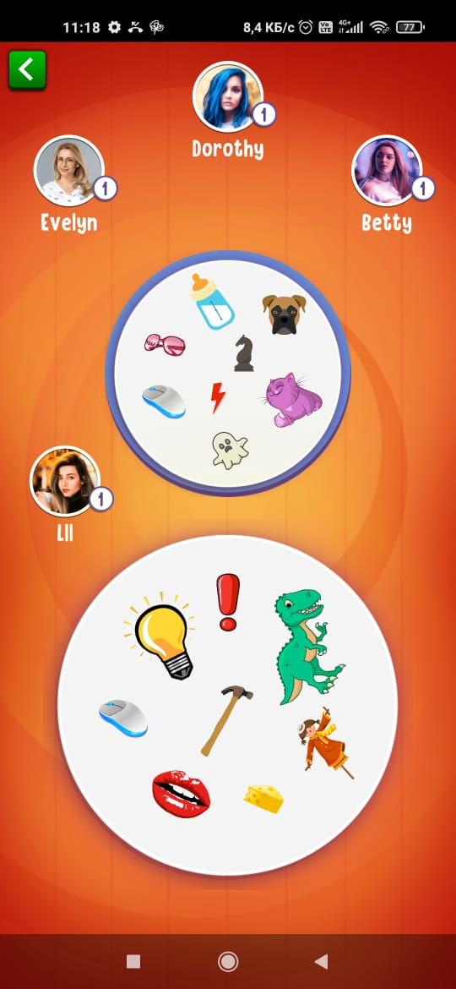
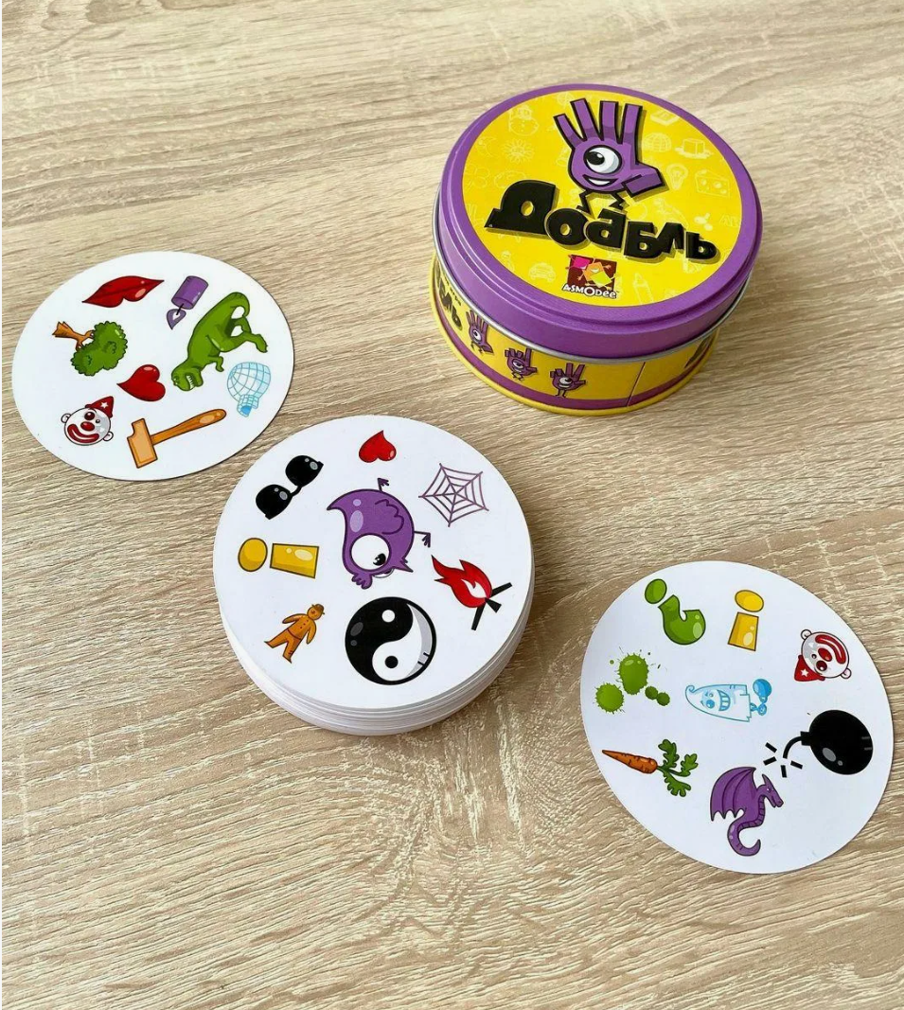
The impact of digital and tabletop games on the development of cognitive processes in preschool age
The main purpose of this project is to compare the impact of digital and tabletop games on the development of cognitive processes - primarily attention and memory - in preschool children.

Slide 5
Children playing a board game and its digital counterpart
Study period:
т
Group 1 (N=19) (ЭГ 1) - experimental - played the board card game "Dobble!"
Group 2 (N=26) (ЭГ 2) - experimental - played the digital version of the board game "Double Match: one common image"
Group 3 (N=31) (КГ) - control
February - May 2023
Sample:
76 children from preparatory groups of preschool educational institutions in Moscow: 37 boys and 39 girls
Duration of the study:
8 weeks
Study design:
pre-test
experiment
post-test

Slide 6
Methods
"Learning 10 Words" technique (A.R. Luria) - used to assess parameters of auditory short-term and long-term memory such as memorization, retention, and reproduction;
"Coding" technique (Wexler's Subtest) - used to investigate the volume of visual memory;
"Test of Interwoven Lines" technique (Modification of A. Rey's test) - used to study the degree of concentration of voluntary attention;
"Place Marks" technique (Pieron-Rooser test) - used to evaluate parameters of voluntary attention such as stability, distribution, switchability, as well as the pace of activity.

Slide 7
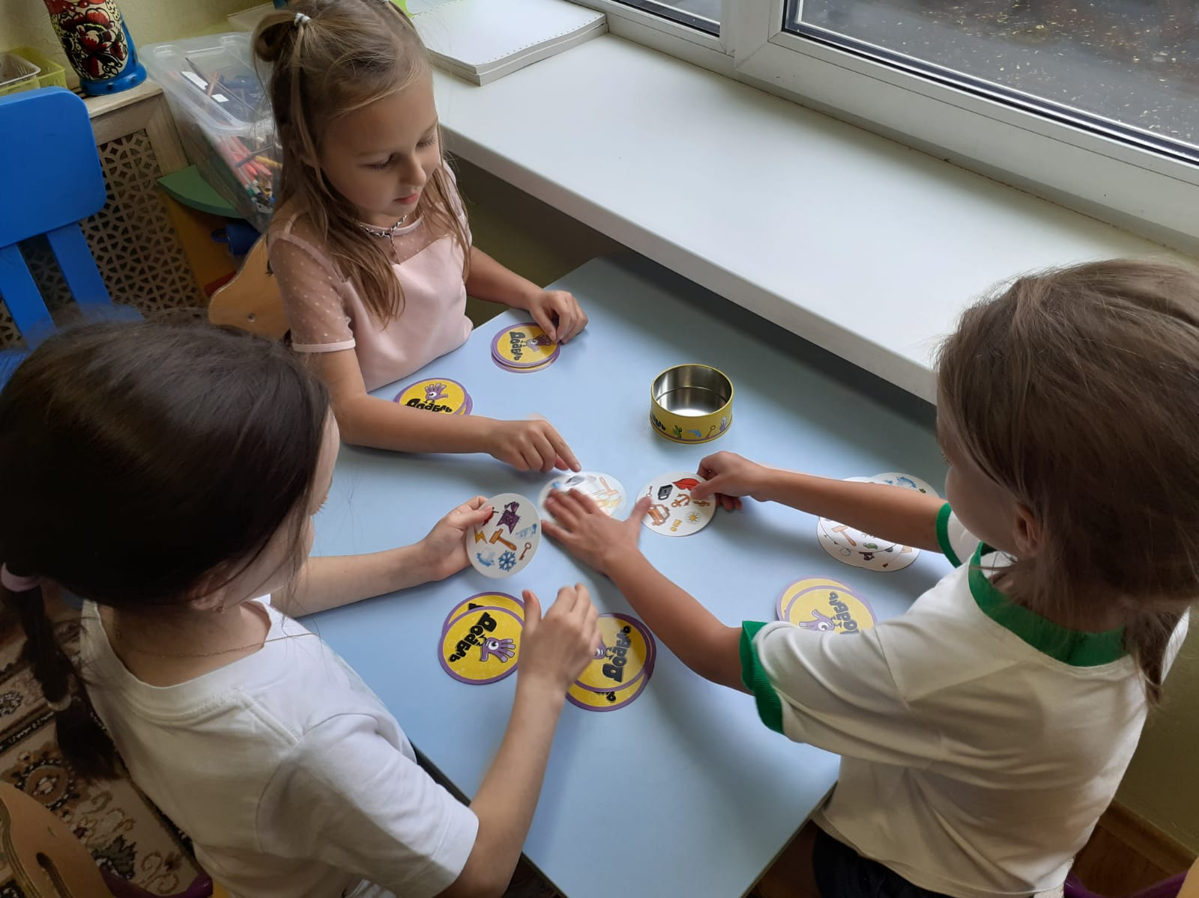
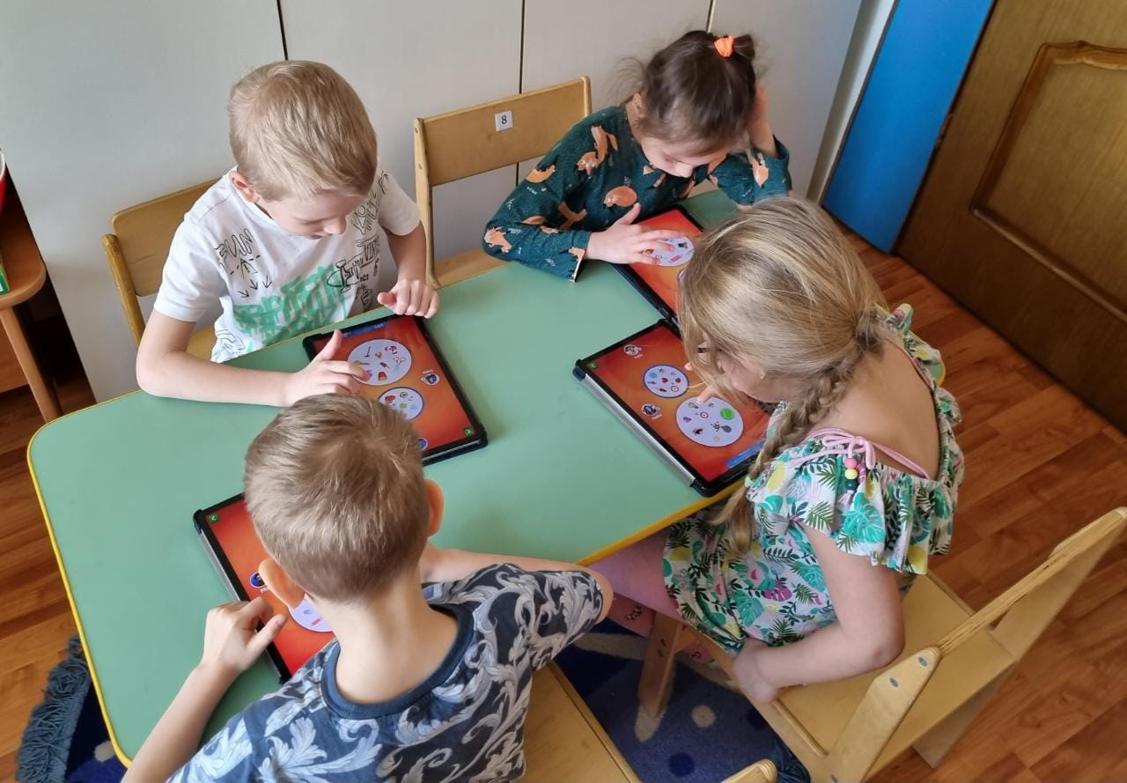
Experiment process
Participants conducted approximately 16 gaming sessions, with each gaming session lasting 10-15 minutes

Slide 8
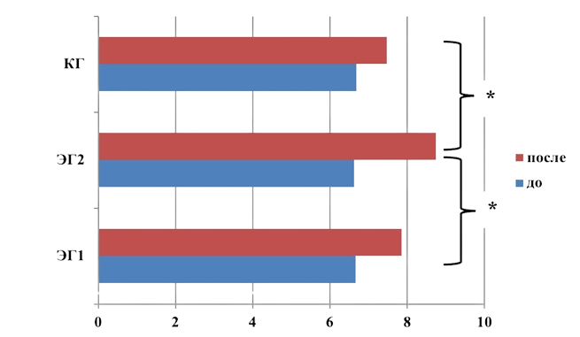
The results of the study
"Learning 10 Words" technique (A.R. Luria)
Comparison of input and output testing results across all groups
The results of the comparative analysis demonstrates effects on the development of short-term and long-term auditory memory in children who played the digital game.

Slide 9
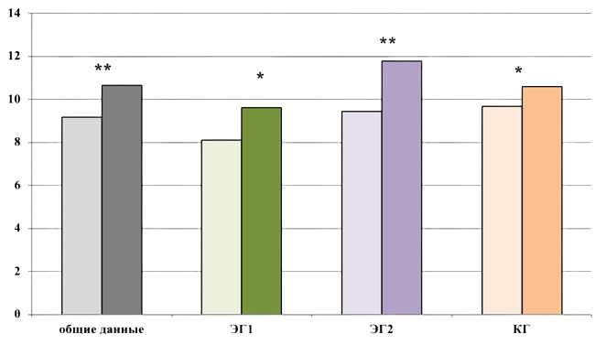
The results of the study
"Coding" technique (Wexler's Subtest)
Comparison of input and output testing results across all groups(*р ≤ 0,05; **р ≤ 0,000)
Children who played the digital version of the game became more effective at memorizing and reproducing visual stimuli compared to children who played the tabletop game and those in the control group.

Slide 10
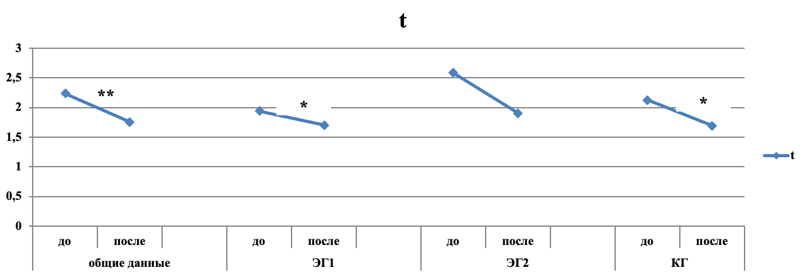
The results of the study
"Test of Interwoven Lines" technique (Modification of A. Rey's test)
Comparison of input and output testing results across all groups (*р ≤ 0,05; **р ≤ 0,000)

Slide 11
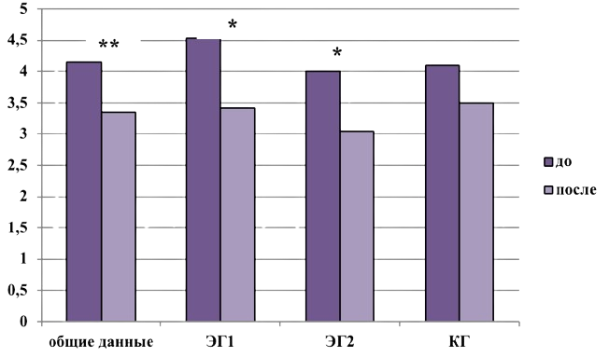
The results of the study
"Test of Interwoven Lines" technique (Modification of A. Rey's test)
Comparison of error rates across all groups (*р ≤ 0,05; **р ≤ 0,000)
There were no statistically significant differences in the measures of time and error count among the three groups. The data obtained suggest a trend towards increased attentional stability associated with overall cognitive development in children.

Slide 12
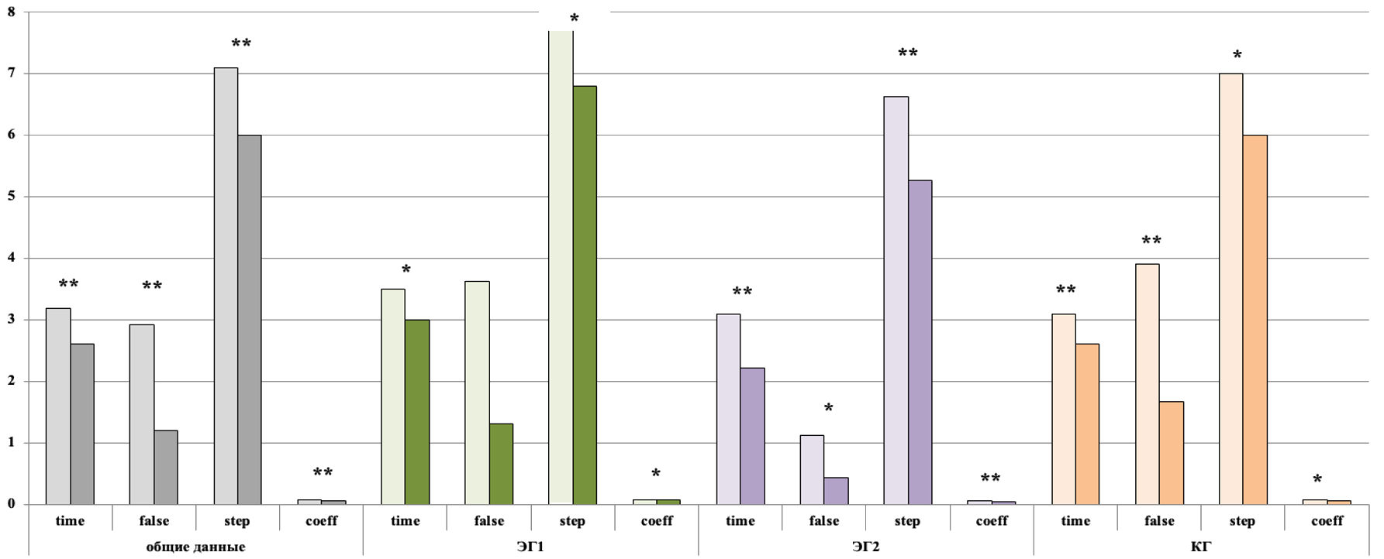
The results of the study
"Place Marks" technique (Pieron-Rooser test)
Comparison of input and output testing results across all groups аnd all rates (*р ≤ 0,05; **р ≤ 0,000)
The group playing digital games showed the best results across all analyzed parameters. Children in this group performed the task more accurately and efficiently, spending less time and making fewer moves. They quickly memorized the symbols for each figure, retained the instructions, and rarely referred back to them during the task. These effects suggest a high degree of sustained attention and a fast pace of activity.

Slide 13
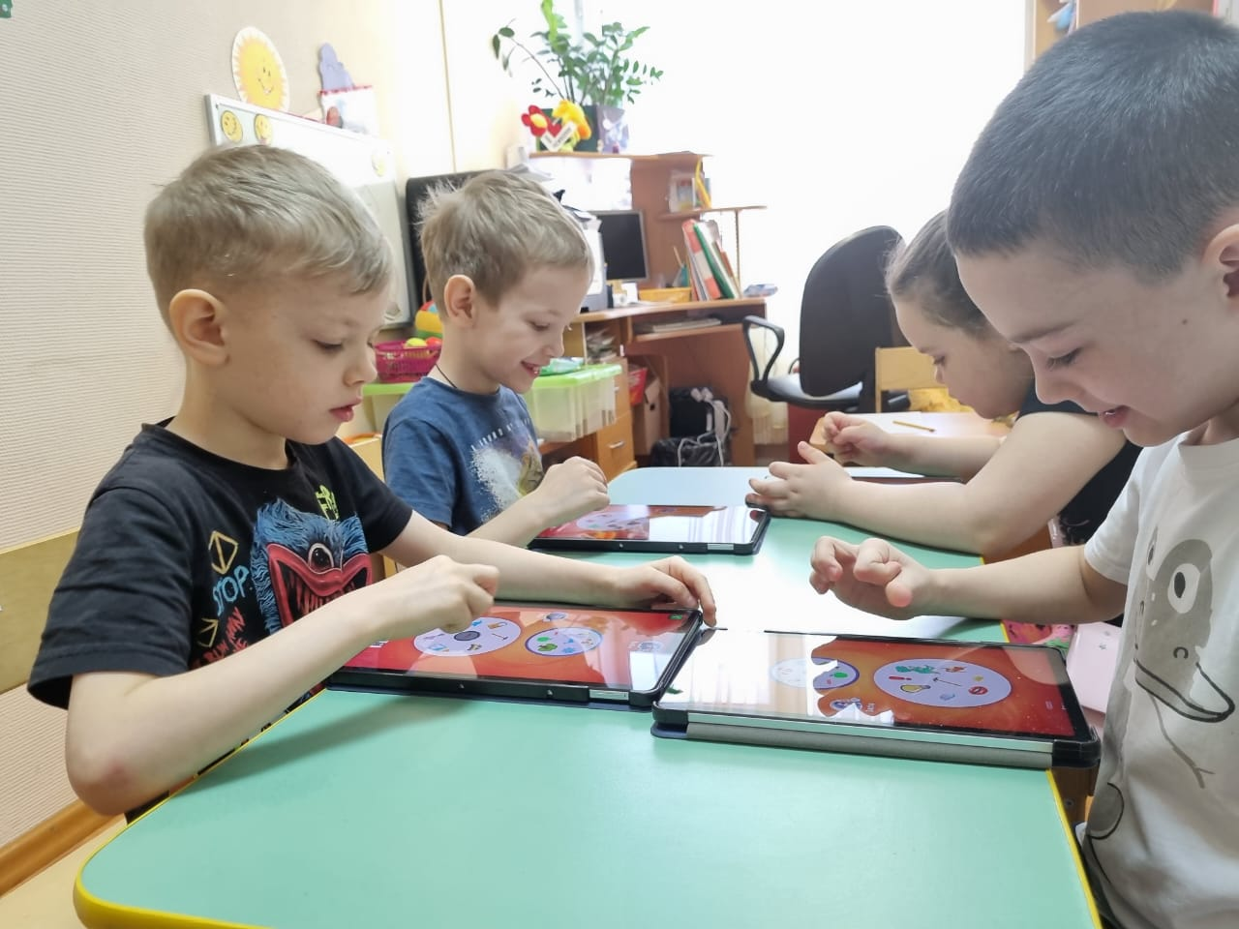
Conclusions
The results of the comparative analysis demonstrate significant effects in children from the experimental group who played the digital version of the tabletop game.
These effects include:
the development of short-term and long-term auditory memory,
a higher degrees of sustained attention,
a higher levels of activity,
more effective memorization,
reproduction of visual stimuli.

Slide 14
The prospects for future researches
For a reliable extrapolation of the obtained effects to a broader audience, it is necessary to increase the sample size of respondents in future research and to expand the diagnostic tools used in the study.
Based on the results of similar studies, it also seems important to conduct a follow-up assessment several months after the experiment's completion, which will provide data on the long-term impact of digital and board games on the development of cognitive processes.

Slide 15
Rubtsova O.V., Tokarchuk Yu.A., Salomatova O.V., Gavrilova E.V. Association between Memory and Attention Performance among Preschoolers Playing Traditional and Digital Games (on the Example of «Dobble»). Psikhologicheskaya nauka i obrazovanie = Psychological Science and Education, 2024. (In Russ.).

Slide 16
Our site https://en.childresearch.ru (ENG)
https://childresearch.ru (RUS)
E-mail info@childresearch.ru

