Slide 1
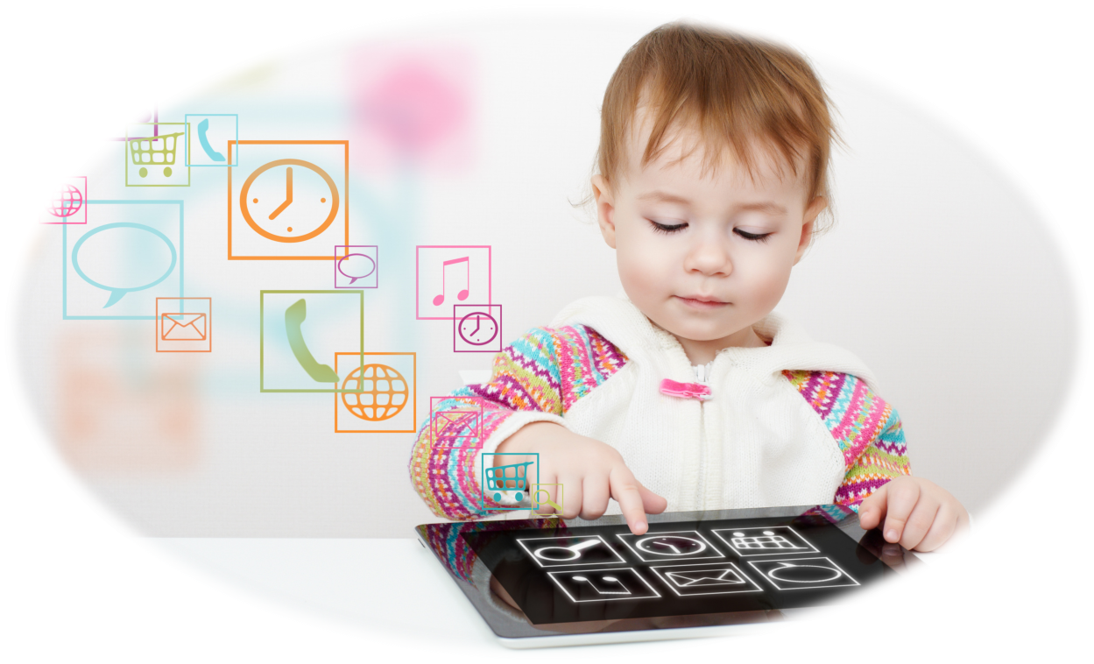
Modern technical means of education in preschool organizations of the Ivanovo region
Elena V. Shakirova,
PhD in Pedagogy, teacher of the Department of preschool and inclusive education, State Autonomous Institution of Additional Professional Education of the Ivanovo Region “University of Countinuing Education and Innovation”,
Ivanovo, Russia

Slide 2
To assess the level of implementation of digital technologies in preschool education, it is necessary to find out what technical means kindergartens have
Budget funds
Sponsorship
Income from the provision of additional paid services
Grants and prizes
Voluntary donations
A variety of sources of financing for the purchase of electronic learning tools for preschoolers
Lack of a centralized program for equipping preschool organizations with modern learning tools

Slide 3
The study was conducted from December 2021 to January 2022 in the form of an anonymous survey of heads of preschool organizations of the Ivanovo region
Ivanovo
Vichuga
Kineshma
Kohma
Teikovo
Shuya
Palekh district
Pestyakovsky district
Privolzhsky district
Puchezhsky district
Rodnikovsky district
Savinsky district
Teikovsky district
Furmanovsky district
Verkhnelandekhovsky district
Vichugsky district
Gavrilovo-Posadsky district
Zavolzhsky district
Ivanovo district
Ilyinsky district
Kineshemsky district
Komsomolsky district
Lezhnevsky district
Lukhsky district
Shuisky district
Yuzhsky district
Yuryevetsky district
The sample was 49 % of the total number of kindergartens in the region

Slide 4
A variety of technical means of education in kindergartens of the Ivanovo region
Interactive whiteboard
Interactive table
Screen and projector
Cartoon Studio
A laptop
3-D printer
3-D handle
Talking pen with sound recording stickers
Learning Robots
Augmented Reality Manuals
Robotics Kits
Tablet
Interactive Sandbox

Slide 5
Equipment with electronic means of teaching preschool organizations of the Ivanovo region
There is nothing
A laptop
Electron microscope
Interactive Sandbox
Cartoon Studio
Toys and aids with augmented reality
Tablet
Computers for children
Computer Class (computers for children)
Robotics kit
Training Robot
Pen with sound recording stickers
3-D handle
3-D printer
Interactive whiteboard
Screen and projector

Slide 6
The quantitative nature of the equipment with electronic means of teaching preschool organizations of the Ivanovo region
Toys and Aids with Augmented Reality Tablet
Computers for children
Computer Class
Robotics kit
Training Robot
Pen with sound recording stickers
3-D handle
3-D printer
Interactive whiteboard
Screen and projector
Number of units
pcs.

Slide 7
Quantity
In most preschool organizations, electronic learning tools are available in the amount of 0 to 3 units
Diversity
As a result of the study, the presence of 15 names of electronic learning tools in preschool organizations of the Ivanovo region was revealed

Slide 8
Comparative diagram of the opinion of heads of preschool organizations of the Ivanovo region on electronic learning tools
Interactive Sandbox
Cartoon Studio
Toys and aids with augmented reality
Tablet
Computer Class (computers for children)
Robotics kit
Training Robot
Pen with sound recording stickers
3-D handle
3-D printer
Interactive whiteboard
Screen and projector
Please indicate which technical training tools you would like to purchase if there was a financial opportunity?
What technical means of education, in your opinion, are useless in a preschool organization for classes with children?

Slide 9
Opinion of the heads of kindergartens of the Ivanovo region on the need to introduce technical means of education in the education of a preschooler: characteristic answers
"Be sure to implement, as it is necessary to keep pace with the times and meet the modern realities"
"To introduce as a means of increasing the motivation and organization of independent cognitive activity of the child"
"We need additional funding"
"Before implementing technical means of training, you need to solve problems with repairs in the premises of the preschool organizations"
"It is necessary to make small amounts, not at the expense of real communication and other types of children's activities"
"You need to implement in a parallel training teachers to use technology"

