Slide 1
International Psychological Forum "Child in a Digital World" 2023
Some aspects of digital socialization of preschool and primary school children
(results of an empirical study)
Svetlana Smirnova,
Researcher of the Centre for Interdisciplinary Research
on Contemporary Childhood
Ekaterina E. Klopotova,
PhD in Psychology,
Assistant Professor at the Faculty of Educational Psychology,
Senior Researcher of Center for Interdisciplinary Research on Contemporary Childhood

Slide 2
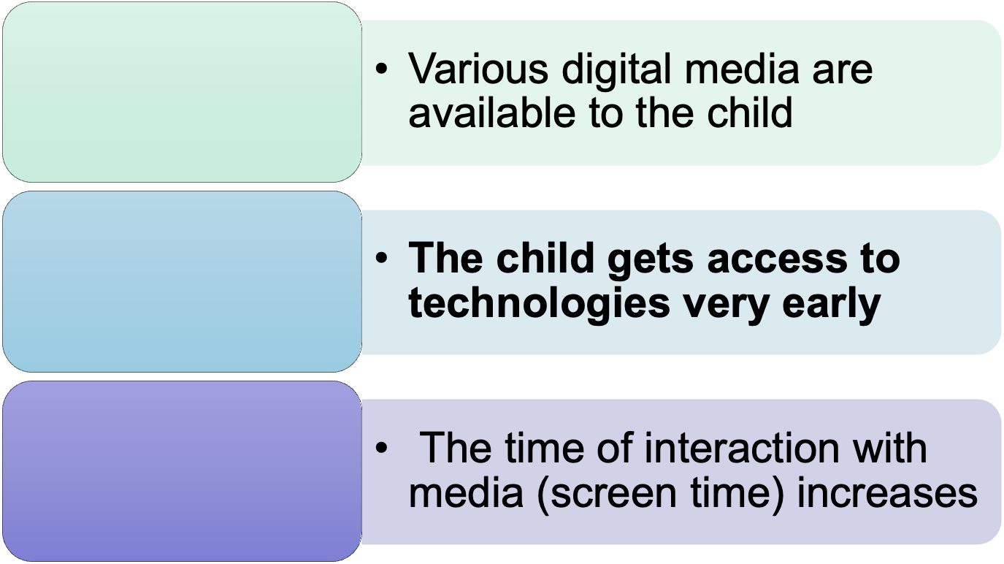
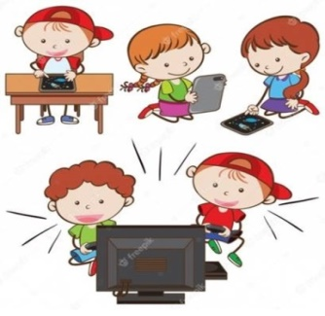
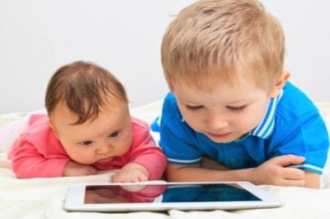
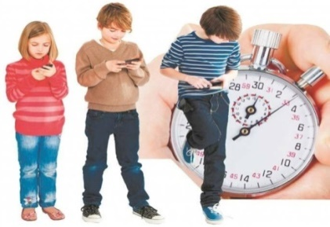
Digital childhood

Slide 3
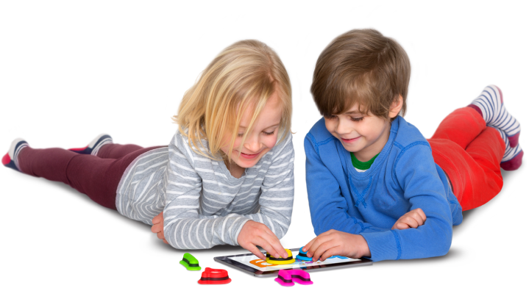
In 2022 Moscow State University of Psychology and Education (Moscow, Russia) launched a research project, aimed at revealing the peculiarities of contemporary preschoolers’ social situation of development under the digital transformation.
The project included an empirical study, focusing on parents’ position in relation to preschoolers’ use of digital media, that was conducted by the “Center for Interdisciplinary Research of Contemporary Childhood” (childresearch.ru).

Slide 4
Research design
The study sample included:
6376 parents of children aged from 2 to 7 years old
506 parents of children aged from 6 to 10 years old
(from the Russian Federation)
The data was collected in different social networks via a Google-form.
Quantitative analysis of the data was conducted by the means of descriptive statistics, while calculations were made in SPSS V23.

Slide 5
Availability of digital devices

Slide 7
Parents’ goals

Slide 8
Need of professional assistance

Slide 10
Сonclusions
Most children get access to digital devices at preschool age for entertainment and the development of individual mental functions
At primary school age, the functionality of using digital devices by children is expanding
With the age of the child, parents have an increasing need for qualified assistance in the use of digital devices by children, but they still do not seek help from specialists
In primary school age, the socializing role of digital devices increases

Slide 11
References
Klopotova E.E., Smirnova S.Y., Rubtsova O.V., Sorokova M.G. Accessibility of Digital Devices to Preschool Children: Differences in Parents’ Positions [Elektronnyi resurs]. Konsul'tativnaya psikhologiya i psikhoterapiya = Counseling Psychology and Psychotherapy, 2022. Vol. 30, no. 2, pp. 109–125. doi:10.17759/cpp.2022300207.
2. Klopotova E.E., Smirnova S.Y. The child in the age of digital toys. Review of foreign studies [Elektronnyi resurs]. Sovremennaia zarubezhnaia psikhologiia = Journal of Modern Foreign Psychology, 2022. Vol. 11, no. 2, pp. 50–58. doi:10.17759/jmfp.2022110204.
3. Rubtsova O.V. Digital Media as a New Means of Mediation (Part One). Kul'turno-istoricheskaya psikhologiya = Cultural-Historical Psychology, 2019. Vol. 15, no. 3, pp. 117–124. doi:10.17759/chp.2019150312.
4. Rubtsova O.V. Digital Media as a New Means of Mediation (Part Two). Kul'turno-istoricheskaya psikhologiya = Cultural-Historical Psychology, 2019. Vol. 15, no. 4, pp. 100–108. doi:10.17759/chp.2019150410.
5. Smirnova S.Y., Klopotova E.E., Rubtsova O.V., Sorokova M.G. Features of Preschoolers’ Use of Digital Media: New Socio-Cultural Context. Sotsial'naya psikhologiya i obshchestvo = Social Psychology and Society, 2022. Vol. 13, no. 2, pp. 177–193. doi:10.17759/sps.2022130212.

